Slide 1
Diabetes
By Basel Ebaid,Ghassan Bargouth,Fahed Al-Deir and Sanad Mraybeh
To:Highschoolers

Slide 2
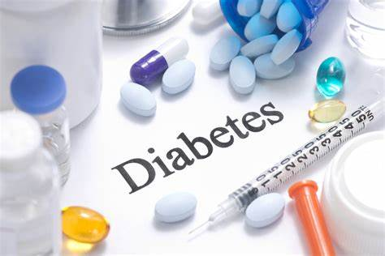

Slide 3
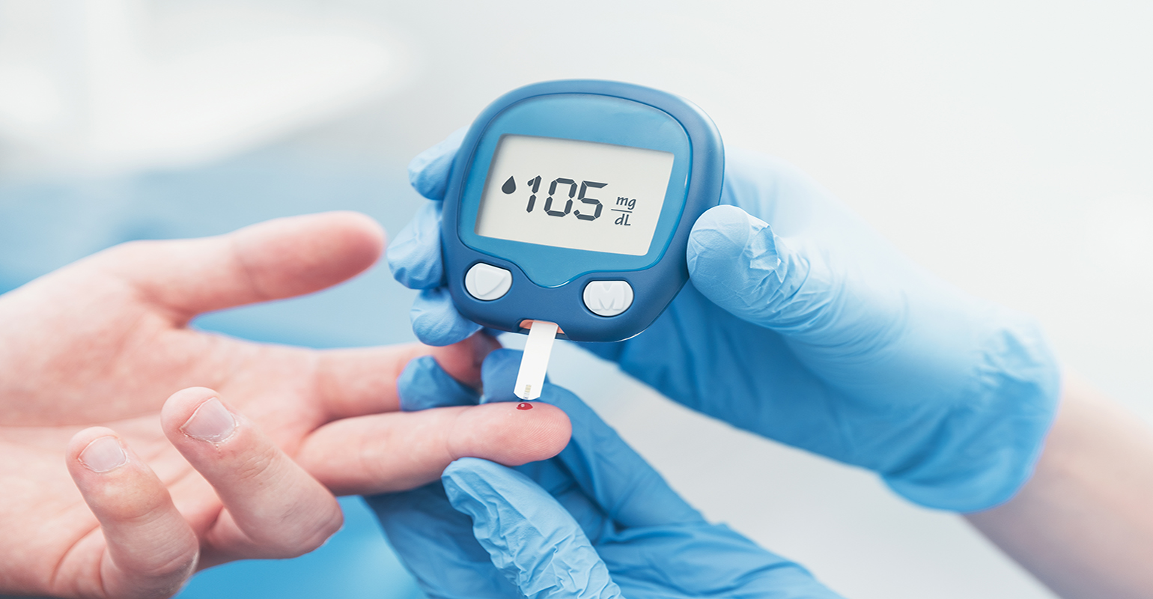
What is diabetes?
Diabetes is a chronic medical illness that develops when the pancreas either fails to make enough insulin or fails to use the insulin that is produced by the body properly. Blood sugar levels are controlled by the hormone insulin.

Slide 4
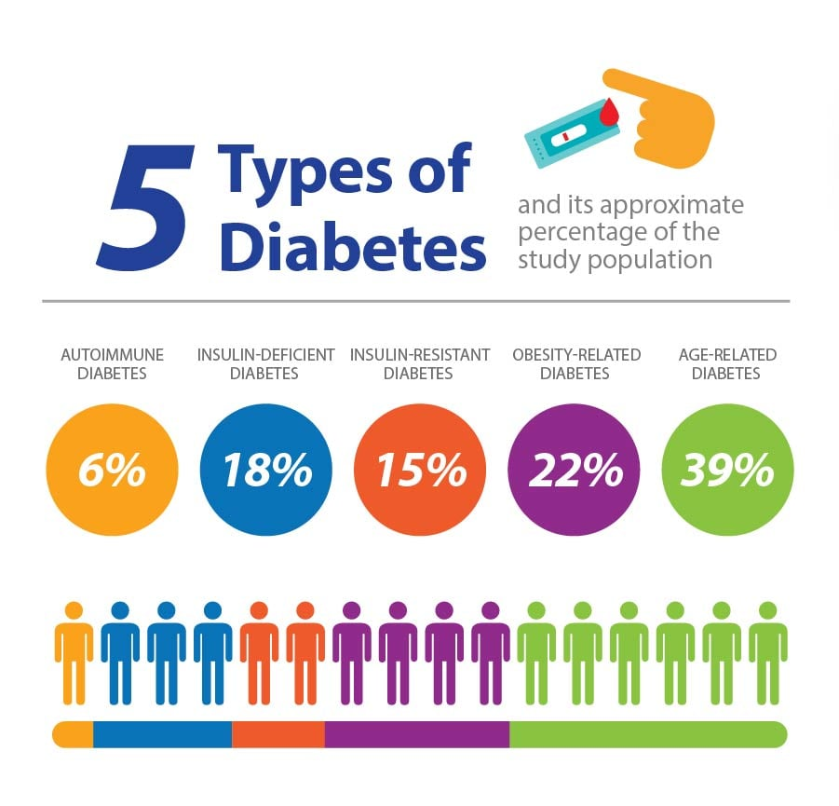

Slide 5
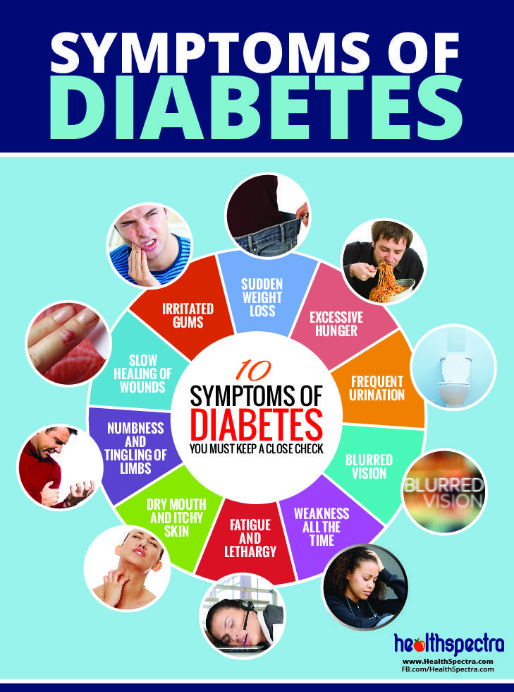
The symptoms of diabetes are:
Increased thirst
blurred vision
Urinating often
Losing weight without trying
acquiring several infections, such as skin, and gum diseases

Slide 6
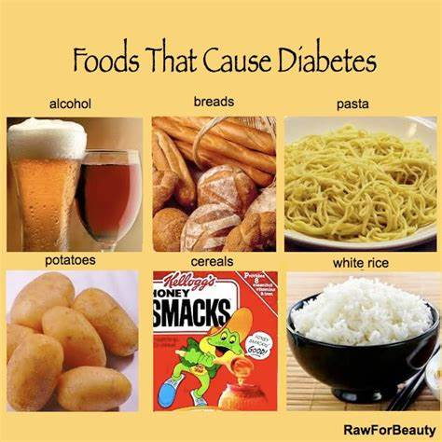
What are the foods/Drinks that cause diabetes?
high fat meat
full-fat dairy
Sweets
sugar-sweetened beverages

Slide 7
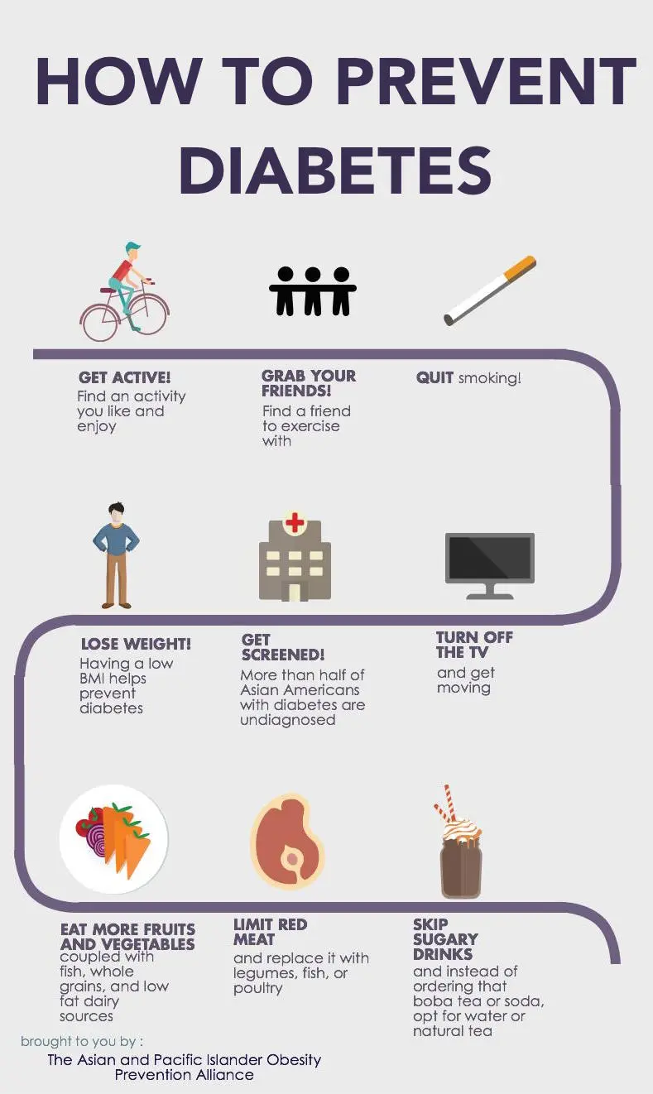
What can a high school student do to prevent diabetes in the future ?
Lose extra weight
Be more physically active(do exercise)
Eat healthy plant Foods
Quit smoking
Talk to your health care provider

Slide 8
Losing extra Weight:
An essential component of preventing diabetes is weight management. If you lose 5 to 10% of your present weight, you may be able to limit or delay the onset of diabetes. If you weigh 200 pounds, for instance, your objective would be to shed between 10 and 20 pounds. It's crucial to avoid gaining the weight back after you've lost it.

Slide 9
Be more physically active:
Exercise has a variety of health advantages, including assisting with weight loss and lowering blood sugar levels. Both of them reduce the possibility of type 2 diabetes. Try to exercise for at least 30 minutes five days a week. If you haven't exercised, consult a health care expert to determine the best forms of exercise for you.

Slide 10
Quit smoking:
Insulin resistance brought on by smoking can result in type 2 diabetes. Try to stop smoking if you already do, or don’t ever try smoking.

Slide 11
Eat healthy plant Foods:
It's crucial to cut back on your daily calorie intake if you want to lose weight and keep it off. Your diet should consist of fewer servings and less fat and sugar to achieve that. A diversity of foods from each dietary group, as well as a lot of whole grains, fruits, and vegetables, should also be consumed.

Slide 12
Talk to your health care provider :
Talking to your health care provider in order to determine if there is anything else you can do to postpone or avert type 2 diabetes. Your doctor could advise you to take one of a few different types of diabetic medications if you are at high risk.

Slide 13
Citations:
Type 1 diabetes - symptoms. Type 1 Diabetes - Symptoms | ADA. (n.d.). Retrieved October 13, 2022, from https://diabetes.org/diabetes/type-1/symptoms
Mayo Foundation for Medical Education and Research. (2021, June 25). Diabetes prevention: 5 tips for taking control. Mayo Clinic. Retrieved October 13, 2022, from https://www.mayoclinic.org/diseases-conditions/type-2-diabetes/in-depth/diabetes-prevention/art-20047639
U.S. National Library of Medicine. (n.d.). How to prevent diabetes. MedlinePlus. Retrieved October 18, 2022, from https://medlineplus.gov/howtopreventdiabetes.html
Radcliffe, S. (2018, October 20). Four food choices that greatly increase your diabetes risk. Healthline. Retrieved October 18, 2022, from https://www.healthline.com/health-news/food-four-food-groups-that-raise-diabetes-risk-111313#:~:text=high%20fat%20meat%20(fatty%20cuts,%2C%20sweet%20tea%2C%20sports%20drinks)

Slide 14
Centers for Disease Control and Prevention. (2022, July 7). What is diabetes? Centers for Disease Control and Prevention. Retrieved October 24, 2022, from https://www.cdc.gov/diabetes/basics/diabetes.html
World Health Organization. (n.d.). Diabetes. World Health Organization. Retrieved October 24, 2022, from https://www.who.int/news-room/fact-sheets/detail/diabetes
Mayo Foundation for Medical Education and Research. (2022, August 9). Diabetes. Mayo Clinic. Retrieved October 24, 2022, from https://www.mayoclinic.org/diseases-conditions/diabetes/symptoms-causes/syc-20371444
U.S. Department of Health and Human Services. (n.d.). Symptoms &amp; causes of diabetes. National Institute of Diabetes and Digestive and Kidney Diseases. Retrieved October 24, 2022, from https://www.niddk.nih.gov/health-information/diabetes/overview/symptoms-causes

