Slide 1
Eating disorder awarness
BY: ANGELINA SAHOURI, JOELLE SAMAAN, YARA JAJJAWI

Slide 2
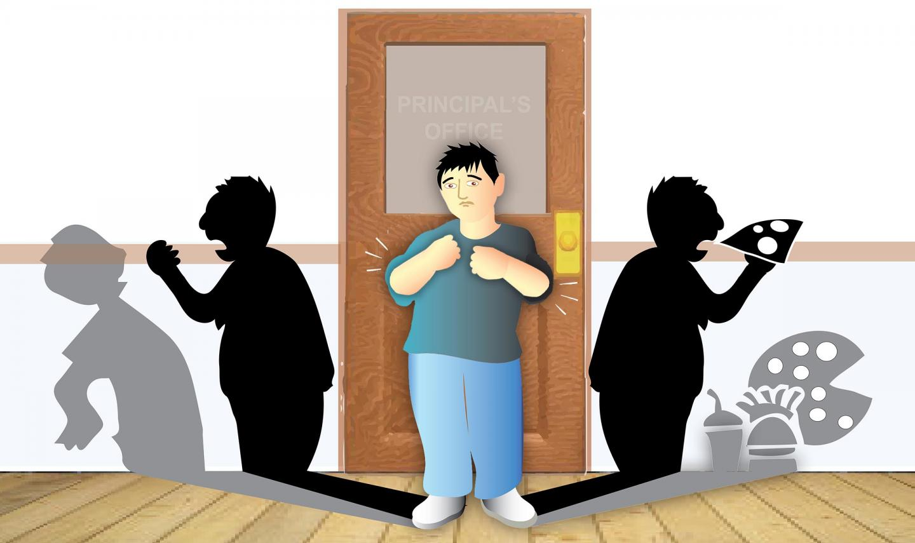
What is an eating disorder?
An eating disorder is a mental disorder defined by unusual eating habits that negatively affect a person's physical and psychological health.

Slide 3
What are the signs of eating disorder?
Changes in Weight.
Obsession With Body Image.
Disturbance in Eating Patterns.
Concentration With Nutritional Content.
Exercising more frequently.
Mood swings.
Use of Laxatives, Diuretics, or Diet Pills.

Slide 4
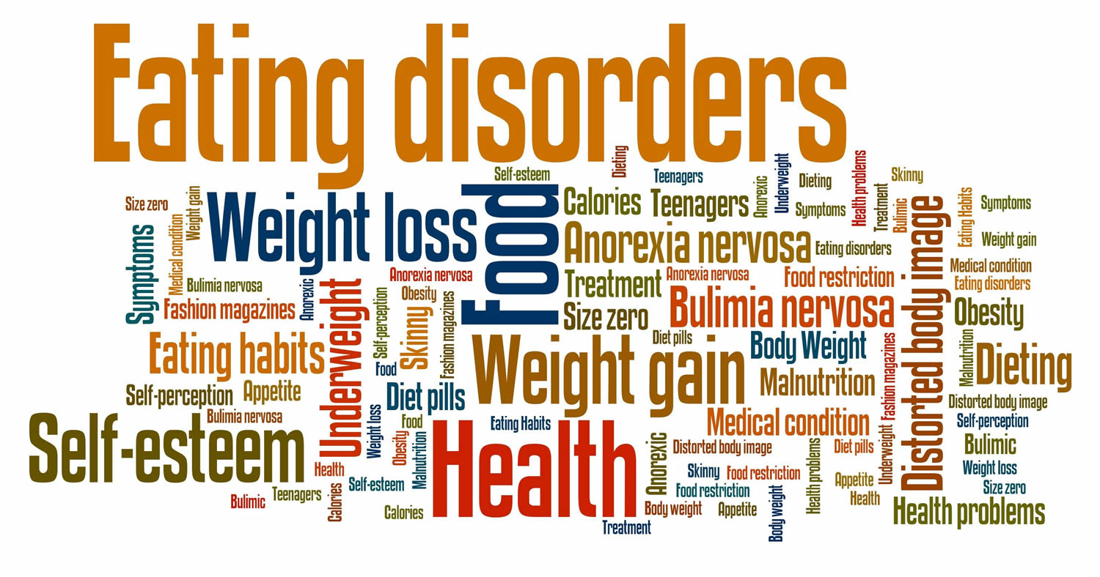
What are the types of eating disorders?
1- Anorexia Nervosa: This disease aims to become very skinny/underweight. You always feel like you’re not enough and to be tinier. People who have Anorexia deprive themself of food.
2- Bulimia Nervosa: People who struggle with Bulimia have multiple binging episodes that are followed by purging and then usually restricting the body to multiple types of food.

Slide 5
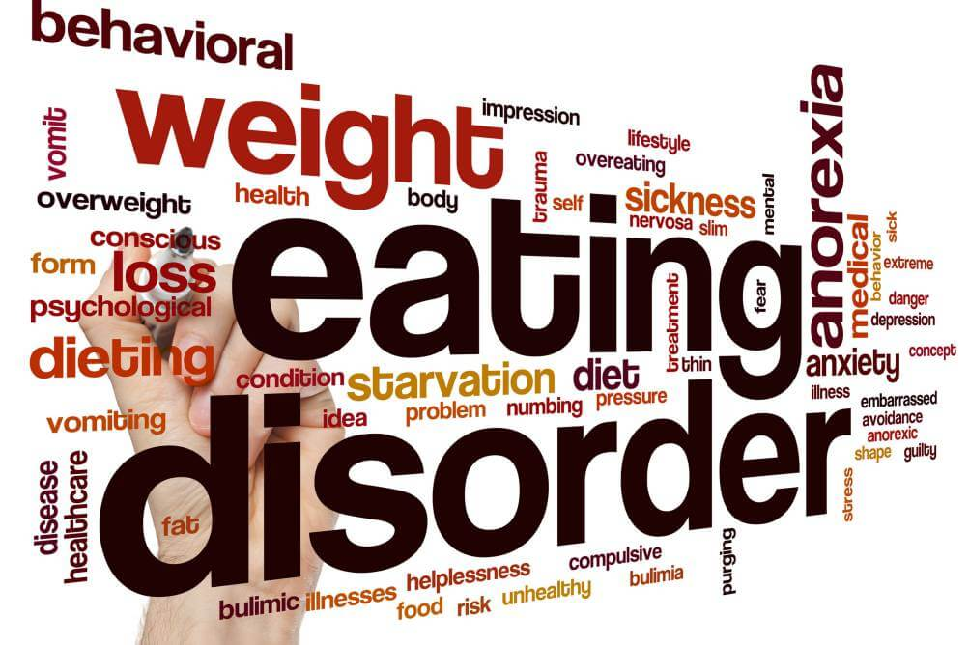
What are the types of eating disorders?
3- Pica: Pica is an eating disorder that has you digest inedible items. These foods can be toxic and do not provide any nutritional value.
4- Purging disorder: Purging disorder often uses purging behaviors, such as vomiting, or exercising over the recommended time so they can control their weight or shape.

Slide 6
what are the Effects of eating disorder?
Eating disorders can do a lot of damage to your health. People with eating disorders usually don’t get the nutrients they need for their bodies to stay healthy and work properly, people with eating disorders are at risk of heart or kidney failure which leads to death if not treated properly.

Slide 7
How can you recover from eating disorders?
Talk to someone you love and feel comfortable around about it like maybe a friends someone who had suffered through it.
Try being more confident about your body and stop comparing yourself to others ,and learn to love yourself.

Slide 8
Chosen research method
In this presentation we chose the technique of document analyses we studied different documents and used terminologies to help us find out this information.

Slide 9
YouTube link
https://www.youtube.com/watch?v=3Bax8ijH038

Slide 10
Citation
https://www.mayoclinic.org/diseases-conditions/eating-disorders/symptoms-causes/syc-20353603
https://www.turnbridge.com/news-events/latest-articles/effects-of-eating-disorders/
https://www.beateatingdisorders.org.uk/get-information-and-support/get-help-for-myself/recovery/
https://www.mayoclinic.org/diseases-conditions/eating-disorders/in-depth/eating-disorder-treatment/art-20046234
https://www.healthline.com/nutrition/common-eating-disorders
https://nedc.com.au/eating-disorders/eating-disorders-explained/the-facts/whats-an-eating-disorder/

