Slide 1
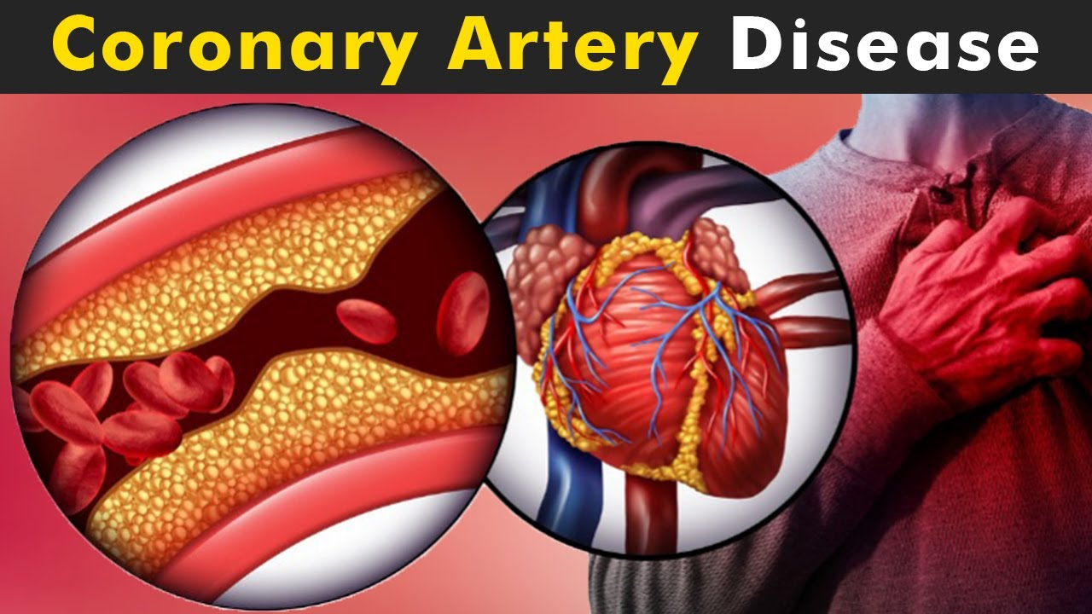
Coronary Heart Disease
By:Jordan,Abdallah,Jad,Karam,Kareem

Slide 2
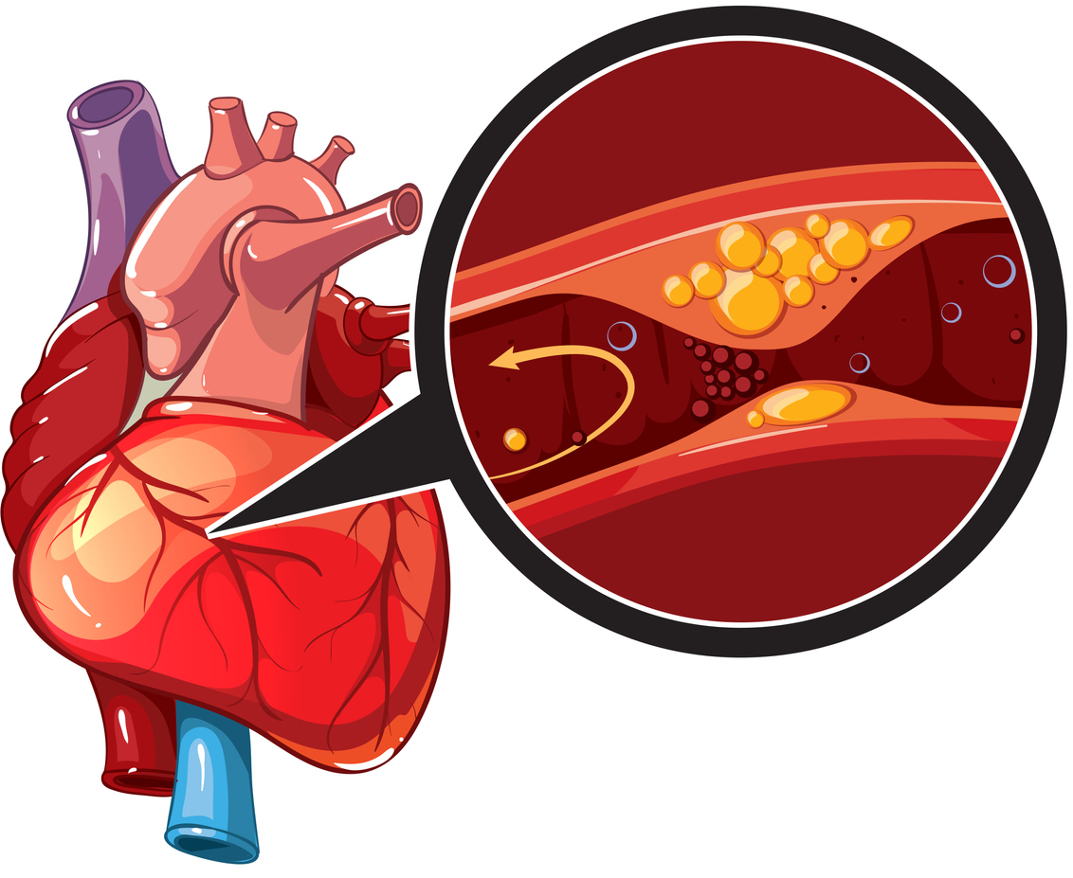
What is Coronary disease?
Plaque
coronary heart disease which is also called Coronary artery disease. Its caused by plaque buildup in the wall of the arteries that supply blood to the heart (called coronary arteries). Plaque consists of cholesterol deposits. As plaque builds up, it narrows the inside of the artery over time. This process is called atherosclerosis.

Slide 3
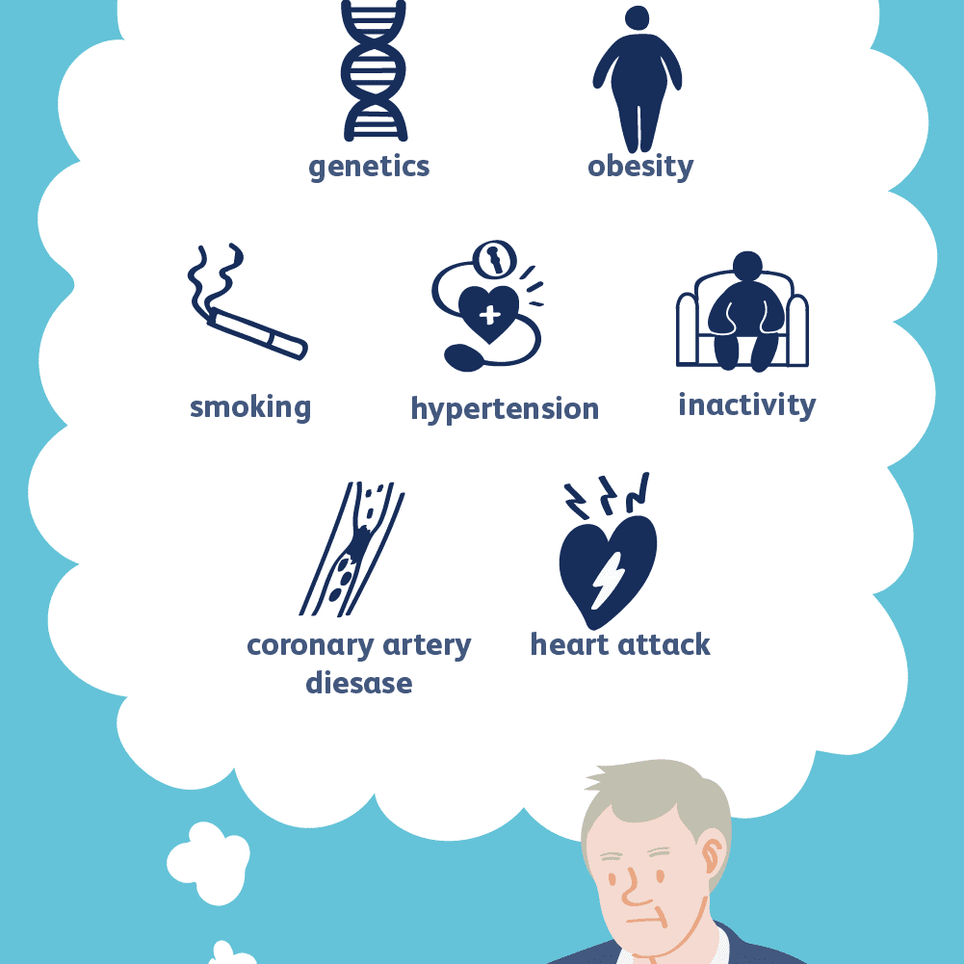
What are the causes?
Obesity
Lack of exercise
Unhealthy diet
Smoking
Having a family history of heart disease also increases the risk of CHD
Diabetes
Atherosclerosis
Hypertension
Genetics

Slide 4
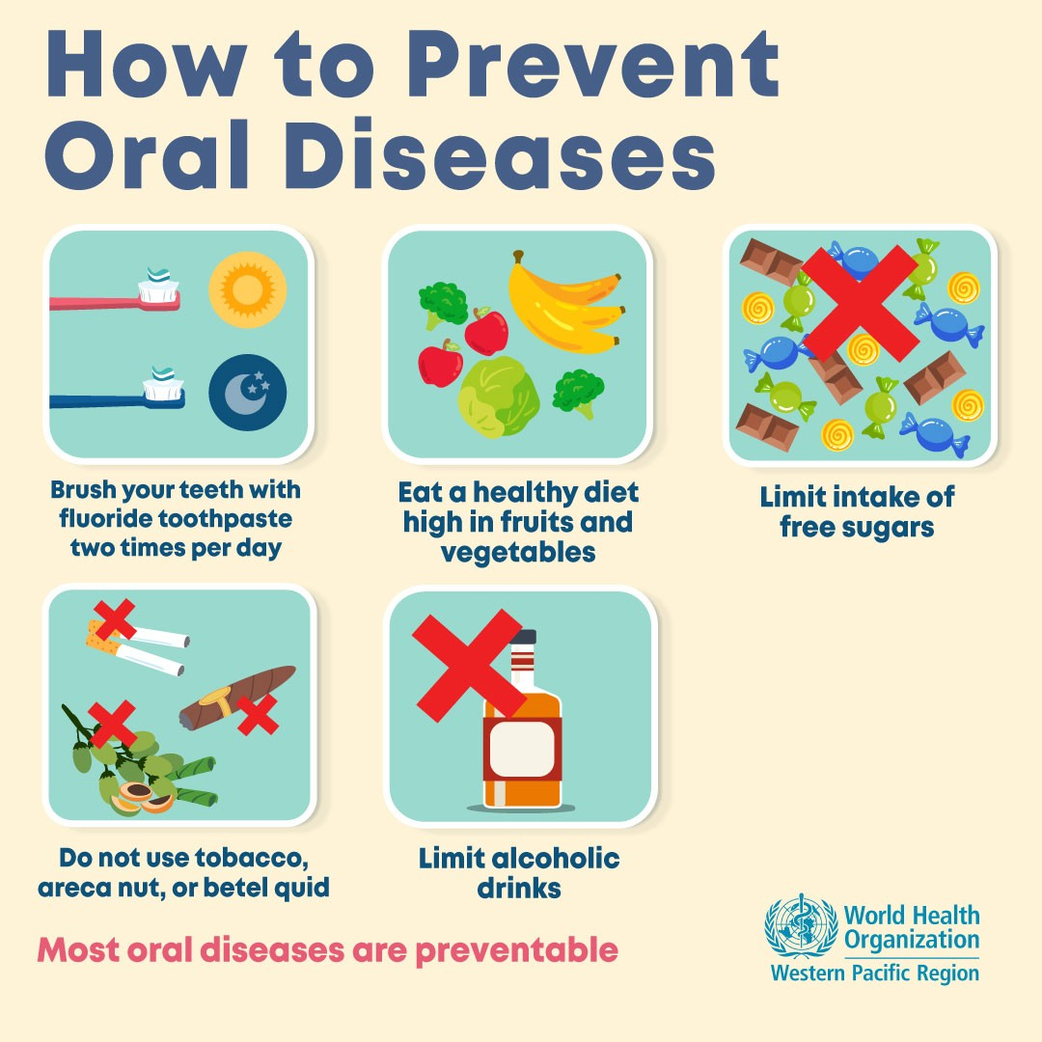
How to prevent this disease?
Eat a healthy, balanced diet.
Be more physically active.
Keep to a healthy weight.
Give up smoking.
Reduce your alcohol consumption.
Keep your blood pressure under control.
Keep your diabetes under control.
Take any prescribed medicine.

Slide 5
How do you know if therapy is helping?
Your moods and emotions have improved.
Your thinking has shifted.
Your behaviors have changed.
Your relationships with others are better.
You have better life satisfaction.
Your diagnosis changes.

Slide 6
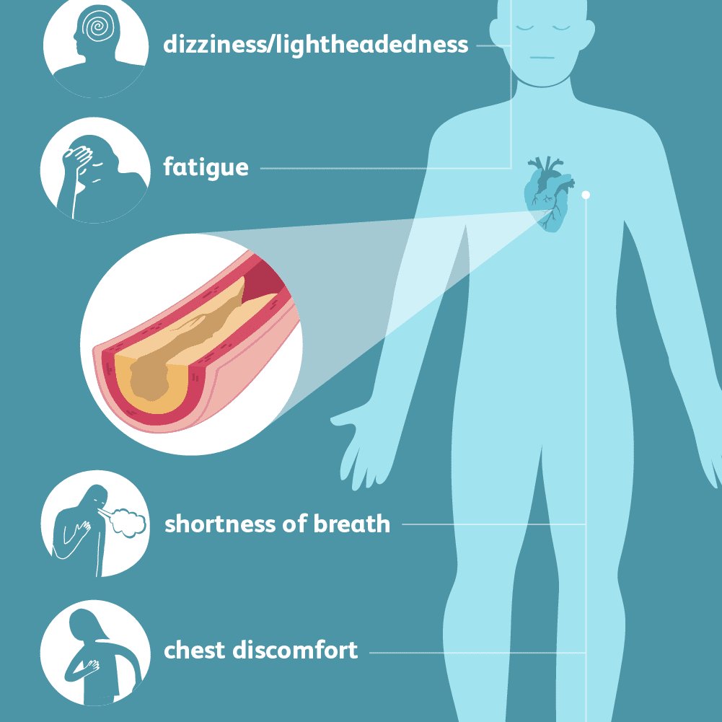
What are the symptoms of coronary artery disease?
Chest pain or discomfort weakness
light-headedness
nausea (feeling sick to your stomach)
cold sweat
Pain or discomfort in the arms or shoulder
Shortness of breath

Slide 7
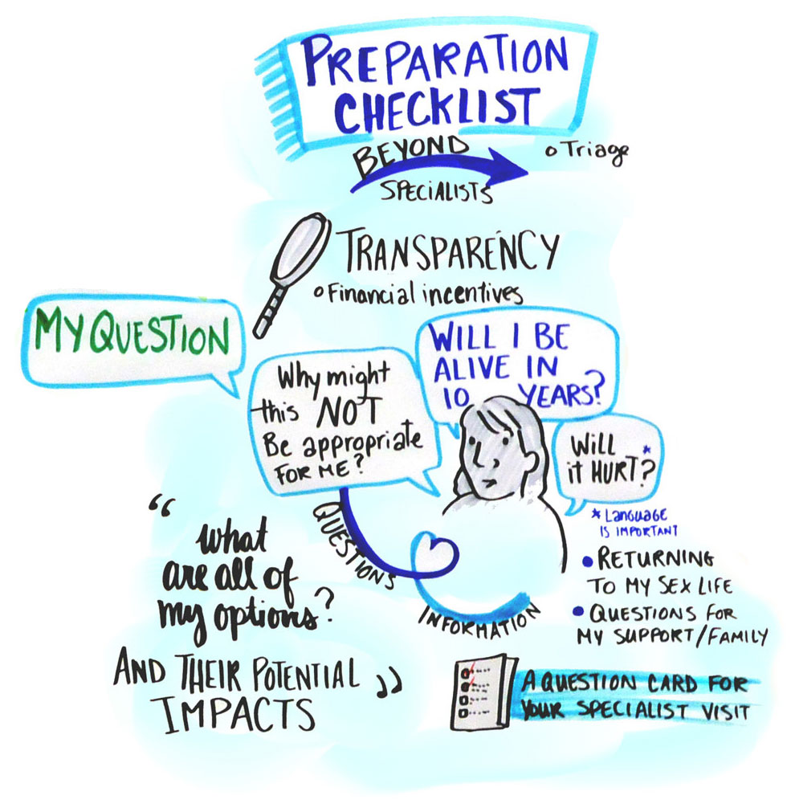
what are important questions asked about coronary artery disease?
Based on my family history, am I at greater risk for coronary artery disease?
Could symptoms I am having be related to coronary artery disease?
Do my cholesterol levels put me at risk for heart disease?
s my weight within a healthy range to prevent heart disease?
Does diabetes put me at greater risk for heart disease?

Slide 8
Citation
https://www.cdc.gov/heartdisease/coronary_ad.htm
https://www.hopkinsmedicine.org/health/conditions-and-diseases/coronary-artery-disease-prevention-treatment-and-research
https://www.cdc.gov/heartdisease/coronary_ad.htm - :~:text=Overweight%2C%20physical%20inactivity%2C%20unhealthy%20eating,age%20(50%20or%20younger).
https://www.mayoclinic.org/diseases-conditions/heart-disease/in-depth/heart-disease-prevention/art-20046502
https://www.cdc.gov/heartdisease/coronary_ad.htm
https://thelightprogram.pyramidhealthcarepa.com/6-signs-youre-making-progress-in-therapy/
https://www.secondscount.org/heart-resources/heart-resources-detail-2/questions-to-ask-your-doctor-about-coronary-artery#.Y10vvnZByUl

Slide 9
https://www.youtube.com/watch?v=o6dpeFj4guo

