Slide 1
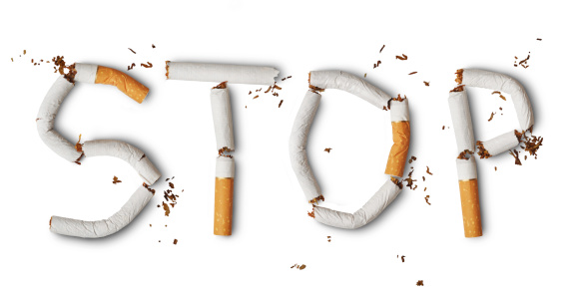
Smoking
Audience : Teenagers
Prepared By: Jad Gammoh , George Fakes,
Ameer Oudat,
Abood Rbeihat, Jad Tarazi

Slide 2
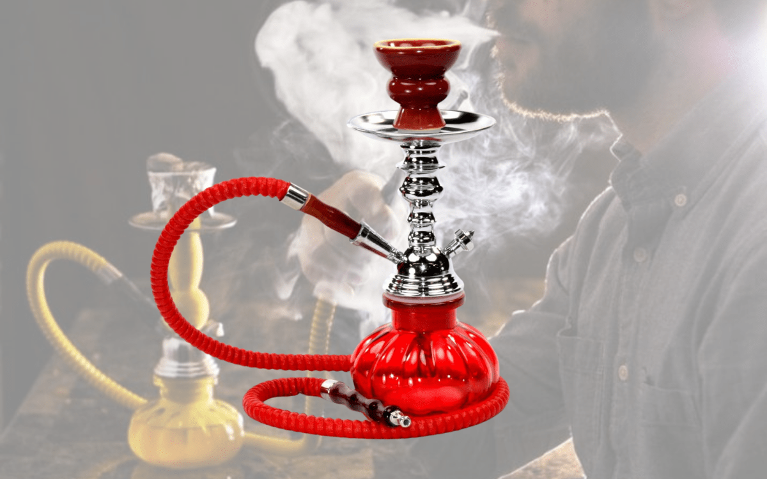
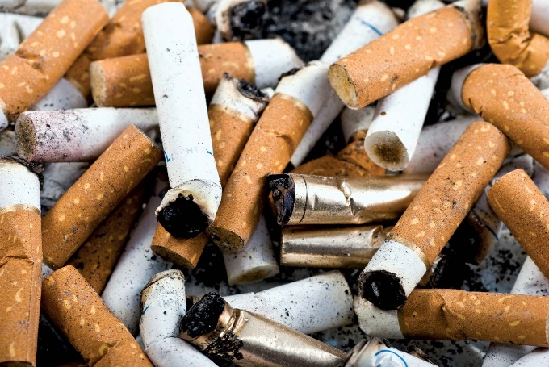
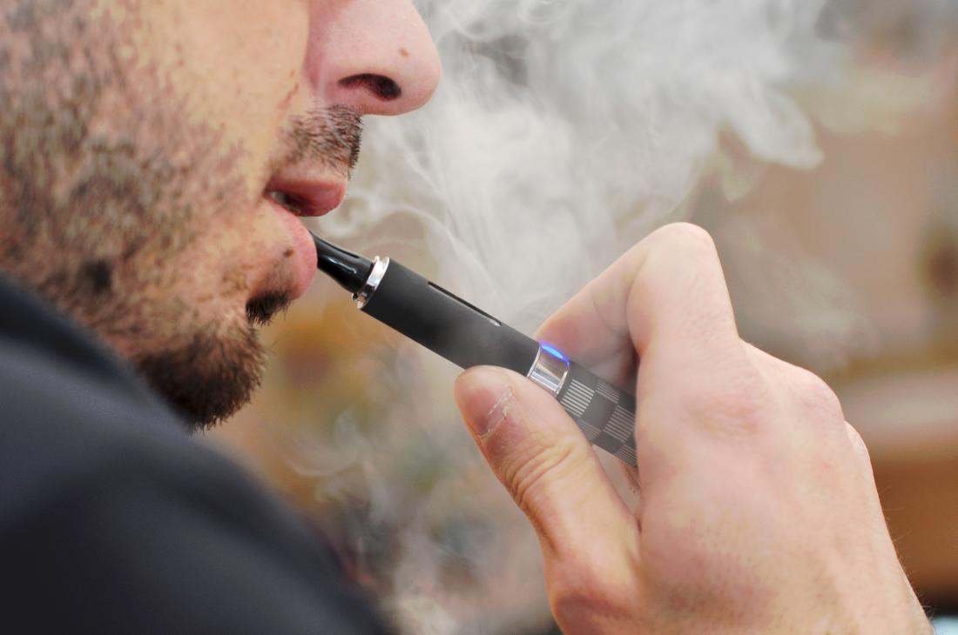
What is Smoking?
Smoking is the act of inhaling and exhaling the fumes of burning tobacco in cigarettes, Shisha, ELECTRONIC CIGARETTES (vape) and other.

Slide 3
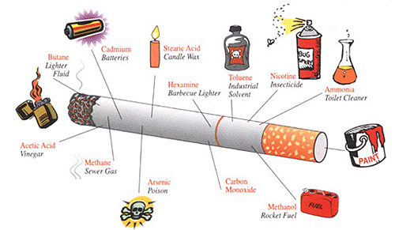
Dangerous chemicals in tobacco
Nicotine
Carbon monoxide
Tar
Benzene
Arsenic
Formalde

Slide 4
Why Tobacco is highly addictive?
Within seconds of inhaling cigarette smoke or vape mist, or using chewing tobacco, nicotine causes the release of dopamine in the brain, which gives people a good feeling. Over time, the brain begins to crave that feeling from nicotine and people need to use more and more tobacco to get that same good feeling.

Slide 5
Why do people cough more after they've quit smoking?
Tobacco smoke slows the normal movement of the tiny hairs (cilia) that move mucus out of your lungs. When you stop smoking, the cilia become active again. As the cilia recover and the mucus is cleared from your lungs, you might cough more than usual

Slide 6
Listen to your BRAIN and hear your lungs!
Nicotine is the main addictive drug in tobacco and Cigarettes are designed to rapidly deliver nicotine to your brain.
Inside your brain, nicotine triggers the release of chemicals that make you feel good. As nicotine stimulates parts of your brain over and over, your brain gets used to having nicotine around.
Over time, nicotine changes how your brain works and makes it seem like you need nicotine just to feel okay.
Reduced lung function and lung growth; Because tobacco smoke contains carbon monoxide, this deadly gas displaces the oxygen in your blood, depriving your organs of the oxygen they need. It also cause lung disease by damaging your airways and the small air sacs (alveoli) found in your lungs

Slide 7
And other health problems that smoking lead to. Such as:
Gum Diseases
Yellow teeth
Eye disease
A greater risk of diabetes
Weaker bones that are easier to break
Skin problems like psoriasis (a type of rash)
Wrinkled skin

Slide 8
How to quit smoking
Commit to your quit
Remind yourself of the benefits
Learn how to handle your triggers and cravings
Find ways to handle nicotine with draw
Keep in mind that trying something to beat the urge to use tobacco is always better than doing nothing. And each time you resist a tobacco craving, you're one step closer to being tobacco-free

Slide 9
What are the benefits of quitting smoking?
Improves health status.
Enhances quality of life.
Reduces the risk of premature death and add 10 years to life expectancy.
Reduces the risk for many adverse health effects.

Slide 10
Summary
Smoking by youth and young adults can cause serious and potentially deadly health issues immediately and into adulthood.
Young people who smoke are in danger of: Exposure to nicotine can have lasting effects on adolescent brain development. Cigarette smoking also causes children and teens to be short of breath and to have less stamina, both of which can affect athletic performance and other physically active pursuits addiction to nicotine.
Lets watch this short movie together:
https://youtu.be/Y18Vz51Nkos

Slide 11
Methods and Recourses
Document analysis: We read documents published by World Health Organization WHO and Mayo Clinic Hospital, health magazines for kids and other trusted publications.
https://kidshealth.org/en/teens/smoking.html
https://www.who.int/news/item/31-05-2022-tobacco-exposed---poisoning-our-planet-and-a-key-driver-for-the-tb-epidemic
https://www.cdc.gov/tobacco/data_statistics/sgr/50th-anniversary/pdfs/fs_smoking_youth_508.pdf
https://www.mayoclinic.org/healthy-lifestyle/quit-smoking/in-depth/nicotine-craving/art-20045454

Slide 12
Survey
We created a survey to measure youth’s general point of view about smoking which can be accessed through the link below:
https://s.surveyplanet.com/qouiw025

