Slide 1
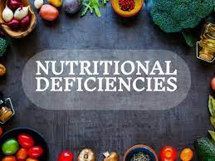
Made by: Fares.A/ Sanad/Micheal/Adam

Slide 2
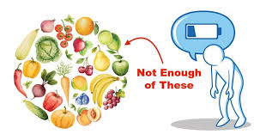
What are food deficiencies?
A food deficiency is mostly produced when an individual does not consume an adequate amount of the needed nutrients in their daily diet, resulting in a dietary deficiency disease.

Slide 3
What are the main types of food deficiencies?
1- Kwashiorkor
2-Rickets
3-Anemia
4-Beriberi
5-Hypoglycemia
6- Scurvy
7-Night blindness

Slide 4
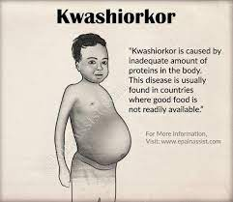
What is kwashiorkor?
Kwashiorkor is a severe form of malnutrition. It is mostly found in children and infants in sub-Saharan Africa where babies and children do not get enough protein or other essential nutrients in their diet.
Symptoms of kwashiorkor:
Muscle shrinkage
Swollen belly
Kwashiorkor prevention:
making sure you eat enough calories
and protein-rich foods.
Such as: meat, chicken and fish

Slide 5
What is rickets?
Rickets is a condition characterized by a deficiency in vitamin D. Vitamin D aids in the regulation of calcium and phosphate levels in the body.
Symptoms of rickets:
Soft bones
bones of children may bent
Rickets prevention:
To prevent rickets, make sure your child eats foods that contain vitamin D naturally — fatty fish such as salmon and tuna, fish oil and egg yolks in addition to exposure to sunlight

Slide 6
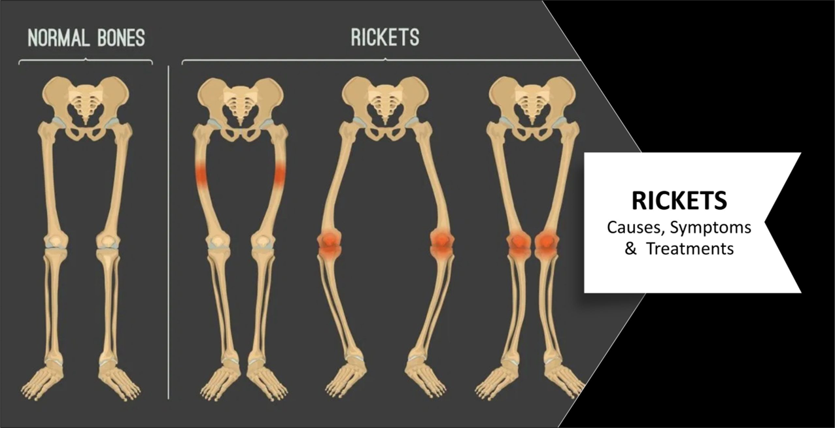

Slide 7
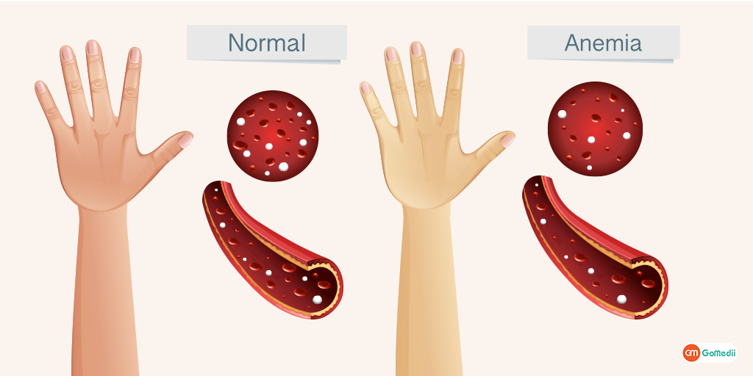
What is anemia
Anemia is a disorder that occurs when your blood produces fewer healthy red blood cells than usual. Anemia occurs when your body does not receive enough oxygen-rich blood.
Types of anemia:
Aplastic anemia.
Iron deficiency anemia.
Sickle cell anemia.
Thalassemia.

Slide 8
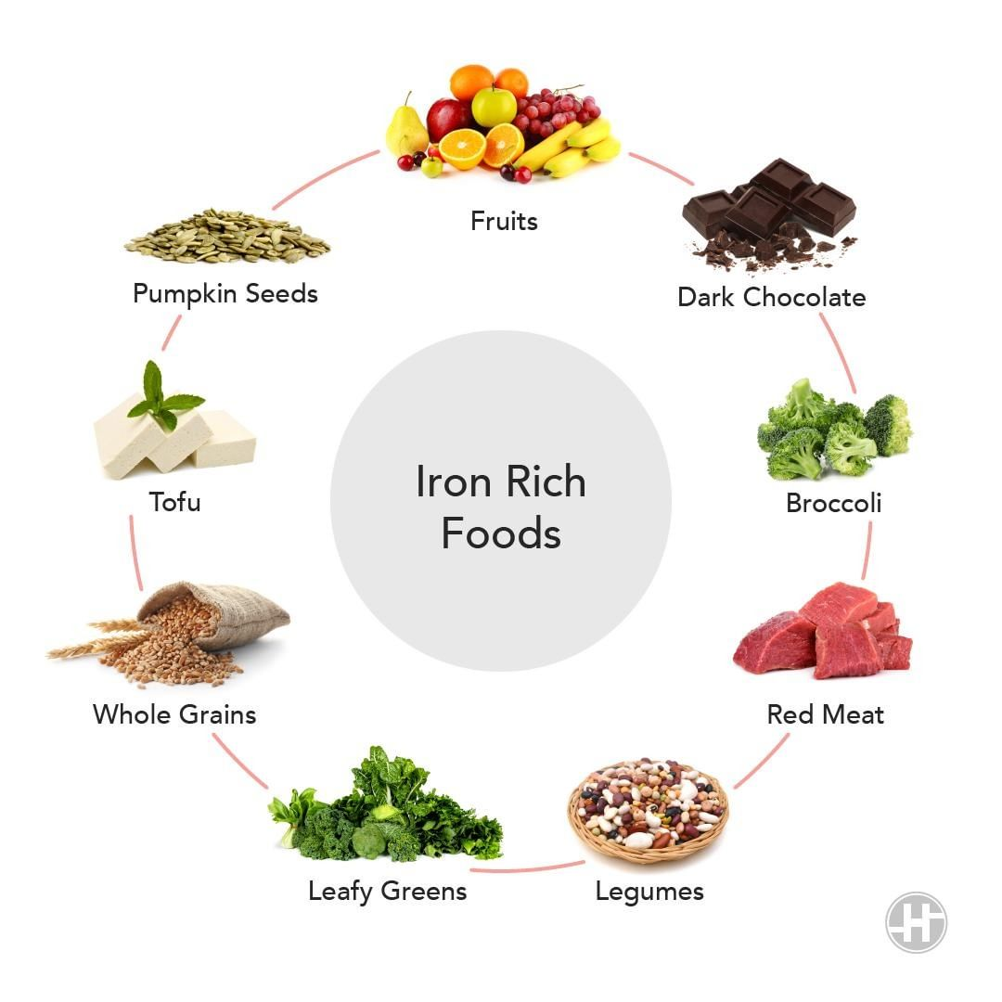
Symptoms of anemia
Fatigue.
Weakness.
Pale or yellowish skin.
Irregular heartbeats
How to prevent iron deficiency anemia?
Good sources of iron include beans, dried fruits, eggs, lean red meat, salmon, iron-fortified breads and cereals, peas, tofu, and dark green leafy vegetables.

Slide 9
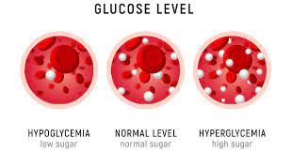
What is hypoglycemia ?
hypoglycemia is when your body lacks the important nutrient: carbohydrate, where the level of sugar (glucose) in your blood drops too low
Symptoms of hypoglycemia
Fast heartbeat.
Shaking.
Sweating.
Nervousness or anxiety.
Irritability or confusion.
Dizziness.

Slide 10
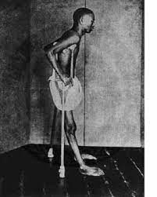
What is beriberi?
Thiamine deficiency leads to the disorder known as beriberi (vitamin B1). Wet and dry Beriberi, which both impact the neurological and cardiovascular systems, are the two main varieties of the disease.
Symptoms of beriberi
Difficulty walking.
Loss of feeling (sensation) in hands and feet.
Loss of muscle function or paralysis of the lower legs.
Mental confusion/speech difficulties.

Slide 11
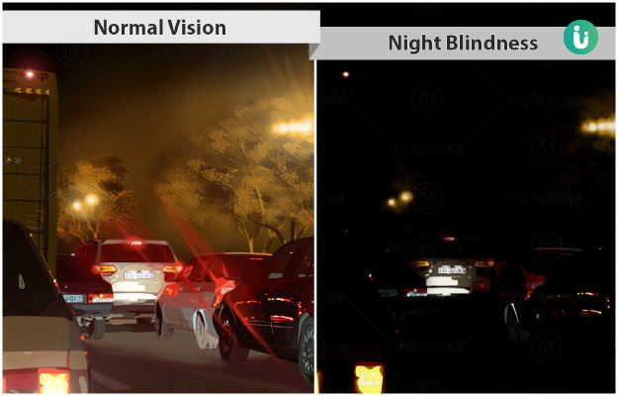
What is night blindness?
An underlying ocular condition that involves the health of the retina, though it can also result from severe or worsening myopia, or a vitamin A deficiency
Symptoms of night blindness:
Abnormal trouble adapting to the dark while driving at night.
Blurry vision when driving in the dark.

Slide 12
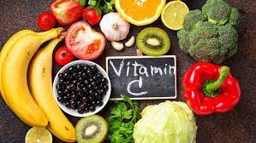


What is scurvy?
Scurvy is caused by not having enough vitamin C in your diet for at least 3 months. Vitamin C is mainly found in fruits and vegetables.
Vitamin C rich foods:
Citrus (oranges, kiwi, lemon, grapefruit)
Bell peppers.
Strawberries.
Tomatoes.
broccoli
Brussels
sprouts
cabbage

Slide 13
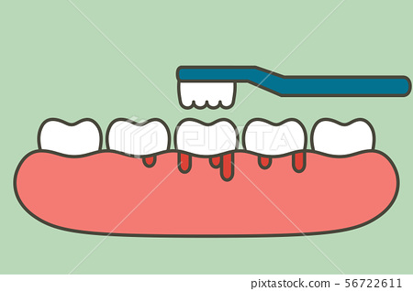
Symptoms of scurvy
feel very tired and weak all the time.
feel irritable and sad all the time.
have severe joint or leg pain.
have swollen, bleeding gums (sometimes teeth can fall out)

Slide 14
Prevalence of each deficiency :
Kwashiorkor: it's most common in children, especially between the ages of 3 to 5.
Rickets: The prevalence of rickets was found to be more prevalent in males with (70%) than in females (30%)
Anemia: WHO( world health organization) estimates that 42% of children less than 5 years of age and 40% of pregnant women worldwide are anemic.
Beriberi: thiamine deficiency rates reached 78% in mothers and 58% in their children. A particularly high prevalence of thiamine deficiency (38%) was found in infants aged 6-12 months (38%)

Slide 15

Hypoglycemia: people with diabetes who have issues with medicine, food, or exercise.
Scurvy: The prevalence of vitamin C deficiency varies across the world, being as high as 73.9% in northern India14 and 7.1% in the United States.
Night blindness: According to WHO( world health organization) statistics, the prevalence of night-blindness is less than one percent, meaning a mild to moderate prevalence.

Slide 16
In conclusion, as this campaign is directed to mainly teenagers between the age of 12-18 years, and it is the most important growth period and they need the most nutrients to grow and be healthy.
They should be consuming all the necessary nutrients in order to avoid these deficiency diseases, and they should switch to a healthy balanced diet and going on daily walks and exercising.
And you should always remember that food could be either a friend or an enemy to your body, so be smart In your choice.

Slide 17
Resources:
We cross checked our data using these websites to make sure the information we got was matching and accurate
https://medlineplus.gov/ency/article/000344.htm
https://www.nhlbi.nih.gov
https://www.mayoclinic.org/
https://rarediseases.info.nih.gov/diseases/9948/beriberi
https://medlineplus.gov/ency/article/000339.htm
https://my.clevelandclinic.org
https://www.ncbi.nlm.nih.gov/
https://www.mayoclinic.org/diseases-conditions/rickets/symptoms-causes/syc-20351943#:~:text=To%20prevent%20rickets%2C%20make%20sure,Cereal
We cross checked our data using these websites to make sure the foods containing iron matched
https://www.healthdirect.gov.au/foods-high-in-iron
https://health.clevelandclinic.org/how-to-add-more-iron-to-your-diet/

