Slide 1
HEALTH AND EXERCISE
By: Jaafar, Sameh, Thomas and Samer

Slide 2
Research Questions
why do we need to exercise and be healthy?
Is doing exercise and being healthy important?
Advantages of being healthy and exercising

Slide 3
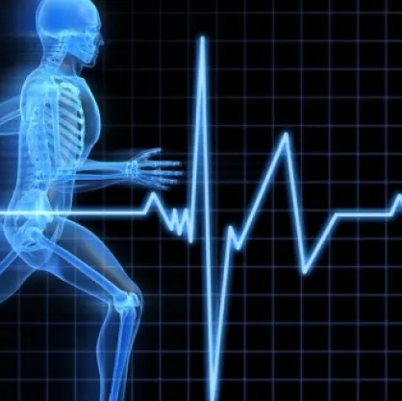
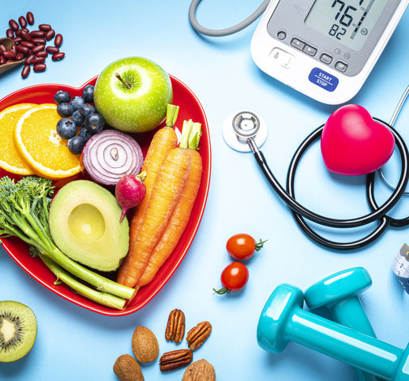
Health And Exercise
Health is a state of complete physical, mental and social well-being and not merely the absence of disease or infirmity. Exercise can slow the loss of bone density that comes with age. It improves mental health and mood, Physical activity keeps thinking, learning, and judgment skills sharp as people age. It also reduces the risk of depression and helps improve sleep quality.

Slide 4
What are the most important things about health?
1)Diet
2) rest
3) exercise
4) posture
5) avoiding the use of alcohol, drugs and tobacco

Slide 5
HOW DO YOU MAINTAIN YOUR HEALTH?
Your body needs more than 40 different nutrients for good health, and there is not one single source for them. ... Eat moderate portions. ... DO NOT SKIP MEALS. ... DO NOT eliminate certain foods. ... Drink water! ... Avoid too much caffeine. ... Be active.

Slide 6
Why doing exercise on a daily base important to your body.
Regular physical activity can improve your muscle strength and increase your endurance. Exercise transports oxygen and nutrients to your tissues and helps your cardiovascular system work better, and when your heart and lung health improve, you have more energy to deal with daily chores. And whatever your age, there's strong scientific evidence that being physically active can help you lead a healthier and happier life.

Slide 7
What are some disadvantages of doing exercise daily
When exercising daily, people would think it’s healthy and they're getting into their dream body, but it’s the complete opposite they’re hurting their body by not giving them any rest, and they are most likely to sustain an injury and feel tired all the time.

Slide 8
The advantages of doing exercise on a regular base
Daily physical activity is one of the most important things you can do for your health, also being physically active can improve your brain health, help control weight, decrease the risk of disease, strengthen bones and muscles, and enhance your ability to do everyday activities.

Slide 9
why do we need to exercise and be healthy?
It's based on your current fitness level – You know where you're at right now and you know your limits. This is important because it gives you a realistic starting point. It gives you the room to improve and grow without having someone else's expectations set upon you

Slide 10
Is doing exercise and being healthy important?
Daily exercise is one of the most important things you can do for your health. Being physically active can improve your brain health, help manage weight, reduce the risk of disease, strengthen bones and muscles, and improve your ability to do everyday activities

Slide 11
Advantages of being healthy and exercising
-It’s a natural mood lifter. Regular physical activity can relieve stress, anxiety, depression and anger.
-It keeps you physically fit and able. Without regular activity, your body slowly loses its strength, stamina and ability to function properly.
-It helps keep the doctor away. Stand up when you eat your apple a day! Too much sitting and other sedentary activities can increase your risk of heart disease and stroke.

Slide 12
According to the newspaper ‘The Guardian’, People who pack all their exercise into one or two sessions at the weekend benefit almost as much as people who work out more frequently.
“Millions of people enjoy doing sport once or twice a week, but they may be concerned that they are not doing enough,” said Gary O’Donovan, a physical activity researcher and author on the study at Loughborough University. “We find a clear benefit. It’s making them fit and healthy.”
The UK’s National Health Service recommends that people should spend 150 minutes doing moderate exercise or 75 minutes a week doing strong exercise.
Moderate exercise can be done while having a conversation, but talking when you’re doing vigorous exercise can make it much harder

Slide 13
People who met the physical activity target by exercising through the week have a 35% lower risk of death than the inactive adults, with cardiovascular deaths down 41% and a 21% lower risk of cancer death.
For those who have resolved to get fit in the New Year, O’Donovan recommends to start with moderate exercise, such as fast walking, and then to set realistic, gradual goals to increase confidence without running the danger of setbacks due to injury. “A middle aged or older person should do as much as 12 weeks of moderate exercise before introducing vigorous exercise,” he said.

Slide 14
Resources
Constitution of the World Health Organizationhttps://www.who.int › about › governance › constitution
https://online.csp.edu/resources/article/the-science-of-exercise/
Five Main Factors for Maintaining Good Healthhttps://www.balancedwellbeinghealthcare.com › five-main
https://www.nhs.uk/live-well/exercise/exercise- health-benefits/
https://www.mayoclinic.org/healthylifestyle/fitness/indepth/exercise/art20048389#:~:text=Regular%20physical%20activity%20can%20improve,energy%20to%20tackle%20daily%20chores
Collegehttps://www.rhodes.edu<health-forms<health-awareness
https://www.theguardian.com/science/2017/jan/09/weekend-workouts-nearly-as-good-as-whole-week-of-excercise-researchers-say

Slide 15
Thank You

