Slide 1
Eating disorders
By: Laya Nowwara, Dareen Al-Farah, Sama Kaawach, Laith Al-Naber
Audience: Teenagers (12+)

Slide 2
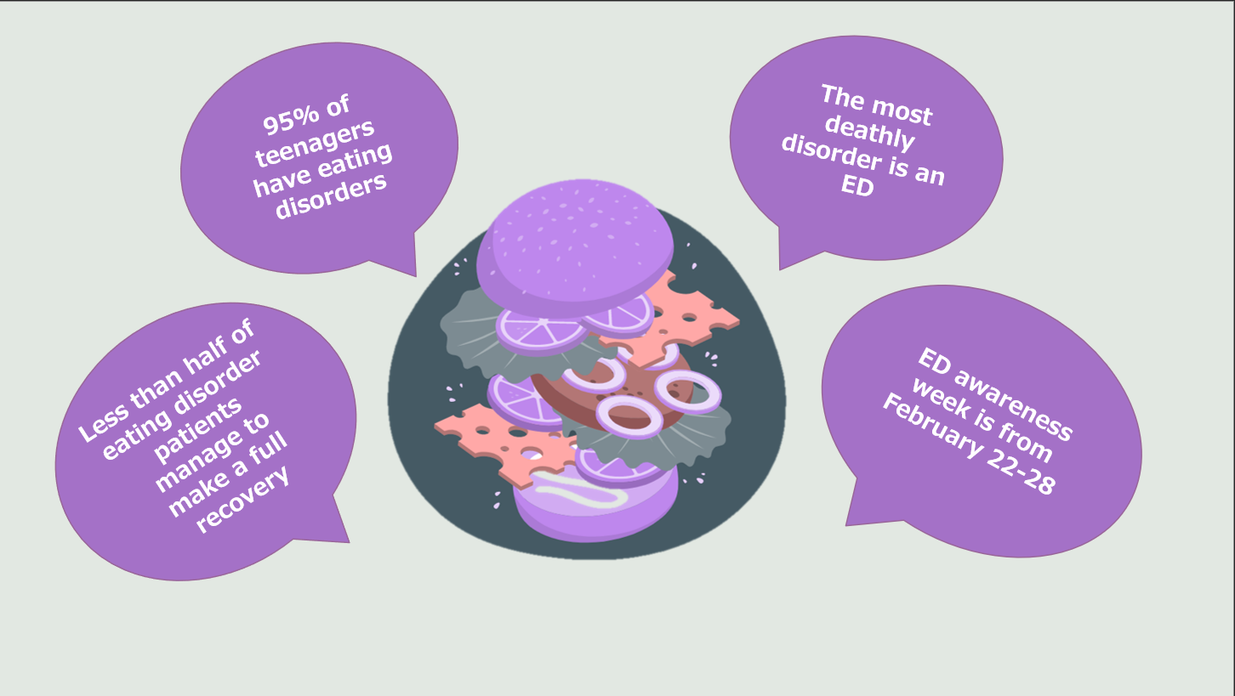

Slide 3
An interview with Dr Mohammad Nofal- a bariatric surgeon
https://youtu.be/ZEos7SWekwo

Slide 4
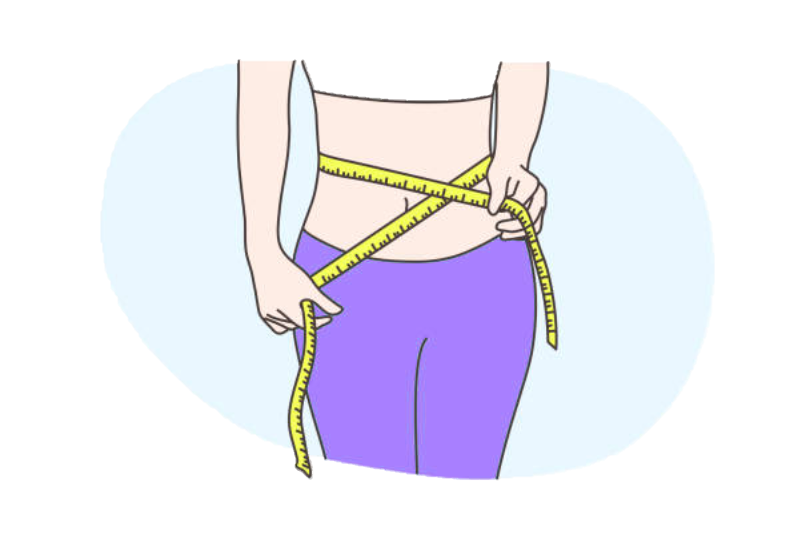
Eating Disorder: Definition
Eating disorders are complex emotional disorders, characterized by abnormal eating habits, unhealthy weight, and extreme body dysmorphia. It is by far the most deadly disorder.

Slide 5
Types of eating disorder
Binge Eating Disorder (BED)- consuming an extraordinarily large amount of food in a short period of time and the inability to control their food intake.
Bulimia Nervosa- ingesting a large amount of food in a small period of time until they become painfully full and purge all the food which will result in major painful consequences.
Anorexia Nervosa- patients view themselves as overweight then limit their food intake to a life-threatening level and purge in ways that might cause body failure.
Pica- craving un-edible substances such as dirt, soap, hair, chalk or hair which increases the risk of poisoning and nutritional deficiencies.

Slide 6
Symptoms of an Eating Disorder
Unusual bodyweight
Broken Diet- restricting vital food groups.
The urge to eat alone or secretly.
Using the bathroom regularly after a meal.
Obsession with dropping or gaining weight rapidly.
Encountering unusual stress or annoyance around eating habits.
Feelings of regret and shame over one’s eating habits.

Slide 7
Causes of an Eating Disorder
There are three major factors that can cause an eating disorder:
Biological Factors- genetics, such as changes in the brain chemicals.
Psychological Factors- emotional problems, such as perfectionism, low self-esteem and past history with anxiety.
Societal Factors- cultural beauty standards, social media use at a young age, family pressure.

Slide 8
Effects of an Eating Disorder
Eating disorders can affect the body and mind in many ways, such as:
Cardiovascular system (known as the circulatory system) is affected when low heart rate and blood pressure weaken the body’s muscles, including the heart, which increases the risk of failure.
Depression and anxiety- with malnutrition and a reduction of social support, it’s much easier to develop those mental illnesses.
Vitamin and mineral deficiencies- mainly cause physical effects.
Swelled limbs
Enlarged Glands
Menstrual Abnormality
Infertility

Slide 9
Eating Disorders: Complex Recovery
ED recovery typically entails psychotherapy for the major mental factor of the disorder, along with getting in touch with a registered nutritionist to fix any deficiency issues, and specific medication by seeing a medical or dental specialist to address any health issues brought on by your ED (which can be permanent and dangerous).
An eating disorder is a surprisingly addictive disease, and victims’ path to recovery may vary to which type of ED it is and its symptoms. However, These conditions can also worsen and persist for many more years leaving a significant impact on the patient, including that 35%- 40% of ED patients have made a full recovery.

Slide 10
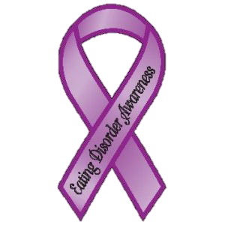
Ways to help
Ways to help and support someone with an eating disorder:
1. Keep the atmosphere stress free.
2. Avoid conversations about food or eating.
3. Don’t rush them into opening up about the situation.
4. Motivate them into seeking medical help.
5. Help develops their self-esteem.
6. Always make them feel understood and heard.

Slide 11
References
https://www.mayoclinic.org/diseases-conditions/eating-disorders/symptoms-causes/syc-20353603
https://www.eatingdisorderhope.com/information/eating-disorder
https://www.nationaleatingdisorders.org/risk-factors
https://www.montenido.com/eating-disorders-affects-mind-body-learn-anorexia-treatment-can-help/
https://www.mayoclinic.org/diseases-conditions/eating-disorders/in-
depth/eating-disorder-treatment/art-20046234
https://www.healthline.com/nutrition/common-eating-disorders
https://www.nhs.uk/mental-health/advice-for-life-situations-and-events/how-to-help-someone-with-eating-disorder/

Slide 12
Cross-Check Sites
https://my.clevelandclinic.org/health/diseases/4152-eating-disorders
https://www.ncbi.nlm.nih.gov/pmc/articles/PMC7883487/
https://www.nationaleatingdisorders.org/learn/general-information/recovery
https://eatingdisorderfoundation.org/learn-more/about-eating-disorders/signs-and-symptoms/
https://www.montenido.com/eating-disorders-affects-mind-body-learn-anorexia-treatment-can-help/
https://www.nm.org/healthbeat/healthy-tips/anorexia-and-your-heart#:~:text=The%20heart%20specifically%20becomes%20smaller,result%20of%20slow%20heart%20rate.
https://www.beateatingdisorders.org.uk/media-centre/eating-disorderstatistics/#:~:text=Research%20suggests%20that%20around%2046,considerably%20and%2023%25%20suffer%20chronically.
https://www.mind.org.uk/information-support/types-of-mental-health-problems/eating-problems/for-friends-family/

