Slide 1
Listeriosis
By:
Rakan-Sanad-Anton-Alex

Slide 2
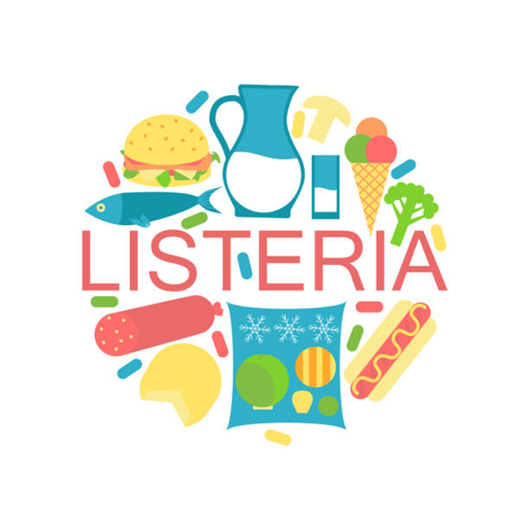
Listeriosis
Listeriosis (also known as Listeria) is a serious infection caused by the germ Listeria monocytogenes. People usually become ill with listeriosis after eating infected or contaminated food.

Slide 3
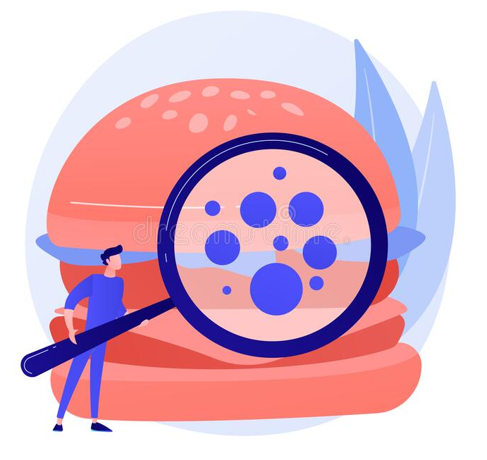
Would you catch listeriosis?
The disease primarily affects pregnant women, newborns, older adults, and people with weakened immune systems, but you have to keep yourself safe because bacteria is everywhere.

Slide 4
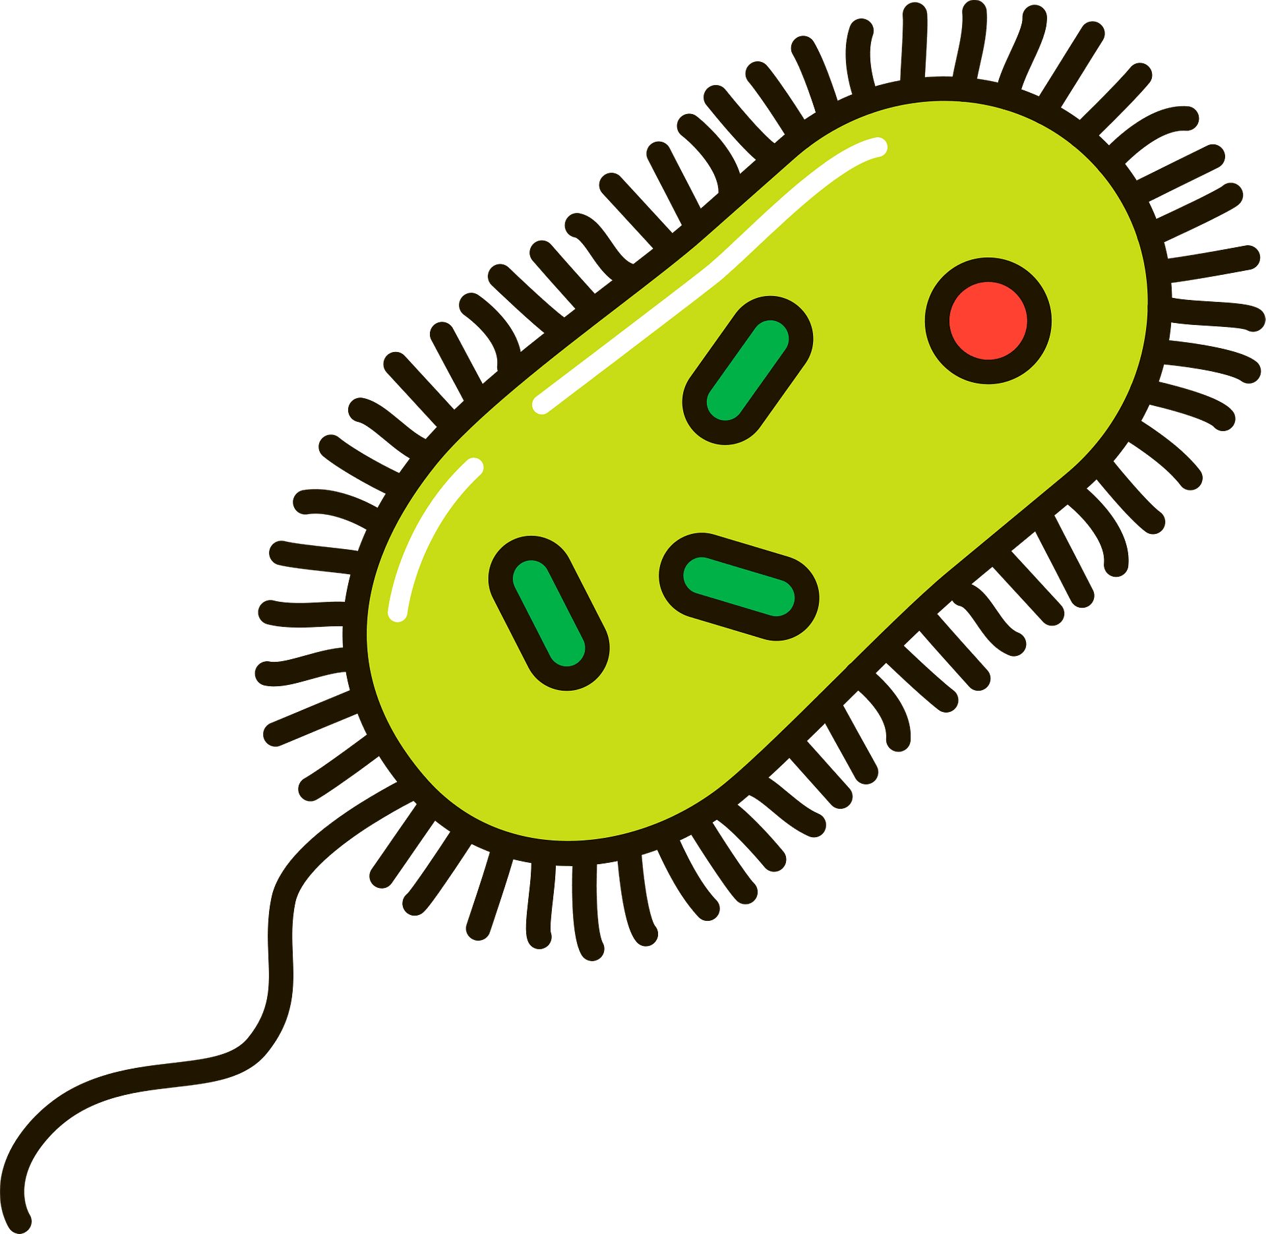
Symptoms of listeriosis
Fever (rise in body temperature)
Myalgia (Muscle aches)
Headache (sharp pain in your head)
stiff neck (strained muscle in the neck)
Confusion (thinking unclearly)
loss of balance
Seizures
Diarrhea

Slide 5
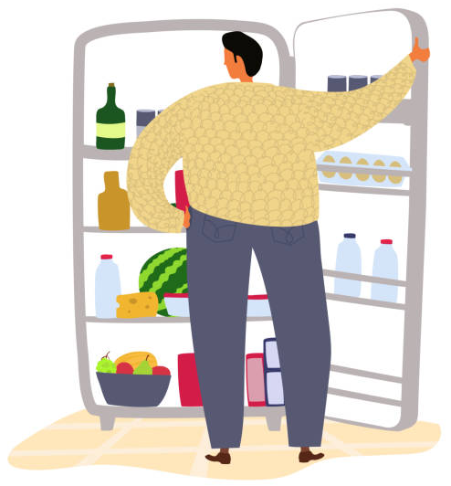
How to prevent listeria
Knowing what foods to avoid and how to safely prepare and store foods is the best way to reduce the risk of listeriosis.

Slide 6
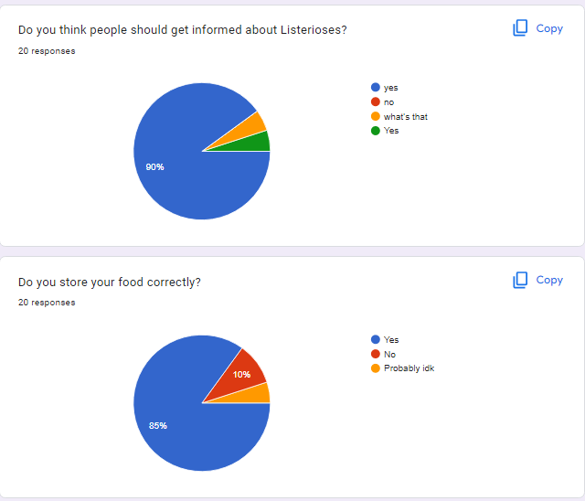
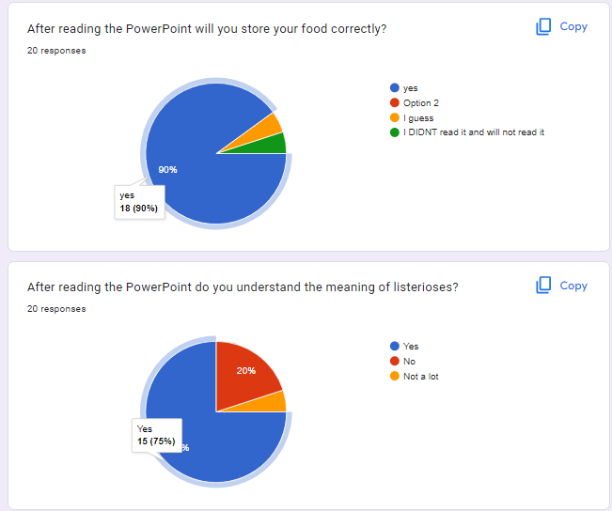
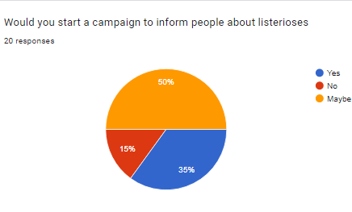
https://forms.gle/DiJvuBFLp2r3URJR7

Slide 7
https://www.cdc.gov/listeria/faq.html#:~:text=Listeriosis%20is%20a%20serious%20infection,people%20with%20weakened%20immune%20systems.
https://www.cdc.gov/listeria/prevention.html
https://www.cdc.gov/listeria/outbreaks/cheese-09-12/signs-symptoms.html
https://rarediseases.org/rare-diseases/listeriosis/#:~:text=Listeriosis%20is%20treated%20with%20antibiotics,gentamicin%20in%20combination%20with%20ampicillin.
To cross check
https://www.mayoclinic.org/diseases-conditions/listeria-infection/symptoms-causes/syc-20355269

