Slide 2
The presentation of vaping by Big Vaping and Big Tobacco is as a smoking cessation device. However, their true intent is as a nicotine initiation device. That’s why there are THOUSANDS OF flavors!

Slide 3
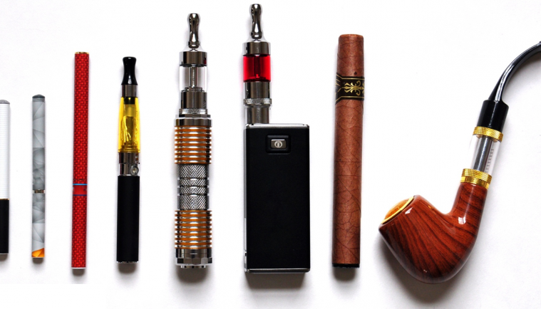
E CIGARETTES comes in different shapes

Slide 4
Vape juice

