Slide 1
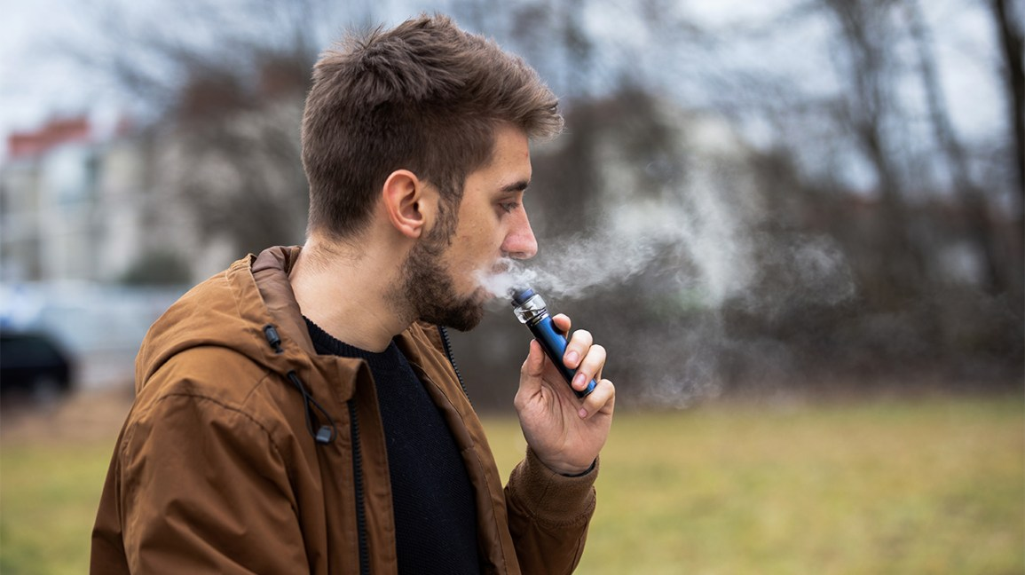
Vaping
By: Jason, Ahmad, Adnan, and Omar.

Slide 2
What is Vaping?
Vaping is the action or practice of inhaling and exhaling vapor created by a device made specifically for this purpose and contains nicotine and flavoring. It is used by people instead of regular cigarettes.

Slide 3
What causes vaping?
To reduce the amount of smoking or cut smoking and move to vape
Vapes vary in price but usually cost less than smoking. Which saves money
Many see vaping as a new hobby, because of the great number of juices and flavors to choose from.
Numerous people vape to relieve stress from themselves
A lot of people vape to fit in the current society by being pressured by others like friends

Slide 4
What are the effects of vaping??
Vapes contain nicotine, a drug that’s highly addictive. Vaping can cause anxiety and depression.
Nicotine makes anxiety and depression worse.
It also affects memory, concentration, self-control, and attention, especially in developing brains.
It can also cause sleep problems, exposure to cancer-causing chemical chronic bronchitis lung damage that can be life-threatening

Slide 5
What are the effects of vaping on teenagers?
Nicotine is a highly addictive drug that is used in e-cigarettes(Vapes).
Nicotine use during adolescence can harm the brain areas that control attention, learning, mood, and impulse control.
It can also alter the formation of synapses (a junction between two nerve cells), which can harm the parts of the brain that control attention and learning.

Slide 6
How to overcome vaping?
Physical activity like sports is an efficient way to stop a craving for an addiction
Changing your environment by getting rid of anything that may remind you of vaping to remove any temptations
Using a distraction to keep your attention off your desire to vape
Main reason for vaping is to get out of stressful situations, finding alternatives to cope with stress is a really effective way to overcome vaping
While quitting celebrating small accomplishments or milestones can boost your resistance to stress and your crave for vaping

Slide 7
Citations/ cross-checked sites
Site 1
https://www.webmd.com/connect-to-care/vaping/what-is-vaping
https://kidshealth.org/en/teens/e-cigarettes.html
https://www.cdc.gov/tobacco/basic_information/e-cigarettes/Quick-Facts-on-the-Risks-of-E-cigarettes-for-Kids-Teens-and-Young-Adults.html#:~:text=Using%20nicotine%20in%20adolescence%20can,%2C%20mood%2C%20and%20impulse%20control.&text=Each%20time%20a%20new%20memory,synapses%20faster%20than%20adult%20brains.
https://truthinitiative.org/research-resources/quitting-smoking-vaping/quitting-vaping-here-are-5-tips-handling-nicotine
https://www.vapemate.co.uk/blog/7-reasons-why-people-start-vaping/
Site 2
https://kidshealth.org/en/parents/e-cigarettes.html
https://ww2.health.wa.gov.au/Articles/F_I/Health-effects-of-vaping
https://e-cigarettes.surgeongeneral.gov/knowtherisks.html
https://teen.smokefree.gov/quit-vaping/how-to-quit-vaping
https://www.livescience.com/58071-why-people-vape.html

