Slide 1
Smoking and vaping
__________________________________________________________
.By: Sarah Zreiqat, Carol oufi, Tala Tadros, Zaid haddad, Abdullah Abujaber

Slide 2
What is vaping? And what can It do to your health?
Most people know that vaping is bad for your heart lungs and the addiction
Yes that is true but smoking and vaping can cause so many other things both
Common side affects and serious side affects smoking can cause.
Common side affects | Serious side affects
Dizziness | Nicotine addiction
Scratchy feeling in mouth, thought, lips | Severe lung injury
Heart palpitations | Seizures
Nausea (Nausea is an uneasiness of the stomach that often comes before vomiting) | Popcorn lung (build up of scar tissue in the lungs)
Eye irritation | Strokes
Shortness of breath | Heart attacks

Slide 3
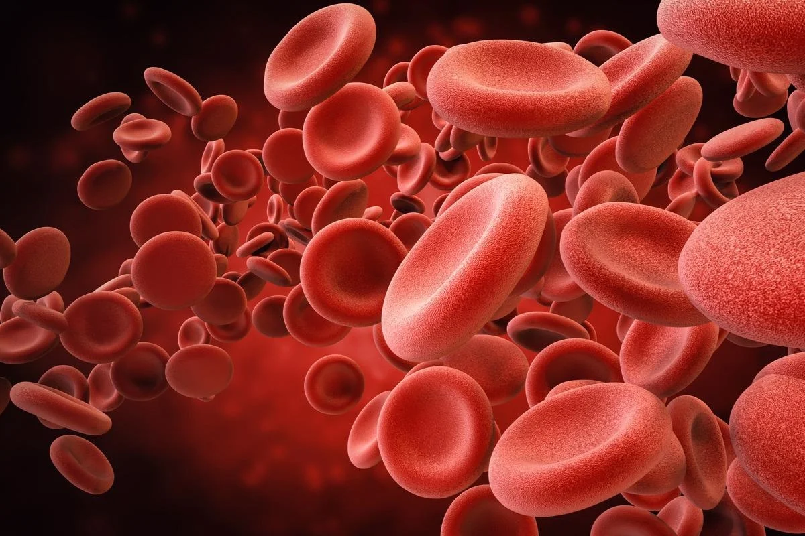
What can help your health while smoking?
smoking is not recommended but quitting it is quite hard, exercise
On the other hand can help with your health while smoking a lot.
The intake of nicotine in your daily lifestyle can narrow your arteries which
Reduces the flow of blood, and exercising can help with recovering
The reduced flow in blood because it helps boosts blood to your muscles

Slide 4
Age groups smoking
In 2019 the age
group that vaped
the most in
England was 25-34

Slide 5
Vaping bar chart about teenagers 2022
Data also shows that teens are
not simply experimenting with
e-cigarettes but are instead using
them habitually. In 2021, more than
a quarter (27.6%) of high school
e-cigarette users and 8.3% of current
middle school e-cigarette users
reportedvaping daily

Slide 6
Is it easy to quit smoking?
Yes, but the process might take a while by stopping the
Intake of nicotine which is stop smoking or taking the
substitutes of vapes that contain no nicotine

Slide 7
Fun facts about vaping:
Vaping facts:
Many vapes contain nicotine making them addictive
Vapes can contain the same harmful chemicals found in cleaning products, nail polish remover, weed killer and bug spray
Vapes can leave young people at increased risk of depression and anxiety
The nicotine in 1 vape can = 50 cigarettes. Depending on the size of the vape and nicotine strength, it can be much higher
Young people who vape are 3 times as likely to take up smoking cigarettes
Vaping has been linked to lung disease.
Vapes can cause long-lasting damaging effects on the brain and physical development.

Slide 8
Thank you!

