Slide 1
Anxeity Disorder
Done by: Yann,Fawzi,Qais,Hamzeh

Slide 2
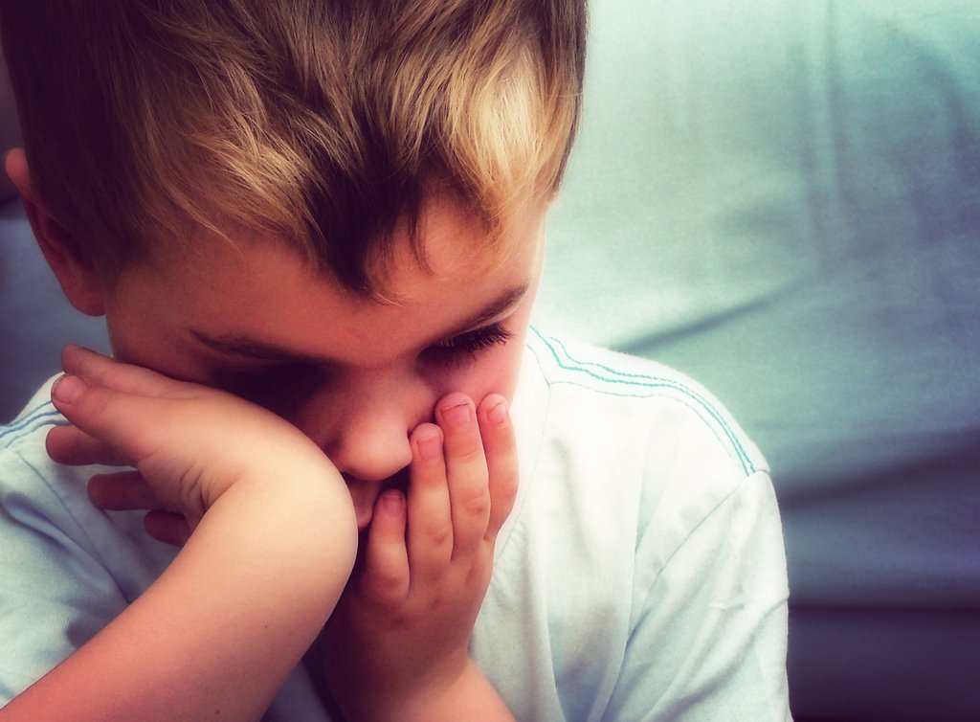
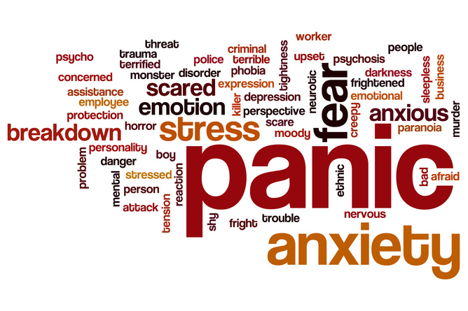
What is Anxeity ?
Anxiety is a feeling of unease, such as worry or fear, that can be mild or severe .

Slide 3
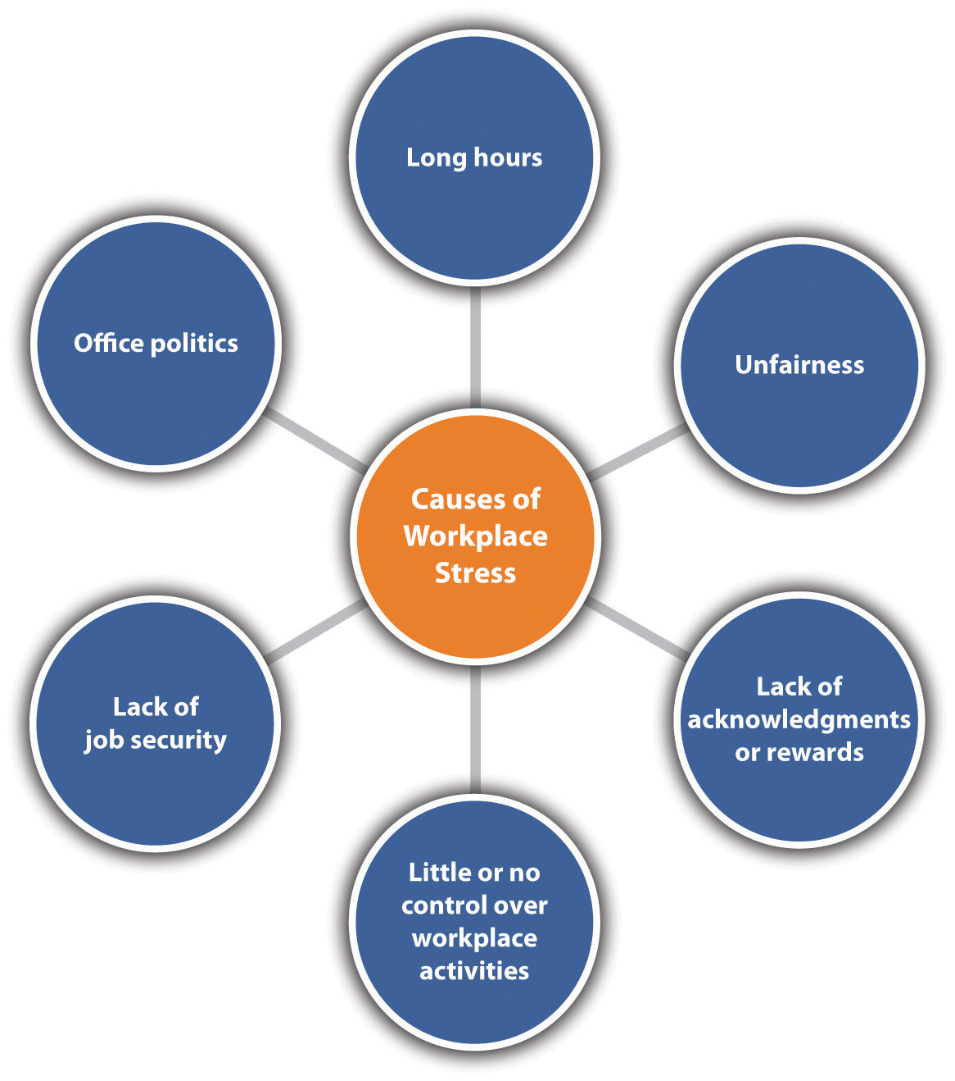
What causes anxiety in students (teenagers)?
Mental health challenges may come about as a reaction to environmental stressors, including trauma, the death of a loved one, school issues, and/or experiencing bullying. All these factors—and more—can lead to anxiety In kids and adolescents.

Slide 4
What are the examples of anxiety ?
Examples of anxiety disorders include generalized anxiety disorder, social anxiety disorder (social phobia), specific phobias and separation anxiety disorder. You can have more than one anxiety disorder. Sometimes anxiety results from a medical condition that needs treatment.

Slide 5
What are the symptoms of anxiety ?
Blushing, sweating, or trembling
Pounding or racing heart
Stomachaches
Rigid body posture or speaking with an overly soft voice
Difficulty making eye contact or being around people they don’t know
Feelings of self-consciousness or fear that people will judge them negatively

Slide 6
Is anxiety a mental illness ?
Anxiety disorders are the most common of mental disorders and affect nearly 30% of adults at some point in their lives. But anxiety disorders are treatable and a number of effective treatments are available. Treatment helps most people lead normal productive lives.

Slide 7
Thank you

