Slide 1
VAPiNG
BY YAHIA,ZEID,JAD,LAITH H

Slide 2
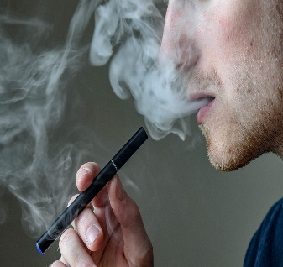
What is vaping?
Vaping is the inhaling of a vapor created by an electronic cigarette or other vaping devices.
Vaping is when you use a small, handheld device to inhale a mist of nicotine and flavoring e-liquid.
Source: https://my.clevelandclinic.org/health/articles/21162-vaping
source: https://kidshealth.org/en/teens/e-cigarettes.html

Slide 3
What does a vape contain?
Vape contains a liquid solution containing thousands of unknown chemicals including: nicotine, flavoring solutions, cannabis (THC, CBD), propylene glycol (PG) or vegetable glycerin (VG) which are all very harmful.
Source:https://www.wdhb.org.nz/our-community/our-health-promotion-service/smokefree-tobacco-free/vaping-and-e-cigarettes/
source:https: //nida.nih.gov/publications/drugfacts/vaping-devices-electronic cigarettes#:~:text=a%20cartridge%20or%20reservoir%20or,the%20person%20uses%20to%20inhale

Slide 4
Diseases caused by vaping
Lung cancer
cardiovascular heart disease.
Damaged cells
Cause of heart attacks
Strokes
Source: https://www.lung.org/quit-smoking/e-cigarettes-vaping/impact-of-e-cigarettes-on-lung

Slide 5
Advantages of vaping
Vaping can help someone quit smoking
Vaping is usually cheaper than smoking
Vaping isn’t harmless, but it is less harmful than smoking
Source: https://www.wdhb.org.nz/our-community/our-health-promotion-service/smokefree-tobacco-free/vaping-and-e-cigarettes/#:~:text=Benefits%20of%20vaping&text=Vaping%20can%20help%20some%20people%20quit%20smoking.&text=Vaping%20is%20usually%20cheaper%20than%20smoking.&text=Vaping%20is%20not%20harmless%2C%20but,much%20less%20harmful%20than%20smoking.&text=Vaping%20is%20less%20harmful%20to,vapour%20is%20dangerous%20to%20others

Slide 6
Disadvantages of vaping
Nicotine addiction.
Severe lung injury.
Seizures.
Cryptogenic organizing pneumonia (COP), formerly known as idiopathic bronchiolitis obliterans with organizing pneumonia (BOOP)
Popcorn lung.
Strokes.
Heart attacks.
Source: https://www.drugwatch.com/e-cigarettes/side-effects/

Slide 7
numerical data about vaping
Gallup says that 20% of people age 18 to 29 vape, compared to 9% of people age 30 to 49, 7% of people age 50 to 64, and less than 0.5% of people older than 65.
And 15-17 years old are 16 times most likely to vape than 25-34 years old
Source: https://www.singlecare.com/blog/news/vaping-statistics/#:~:text=Gallup%20says%20that%2020%25%20of,to%2034%2Dyear%2Dolds.

Slide 8
How often someone would vape?
An average person would inhale 130-140 puffs a day, technically a 600 puff vape would end in a few days.
Source: https://theplanetvape.com/qa/how-much-e-liquid-do-you-vape-per-day.html#:~:text=It%20determines%20your%20vaping%20nicotine%20level%20based%20on,day%20varied%20considerably%20from%20one%20user%20to%20another

Slide 9
How much sales does vaping produce by 2023?
Worldwide vaping sales are predicted to reach more than 40 billion in 2023
Source: https://www.singlecare.com/blog/news/vaping-statistics/

