Slide 1
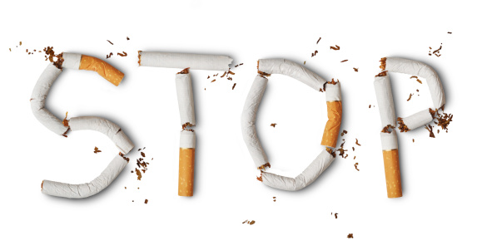
Smoking
By: Jad Gammoh , George Fakes,
Ameer Oudat,
Abood Rbeihat Jad Tarazi

Slide 2
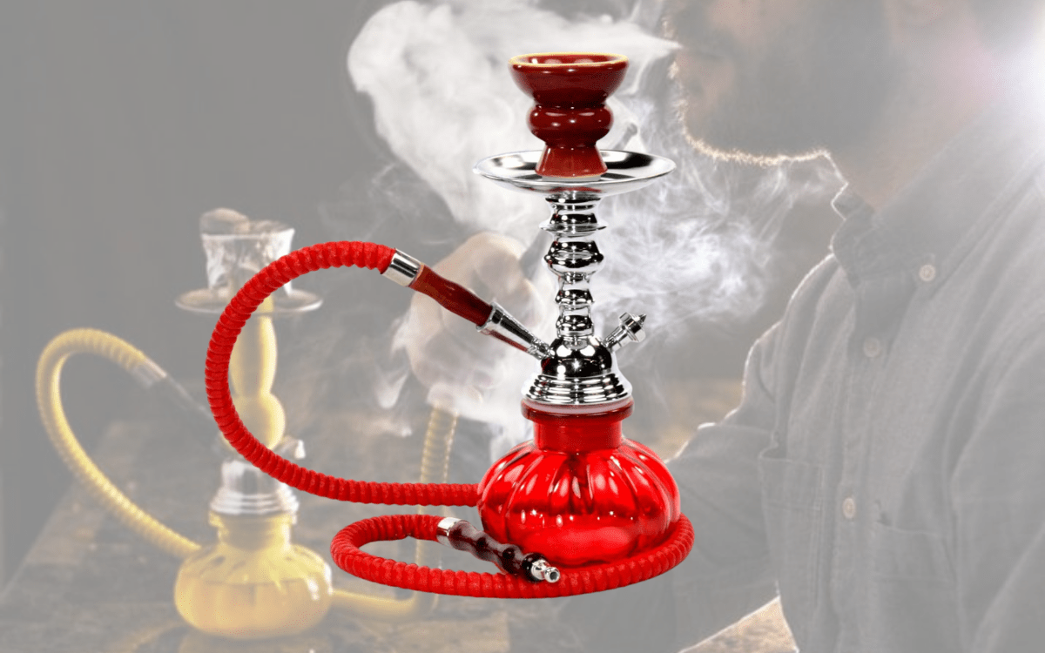
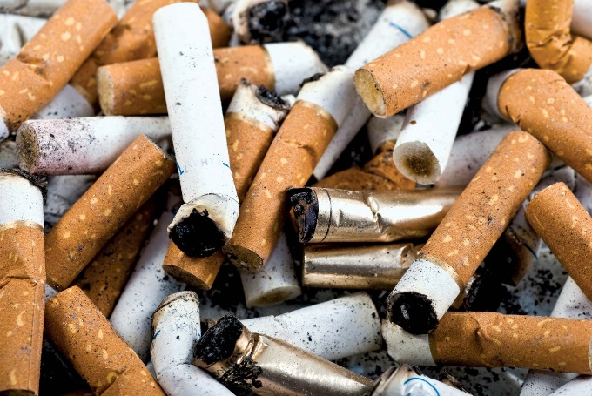
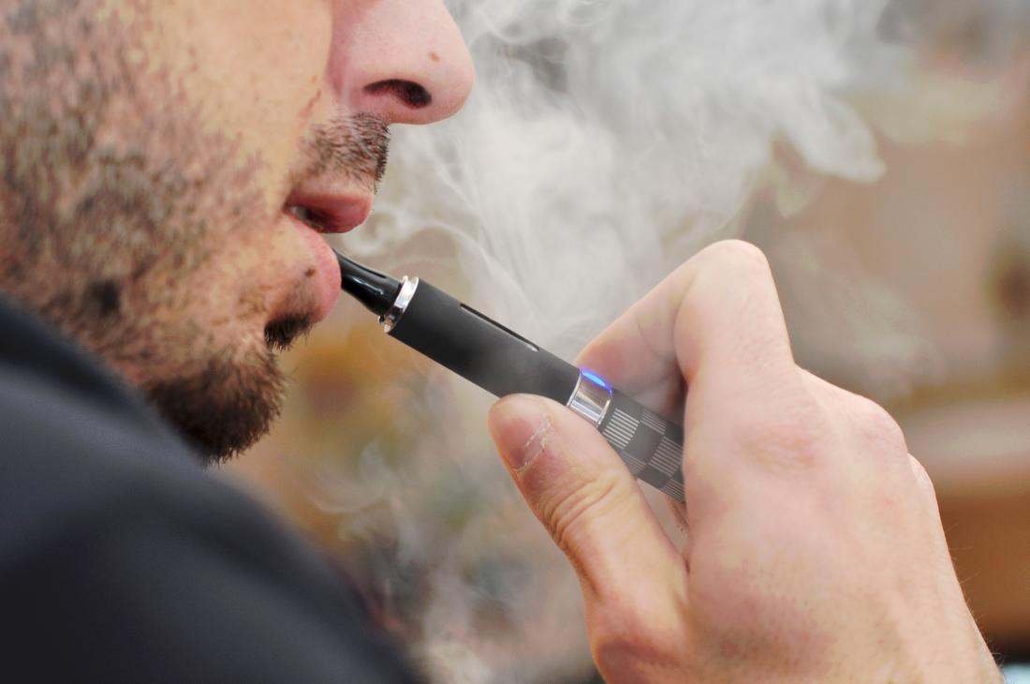
What is Smoking?
Smoking is the act of inhaling and exhaling the fumes of burning tobacco in cigars, cigarettes, Shisha pips, vape and other.

Slide 3
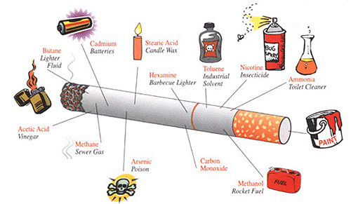
Dangerous chemicals in tobacco smoke
Nicotine
Carbon monoxide
Tar
Benzene
Arsenic
Formalde

Slide 4
Listen to your BRAIN and hear your lungs!
Nicotine is the main addictive drug in tobacco and Cigarettes are designed to rapidly deliver nicotine to your brain.
Inside your brain, nicotine triggers the release of chemicals that make you feel good. As nicotine stimulates parts of your brain over and over, your brain gets used to having nicotine around.
Over time, nicotine changes how your brain works and makes it seem like you need nicotine just to feel okay.
Because tobacco smoke contains carbon monoxide, this deadly gas displaces the oxygen in your blood, depriving your organs of the oxygen they need. It also cause lung disease by damaging your airways and the small air sacs (alveoli) found in your lungs

Slide 5
SO....

Slide 6
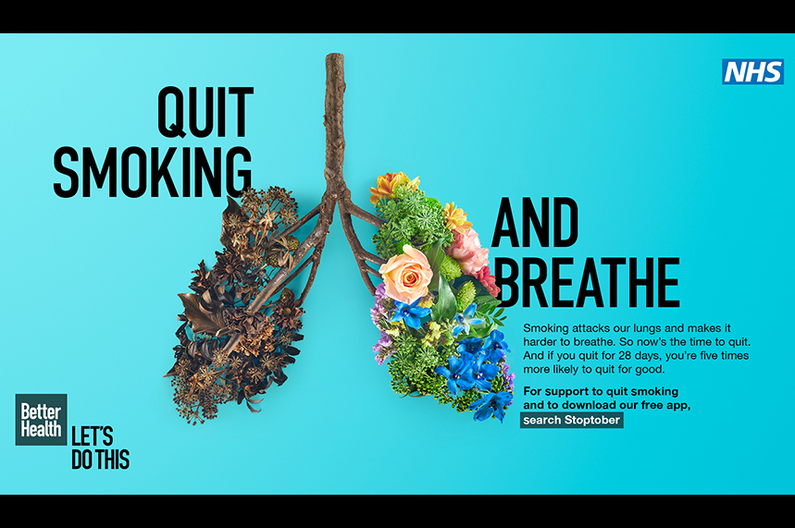

Slide 7
How to quit smoking
Commit to your quit
Remind yourself of the benefits
Learn how to handle your triggers and cravings
Find ways to handle nicotine with draw
Keep in mind that trying something to beat the urge to use tobacco is always better than doing nothing. And each time you resist a tobacco craving, you're one step closer to being tobacco-free

Slide 8
Summary
Smoking is a very bad habit that we need always to encourage people to stay away from, and once they quit they will notice an improvement in health status and enhancement of quality of life, also their circulation will begin to improve, and their blood pressure will start to return to normal.
Lets watch this short movie together:
https://youtu.be/KX82NJMguvA

Slide 9
Methods and Recourses
Document analysis: We read documents published by World Health Organization WHO and Mayo Clinic Hospital.
https://www.who.int/news-room/commentaries/detail/quit-tobacco-to-be-a-winner
https://www.who.int/news/item/31-05-2022-tobacco-exposed---poisoning-our-planet-and-a-key-driver-for-the-tb-epidemic
https://www.mayoclinic.org/healthy-lifestyle/quit-smoking/in-depth/nicotine-craving/art-20045454

