Slide 1
Solvent
Done by: Tareq Tubeileh , Toleen Habahbeh , Sarah Abujbarah ,
Farah Abualzalaf , Omar Alabdalat.

Slide 2
What is a solution?
Before we get to know what is a solvent we need to understand what is a solution and what is it made from?
A solution is a homogeneous mixture of solvent and solute molecules. A solvent is a substance that dissolves another substance by pulling the molecules apart through electrochemical interactions. The solute then diffuses through the solvent until the concentration is equal in all parts of the solution.

Slide 3
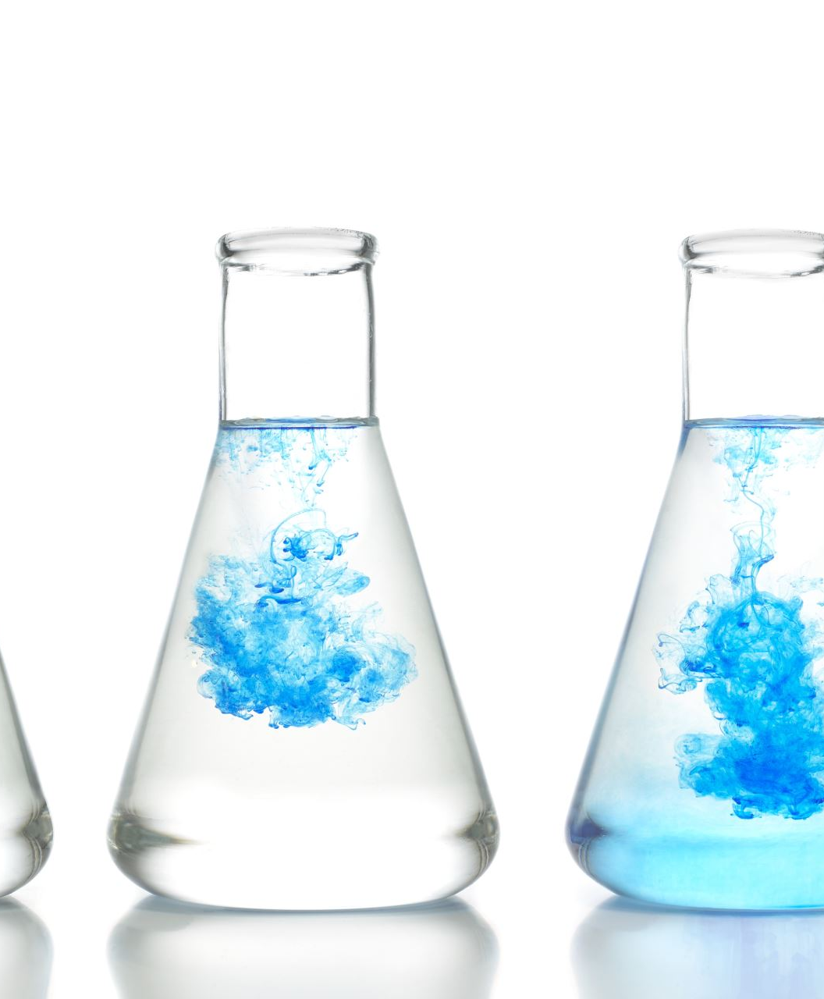
What is a solvent?
After we knew what is a solution now we can tell you that The term 'solvent' can be defined as a substance that has the ability to dissolve a given solute to form a solution with it.
Common examples of solvents include water, ethanol, methanol and acetone.

Slide 4
What is a solute?
Solution is made of three important objectives the third one is called a solute and it is defined as the substance that dissolves in a solvent to produce a homogeneous mixture.
some examples of a solute is Salt in Food,Oxygen in Seawater,Sugar in Tea,Quinine in Tonic Water,Carbon Dioxide in Ca.

Slide 5
Understanding the Types of Cleaning Solvents
Oxygenated solvents.
Hydrocarbon solvents.
Halogenated solvents.

Slide 6
What is Oxygenated solvents?
Oxygenated solvents are organic solvents containing oxygen molecules, created through chemical reactions from olefins.

Slide 7
What is Hydrocarbon solvents?
Hydrocarbon solvents are petroleum derivatives used for cleaning and or dissolving substances, and are used in a variety of industrial and consumer products. Hydrocarbon solvents are a diverse group of liquid complex mixtures. They may contain paraffinic, isoparaffinic, naphthenic and aromatic constituents.

Slide 8
What is Halogenated solvents?
The halogenated solvents are volatile organic chemicals consisting of a hydrocarbon chain or one hydrocarbon substituted with one or more chlorine or bromine atoms. Most of these chemicals are used as degreasers and solvents in various products such as paints.

Slide 9
Why is water a good solvent
Because of its polarity and ability to form hydrogen bonds, water makes an excellent solvent, meaning that it can dissolve many different kinds of molecules

Slide 10
Organic solvents and inorganic solvents
Organic solvents and inorganic solvents are two types of solvents. Inorganic solvents don't contain the element carbon. The most common inorganic solvents are water, and liquid ammonia whereas organic solvents, such as alcohols, glycol ethers, contain carbon and oxygen in their structure.

Slide 11
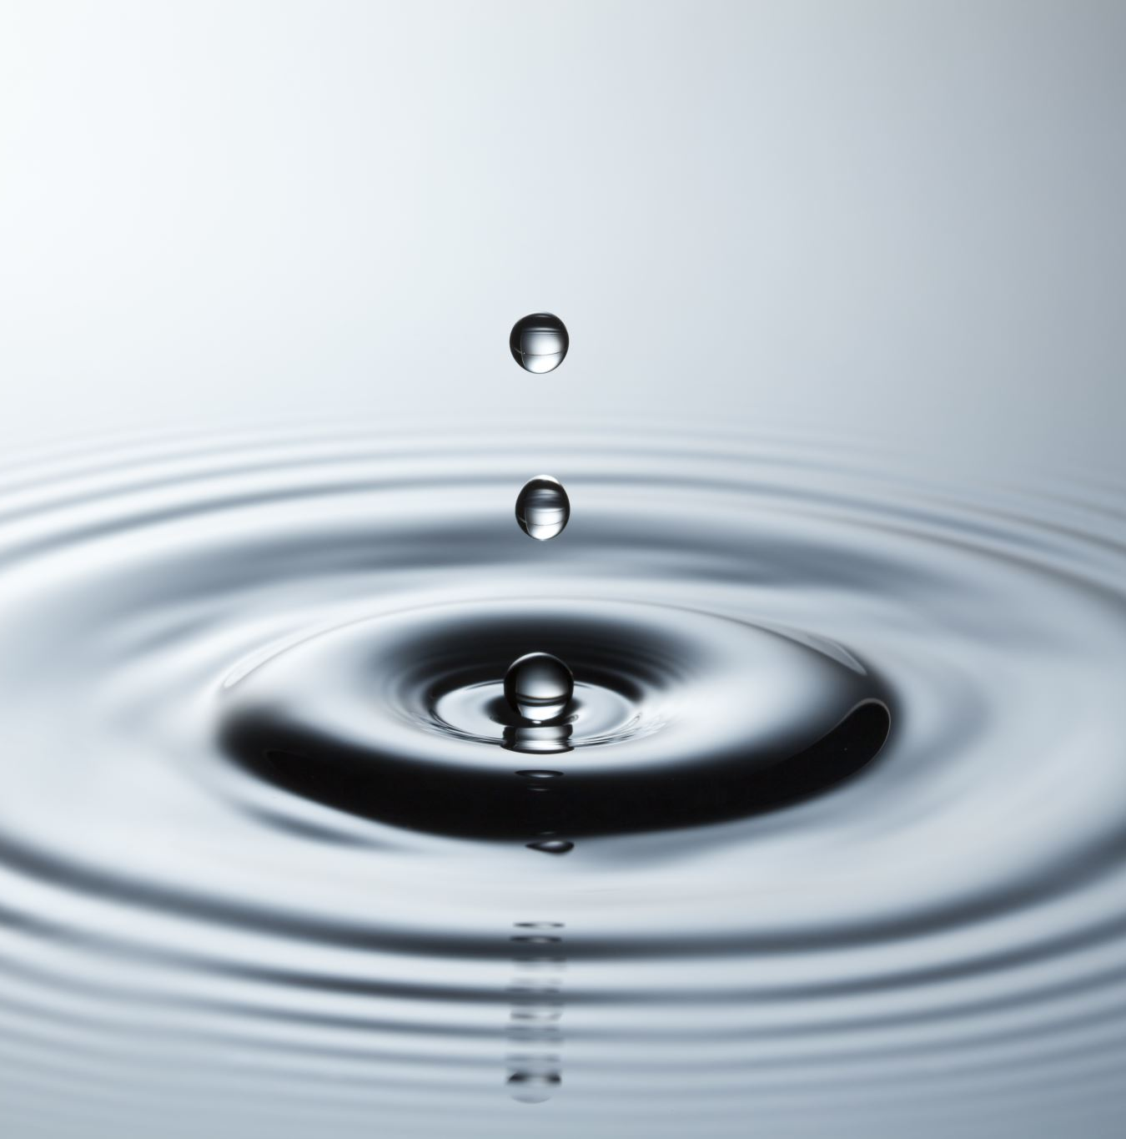
What is the most powerful and popular solvent?
Water is called the "universal solvent" because it is capable of dissolving more substances than any other liquid. This is important to every living thing on earth.

Slide 12
Elements of a good solvent
Not toxic, not flammable.
Immiscible pair of solvents: water and low polarity organic solvents. ...
Good solubility of the target compound. ...
Poor solubility of impurities. ...
Volatility of the extraction solvent. ...
Toxicity and safety properties of the extraction solvent.

Slide 13
What are suitable solvents
Suitable solvents are used to remove hydrocarbon and other contaminants such as cutting fluids, grease, oil, waxes, and primers. Light oxide films can be removed by pickling or by a carefully selected mechanical means of cleaning.

Slide 14
Questions :
Who can name 3 examples of solvent ?
Who can define a solvent in simple words ?
What are two types of solvent ?
What is most power full and known solvent?
What are some of the requirements of a good solvent ?

Slide 15
Ansewr :
Water.
Ethanol.
Methanol.
Acetone.
Tetrachloroethylene.
Toluene.
Methyl acetate.
Ethyl acetate.

Slide 16
Ansewr 2:
solvent, substance, ordinarily a liquid, in which other materials dissolve to form a solution.

Slide 17
Answer 3 :
Organic and inorganic solvents

Slide 18
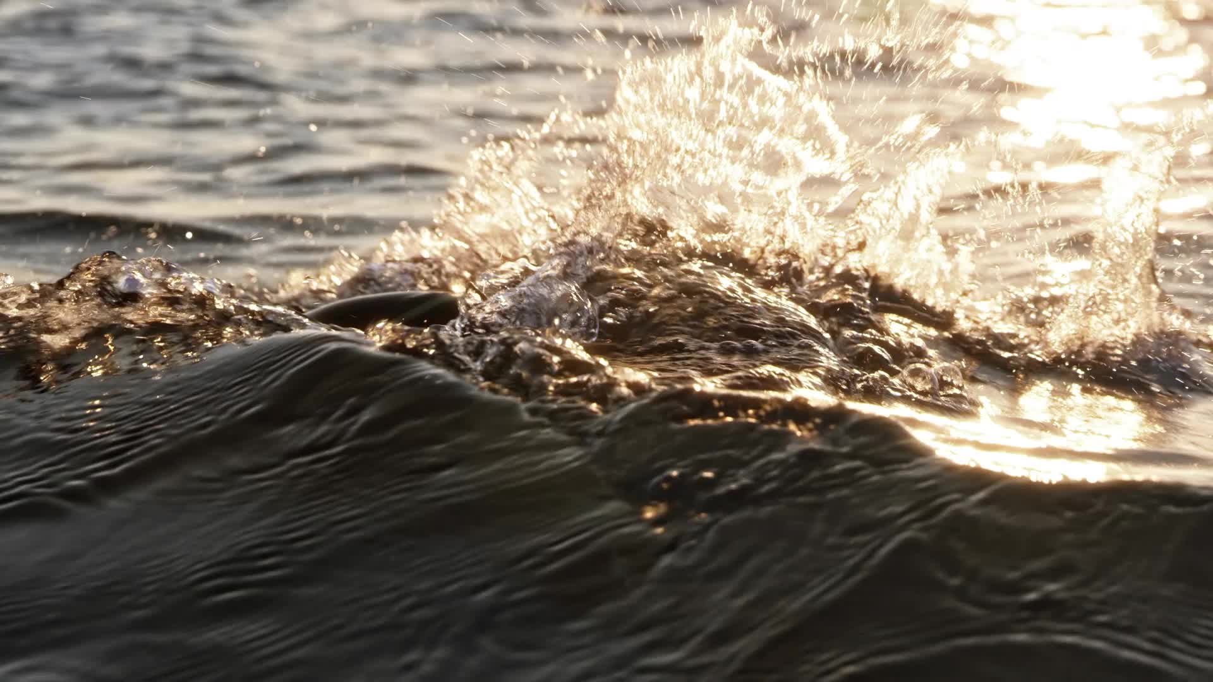
Ansewr 4 :
water

Slide 19
Ansewr 5:
Not toxic, not flammable.
Immiscible pair of solvents: water and low polarity organic solvents. ...
Good solubility of the target compound. ...
Poor solubility of impurities. ...
Volatility of the extraction solvent. ...
Toxicity and safety properties of the extraction solvent.

