Slide 1
Personal hygiene
By: yasmeen sahoury, christina sharqawi, lamar alazzeh

Slide 2
Audience:
This is to raise awareness for middle school students.
Middle school students still are not aware about their personal hygiene because of the changes that their body is going through
Research questions:
hygiene?
What is personal hygiene?
What is the importance of hygiene?
What should be in a personal hygiene kit?
What is personal hygiene?

Slide 3
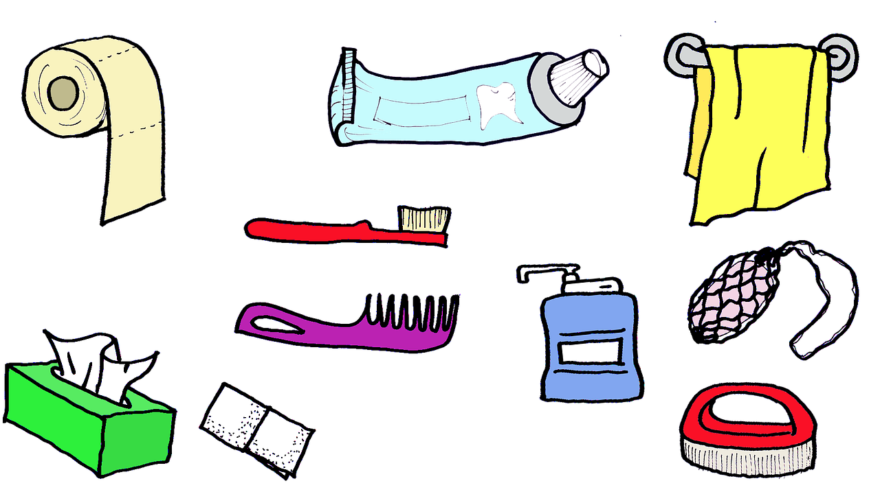
What is personal hygiene?
Personal hygiene is cleaning your body everyday. Washing your hands with soap after going to the toilet. Brushing your teeth twice a day. Covering your mouth and nose with a tissue (or your sleeve) when sneezing or coughing.

Slide 4
What is the importance of hygiene?
Good personal hygiene is one of the best ways to protect yourself from getting gastro or infectious diseases such as COVID-19, colds and flu. Washing your hands with soap removes germs that can make you ill. Maintaining good personal hygiene will also help prevent you from spreading diseases to other people.

Slide 5
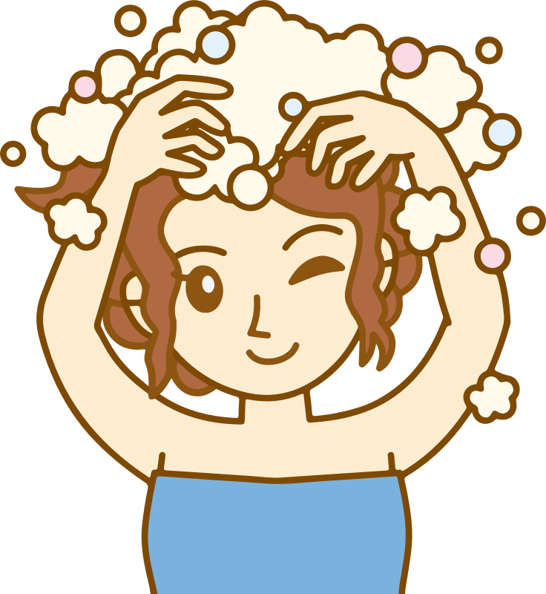
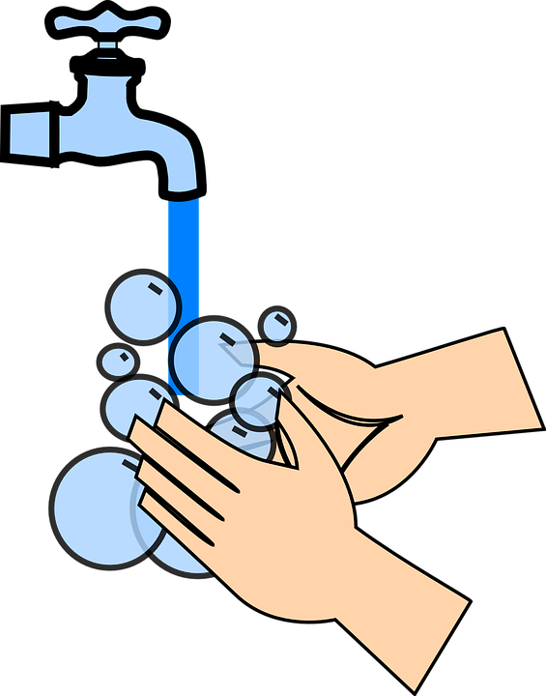
Types of personal hygiene:
Hair hygiene
Face hygiene
Body hygiene
Hand hygiene
Feet hygiene
Nail hygiene
Armpit hygiene
Eye hygiene
Mouth hygiene

Slide 6
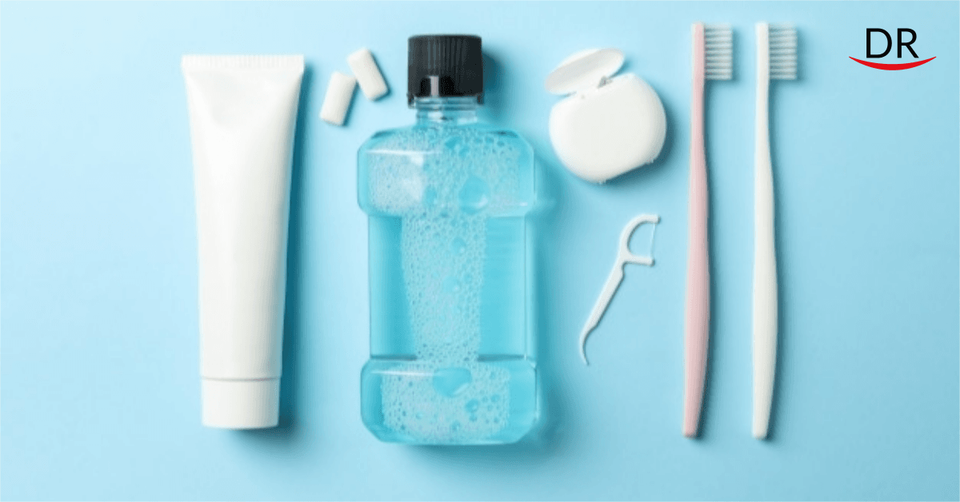
Hygiene kit
A personal hygiene kit is useful collection of your personal care items dedicated to helping you stop the spread of germs.

Slide 7
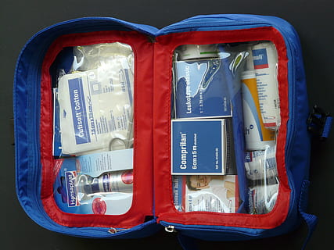
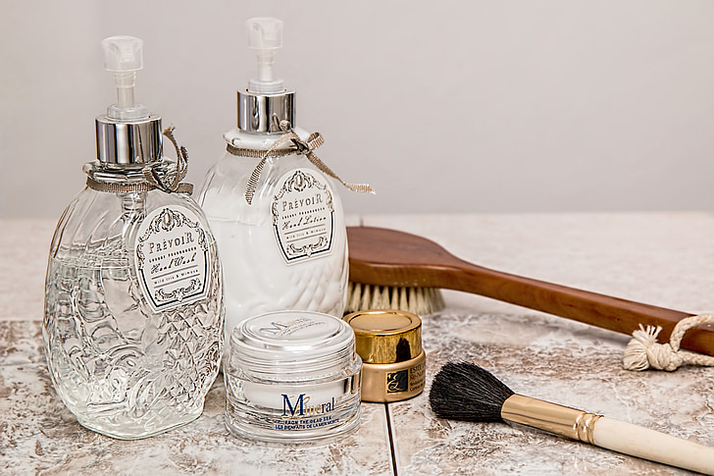
What should be in a personal hygiene kit?
A personal hygiene kit should include a toothbrush, toothpaste, a bar of soap, shampoo, conditioner, body lotion, shave gel, deodorant, comb, razor, lip balm, face cloth, bandages, hand sanitizer, tissues, nail clippers, hair ties, and feminine hygiene products (ex. pads)

Slide 8
Methodology
Our method of data collection will be using a survey on Google Forms, which will be distributed to middle school students aged from 10-13 years.
Attached below is the Google Form link:
https://forms.gle/4ewGx7W2647PRyQf7

Slide 9
Resources
1.https://www.healthdirect.gov.au/
2.https://www.healthline.com/
3.https://www.open.edu/
4. https://humanitarianglobal.com/
5.https://www.healthline.com/
6.https://kitsforacause.com/
7.https://www.conveniencekits.com/

