Slide 1
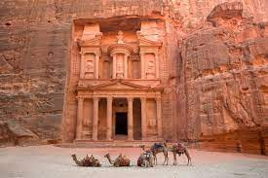
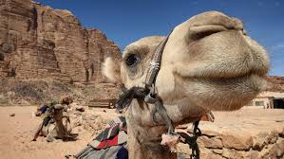
Jordan Traditions
Mohammad Younes, Murad Madaien, Faisal Thalji, AlFaisal Ayoub, Nichola Farraj

Slide 2
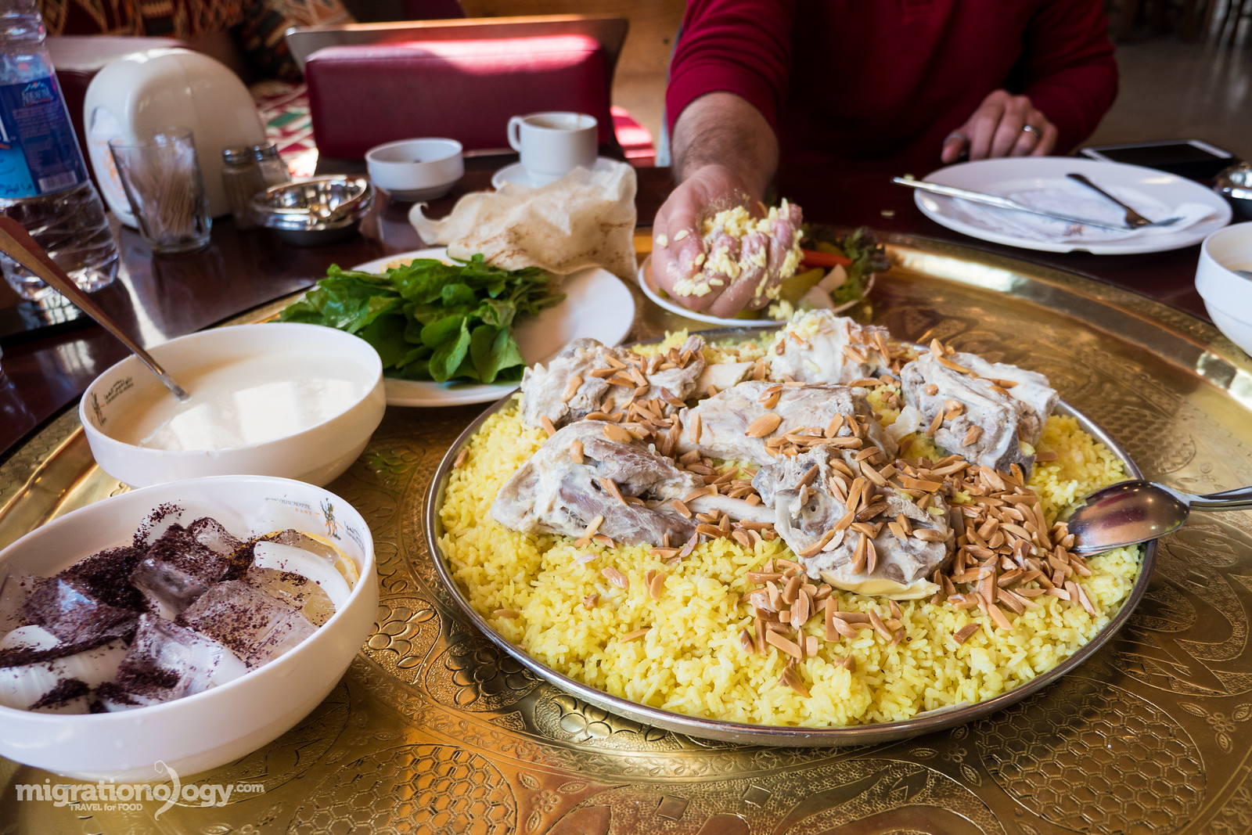
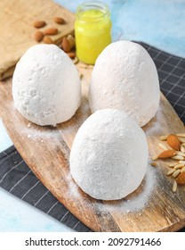
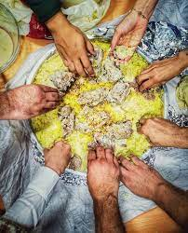
A Tradition of Food and Hospitality in Jordan
Food is commonly used by Jordanians to express their hospitality and generosity.
A 'Jordanian invitation' means that you are expected to bring nothing and eat everything. This invitation is followed by the popular Arabic phrase “Sahtain wa 'Afiya.”
Mansaf
If you’ve found yourself in Jordan than it’s amust you try Mansaf.
Mansaf is the greatest symbol of Jordanian generosity. Usually eaten during social gatherings, Mansaf is a feast meant to be eaten with your hands.
When eating Mansaf, use the bread and the jameed to pick up the rice and lamb; forming a condensed ball of food in your hand, it makes it a lot neater, and Jordanians will be impressed by your technique and try to only use one hand.
https://johtt.com/about-jordan/jordan-traditions

Slide 3
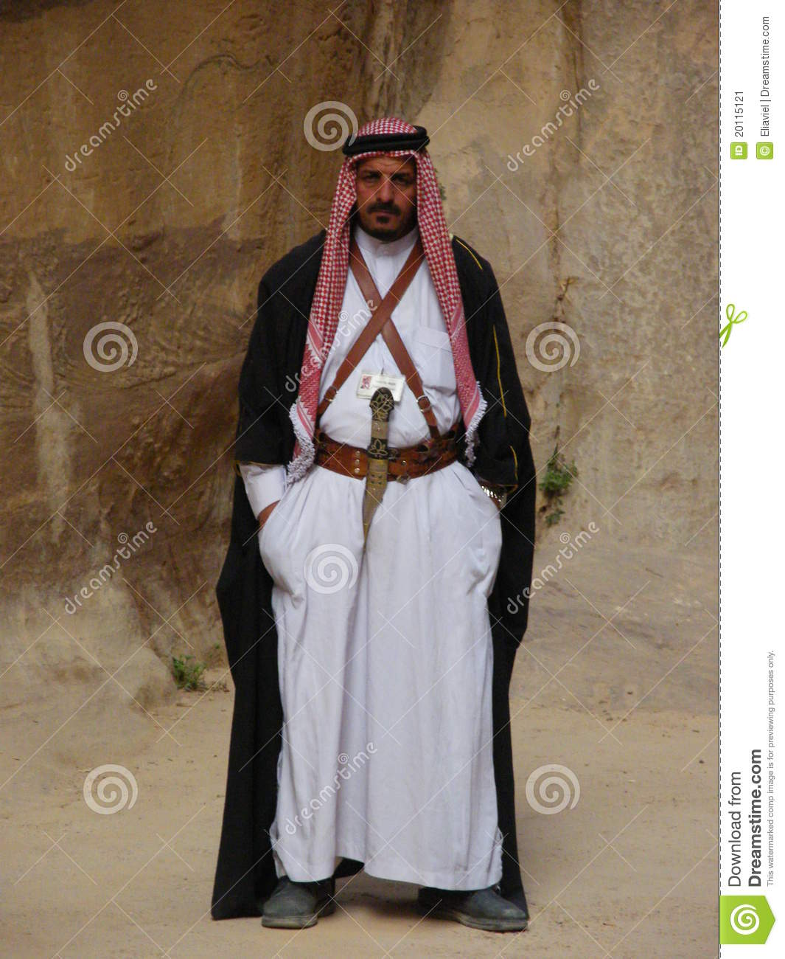
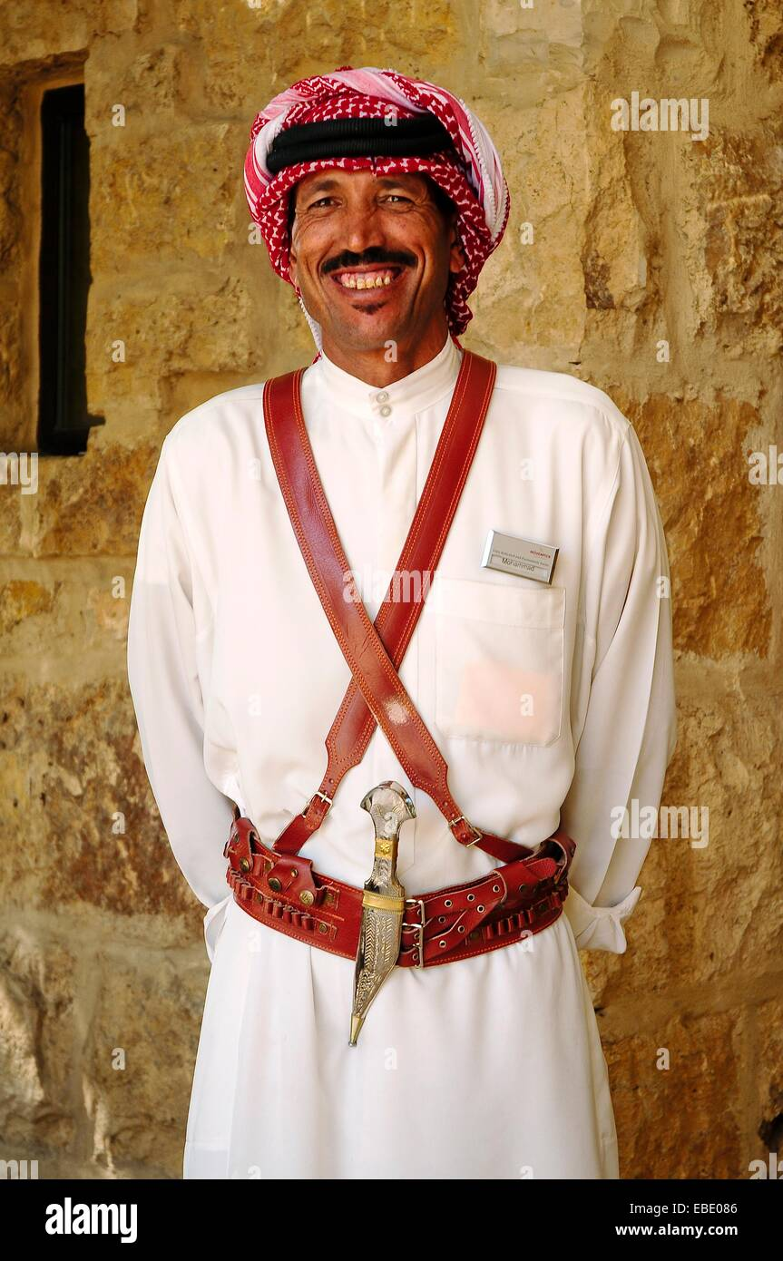
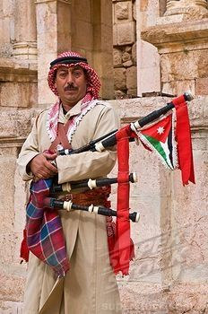
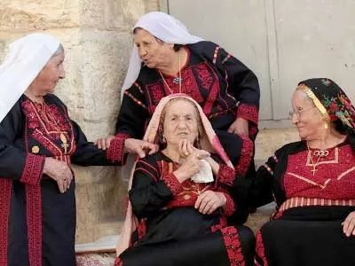
A Tradition of dress for males and females
Some Jordanians wear modern clothes while others wear traditional clothes.
Traditional Jordanian clothes were very colorful. Cotton and synthetic material is often used in modern dresses but in long ago silk, goat hair and wool was used to make dressed. They are embroidered with beautiful designs. Some dresses were even decorated with shells.
Men traditionally wore thobes. It is worn over long white trousers. During the winter the men wear thobes that are made of heavier material. They are often grey, brown, navy or black. They cover their heads with an embroided cap called a Kofiya. The Kofiya is covered with a folded square or circle cloth called the ghutra. The ghutra is held in place with a double black coil called the iqal.
https://whereinourworld.weebly.com/jordan---clothes.html

Slide 4
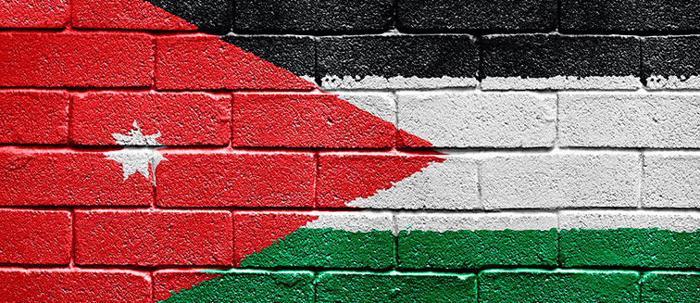
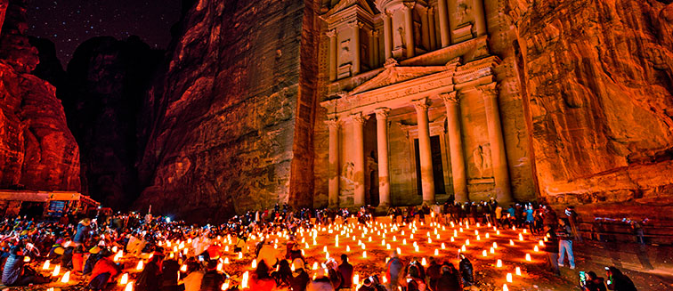
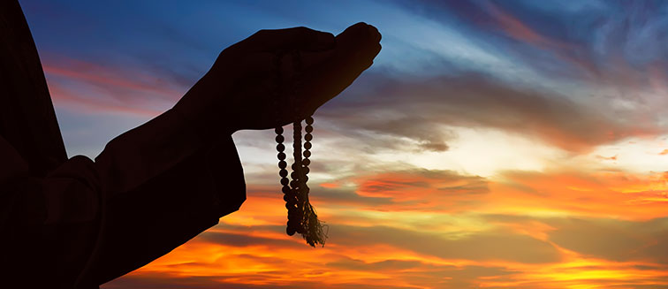
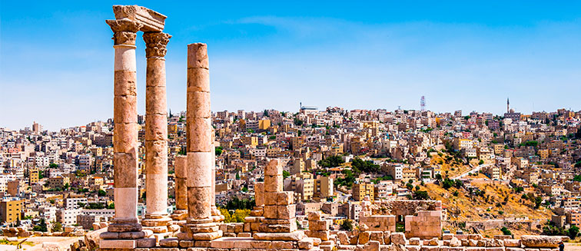
A Tradition of events and Festivals
Festival of Jerash
The Jerash Festival is one of the biggest events in Jordan. It has been held in the homonymous city for more than 30 years. It is a cultural festival, so during the week there are shows of traditional dances of the country, concerts, photography exhibitions and poetry readings. It involves both national and international artists.
Jordanian Independence Day
The Hashemite Kingdom of Jordan celebrates every May 25th, with parades and official acts, to commemorate its independence from Great Britain in 1946. Before that date, the country was known as Trans-Jordan and was ruled, during the subsequent years of its self-determination, by King Abdullah I, who was assassinated in 1951. A fact that until a few years ago was also remembered with solemn acts in the capital.
Ramadan
Held in the ninth month of the Muslim calendar, Ramadan is one of the most important holidays in the Islamic world. Throughout this month, believers fast during the day, from dawn until the sun goes down, at which time they can then eat and drink. There are also several prayers a day in mosques and events dedicated to the Muslim community.
Jordan Festival
The Friends of Jordan Festivals association is responsible for organizing a series of secular and cultural events every year in Amman, the Jordanian capital. During the month of September at the City Citadel they offer a broad agenda of musical performances by both national and international artists.
https://www.exoticca.com/us/asia/middle-east/jordan/events

Slide 5
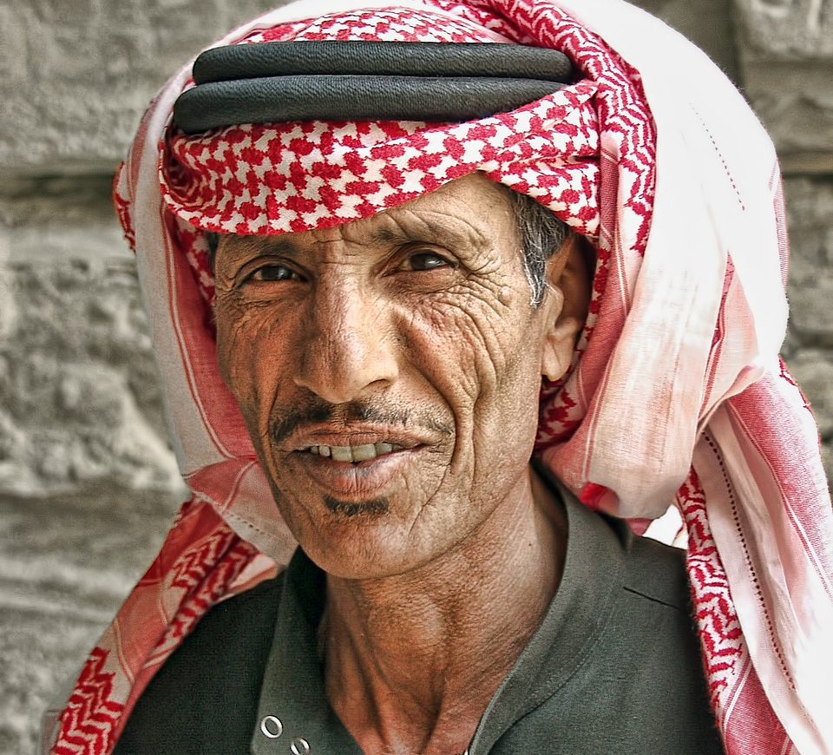
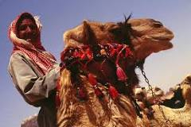
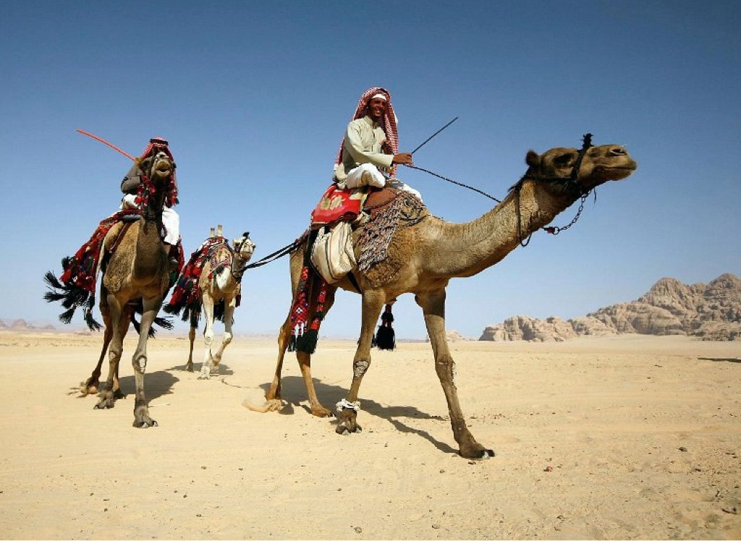
A Tradition of Bedouin
The Bedouin people are an ancient population of Jordan that have preserved their local customs for generations. Though the Bedouin people are small in number, there are still many ways to learn and experience their traditions. The name for the Bedouin people in Arabic translates to ‘desert dwellers. These nomadic people have lived in the deserts for thousands of years and today there are around 4 million Bedouin.
Bedouin culture and customs have become fascinating to western visitors and today the Bedouin people are very happy to share their traditions with travelers. The best way to enjoy a Bedouin experience in Jordan is by visiting a local Bedouin village. Many Bedouin villages invite tourists into their tents to enjoy traditional food and customs and these experiences can be booked through a number of experienced tour companies.
https://www.touristjordan.com/jordanian-traditions/

Slide 6
A Tradition of Tribes
A tribe is an extended grouping of families who cultivate a distinctive tradition of history and folklore (mainly oral) and assert ownership of a particular territory. Not all tribes are desert-dwelling – there are many whose background is rural, and others who have become urbanized.
Some tribes are made up of clans and branches which have taken on tribe-like status; others have banded together in larger, often pan-national, tribal confederations. All these concepts are rather loose, but for a lot of Jordanians, tribal identity is at least as strong as religious or national identity.
Within tribal identity, many people make a distinction between two broad social traditions. The bedouin originate in families who are current or former desert-dwellers: they may once have been nomadic but are almost all now settled. Some still live in tents in or near the desert, following traditional lifestyles, but many do not: a police officer in Amman or a marketing executive in Aqaba might be as bedouin as a camel-guide in Wadi Rum.
https://jordan-travel.com/jordan-culture-and-traditions/

Slide 7
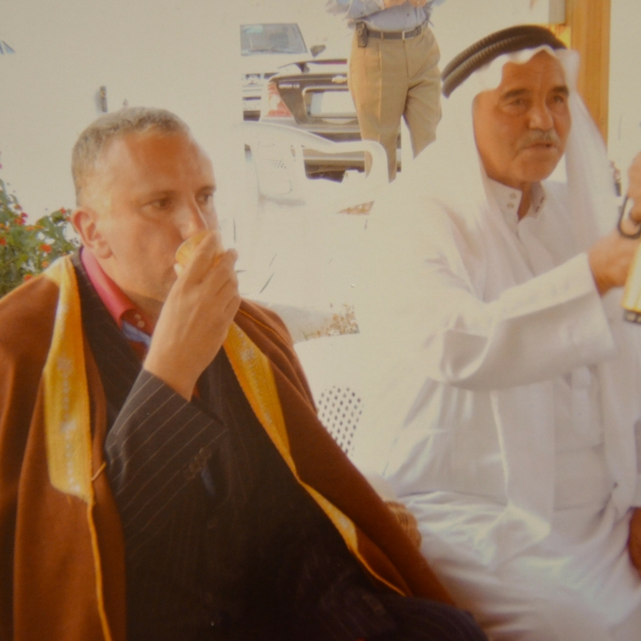
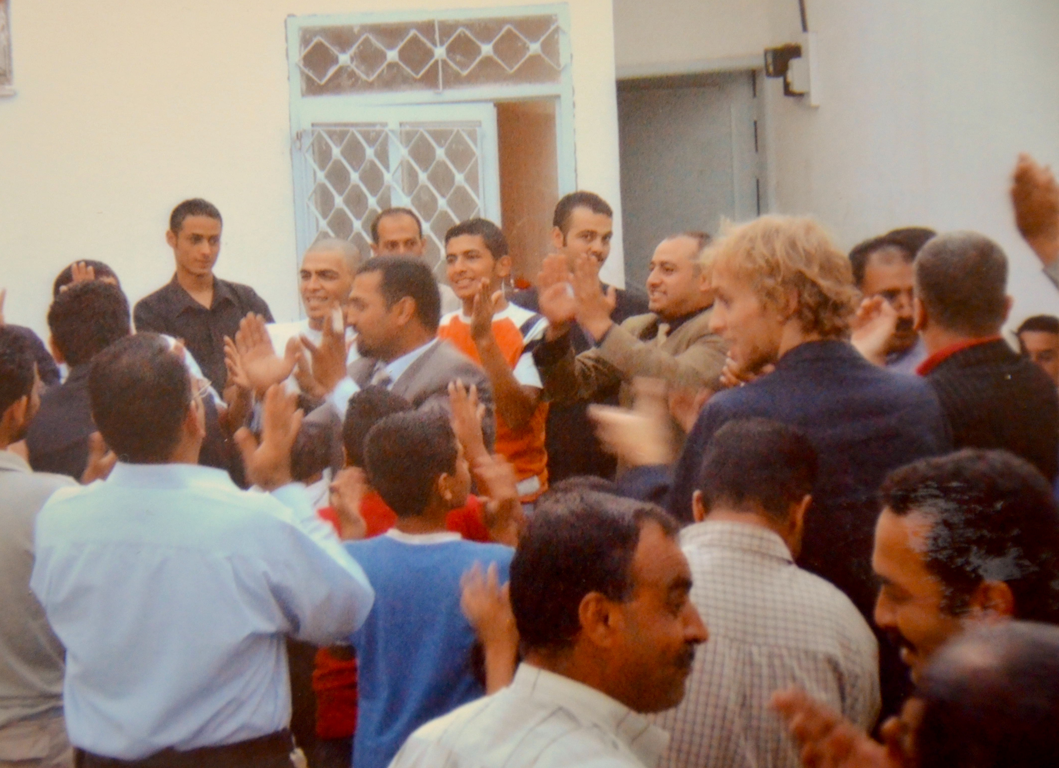
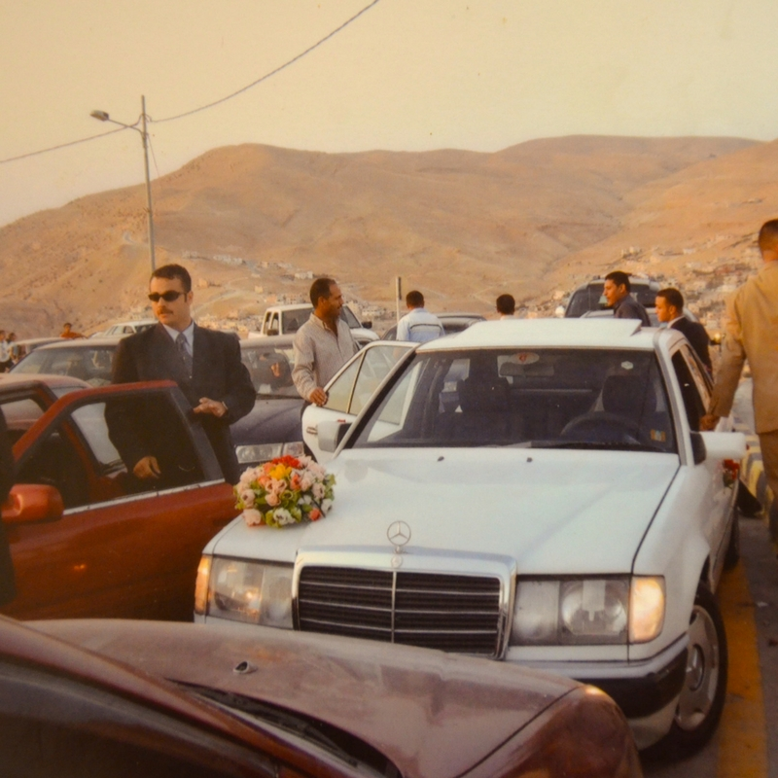
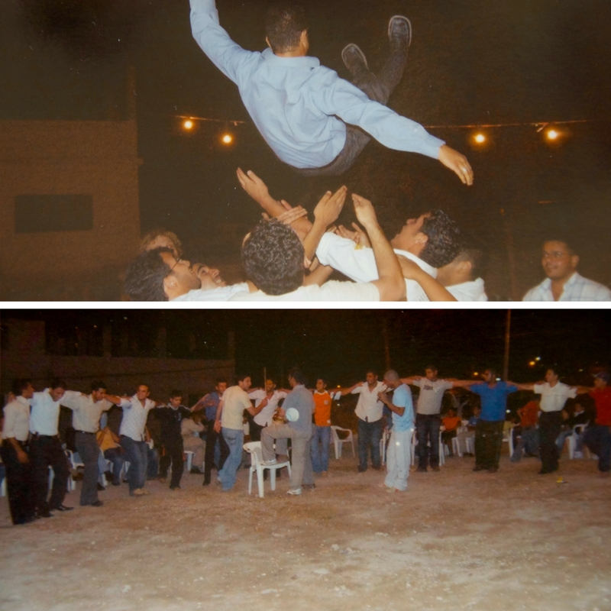
A Tradition of Weddings
While other cultures around the world rush towards half-a-day wedding ceremonies, Jordanians not only have the audacity to host a weeklong wedding party, but they always enjoy every bit of it.
A Jordanian wedding is a several day event consisting of preparations and parties. This is a religious process that’s initiated the moment the woman when asked in front of a witness, agrees to the union proposal. Customs and traditions dictate that this is the first requirement in a Katb Al Kitab or a marriage ceremony.
The party starts at night, when women from the groom’s family go the bride’s house to paint her hands with henna with beautiful designs. The night is traditionally named the henna night.
During the day, the groom’s friends and close relatives thoroughly groom him for his wedding night. The day is traditionally referred to as the groom’s shower night.
The official wedding day. On this day the family of the groom will proceed in a line-up of vehicles to the bride’s home to pick her up. Her father hands his daughter a traditional Bedouin coat also called furwa before she’s taken away.
They are welcomed at the venue by more Arabic music from a traditional band whose main instrument is the drum called tabla. Apart from the excessive cultural dabke dancing the other best thing about a Jordanian wedding is the traditional meat and rice dish known as mansaf.
A traditional Jordanian wedding is a week-long because the events leading up to the wedding party day are culturally relevant; otherwise, it would just be another ceremony. Jordanians are known for cultural inter-marriages thus making each wedding unique and a week is all it takes for two families from different cultures to be united properly.
https://www.eventdone.com/blog/150-jordanian-wedding

