Slide 1
Chris Gardner
“The Pursuit of Happiness”
by Zeina Qudies
6C

Slide 2
Chris Gardner is an American successful businessman and motivational speaker who was born in 1954.
A homeless man who became a multi-millionaire investor.

Slide 3
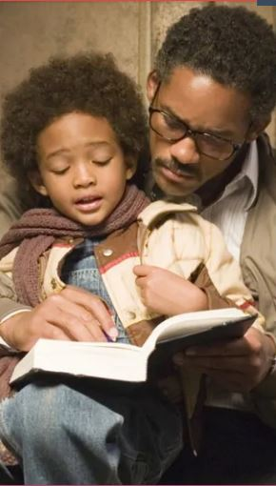
Growing up in a broken family, he didn’t have a stable life with his parents. He didn’t meet his real father until the age of 28. During his mother’s problems, Chris and his sisters were constantly in and out of foster care.
“I went through pain as a child so my children wouldn’t have to. I made a decision as a five-year-old boy that my kids will know who their father is…”

Slide 4
Despite all her problems, his mother was his first source of inspiration. She encouraged Chris to believe in himself and sowed the seeds of self-reliance in him.
After finishing high school, and although he was a bright student, Chris did not have the chance to join any university. He joined the Navy instead. After spending 4 years there, he started his career as a salesman for medical equipment, with a very small salary.
By then, his first child was born, and he was determined on affording a good life for him.
This was his dream.

Slide 5
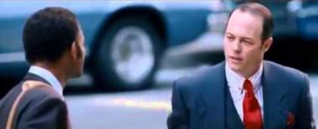
His life changed completely when he met a stockbroker called Bob Bridges who encouraged him that he don’t need a university degree or a previous experience to join this industry that he was interested in. All he needed was a bright mind and a love for numbers to fulfill his dream.
This career became his passion.

Slide 6
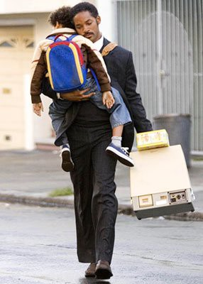
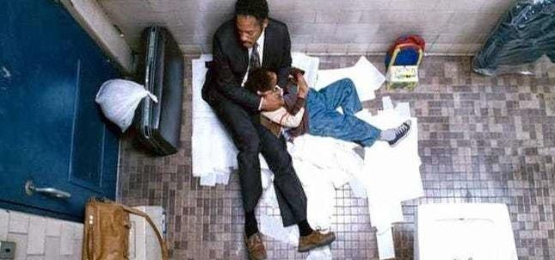
Chris filled an application for a broker company and got an interview appointment.
However, in the days before the interview, Chris and his son became homeless because he could not afford money for renting a house. He even was arrested and jailed for non-payment of parking tickets.

Slide 7
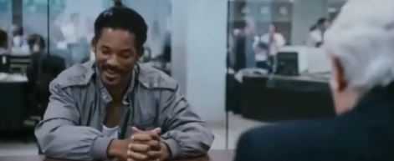
He was ultimately able to make the interview, but only in the clothes he was wearing when he was arrested.
Despite his scruffy appearance, his sense of drive and enthusiasm was enough to get him the training opportunity in the company.

Slide 8
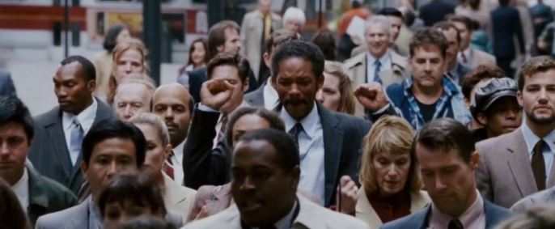
During his training, he worked hard to achieve his goal. His target was to make 200 marketing phone calls a day, so he was the first to arrive and the last to leave. He even stopped drinking water at office to decrease the time spent at the bathroom! At night, he studied hard for the exam intended
for the end of the training.
In 1982, finally after 6 months of training, he passed the exam and was selected for the job. He started his career as a stockbroker.
Chris continued to
pursue his dream.

Slide 9
In 1987, Chris established his investment firm, “Gardner Rich”.
It started in his small apartment, with only a single piece of furniture; a wooden desk that also served as a family dinner table
His business grew, and in 2006, Chris Gardner sold a stake in his brokerage firm in a multi-million dollar deal!

Slide 10
After that, Chris decided to pursue another dream and write his life story, “The Pursuit of Happiness” that was later made a movie.
He reinvented himself as a motivational speaker and author. He now spends 200 days a year travelling the world and speaking about his experience.
“Everyone has a goal, but you’ve got to have a plan to achieve this goal”

