Slide 1
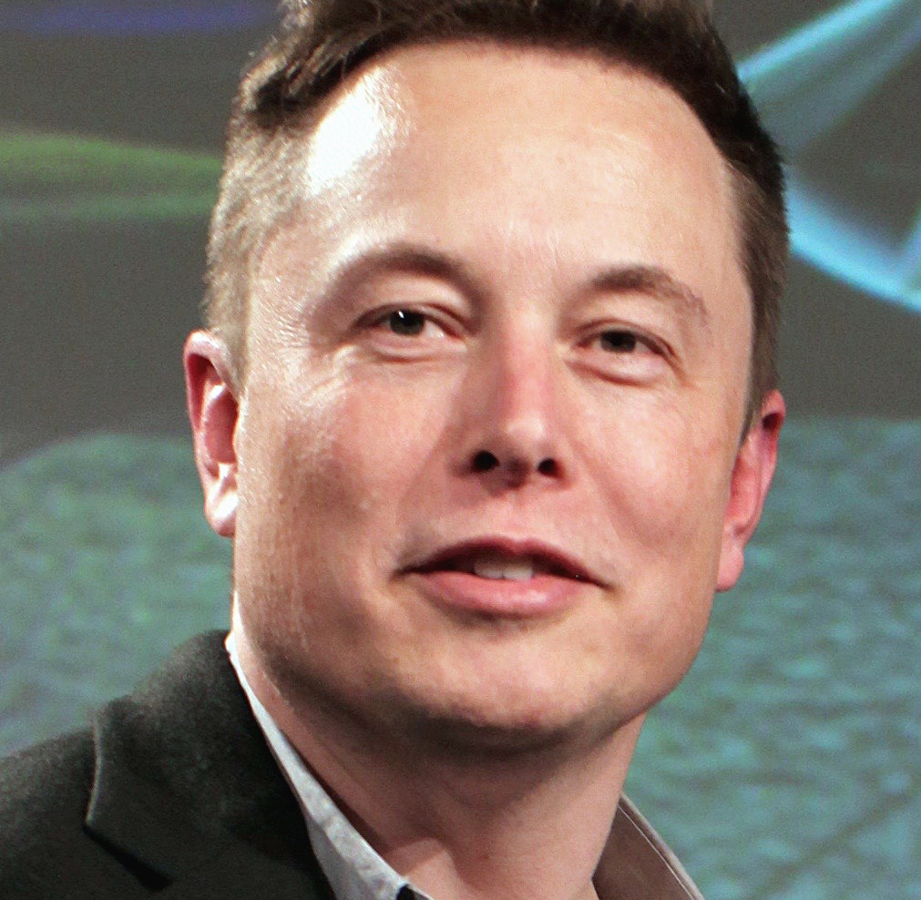
Elon musk
By: Angelina Shamieh
This Photo by Unknown Author is licensed under CC BY-SA

Slide 2
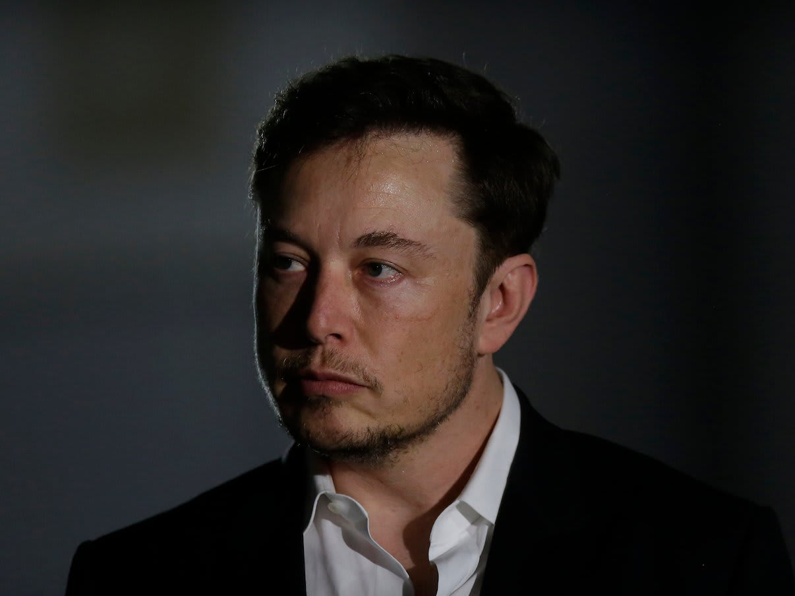
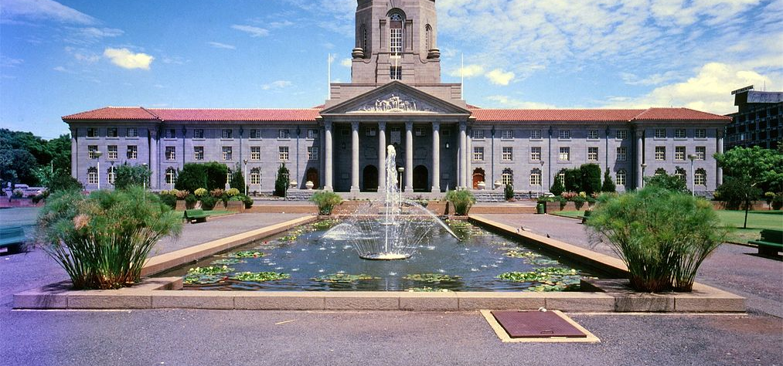
Where was Elon Musk born?
Pretoria, South Africa
Elon Reeve Musk was born on June 28, 1971, in Pretoria, one of the capital cities of South Africa,
and was baptized into an Anglican church. Musk has British and Pennsylvania Dutch ancestry.
His mother is Maye Musk (née Haldeman),
a model and dietitian born in Saskatchewan, Canada and raised in South Africa.
This Photo by Unknown Author is licensed under CC BY-SA
This Photo by Unknown Author is licensed under CC BY-SA-NC

Slide 3
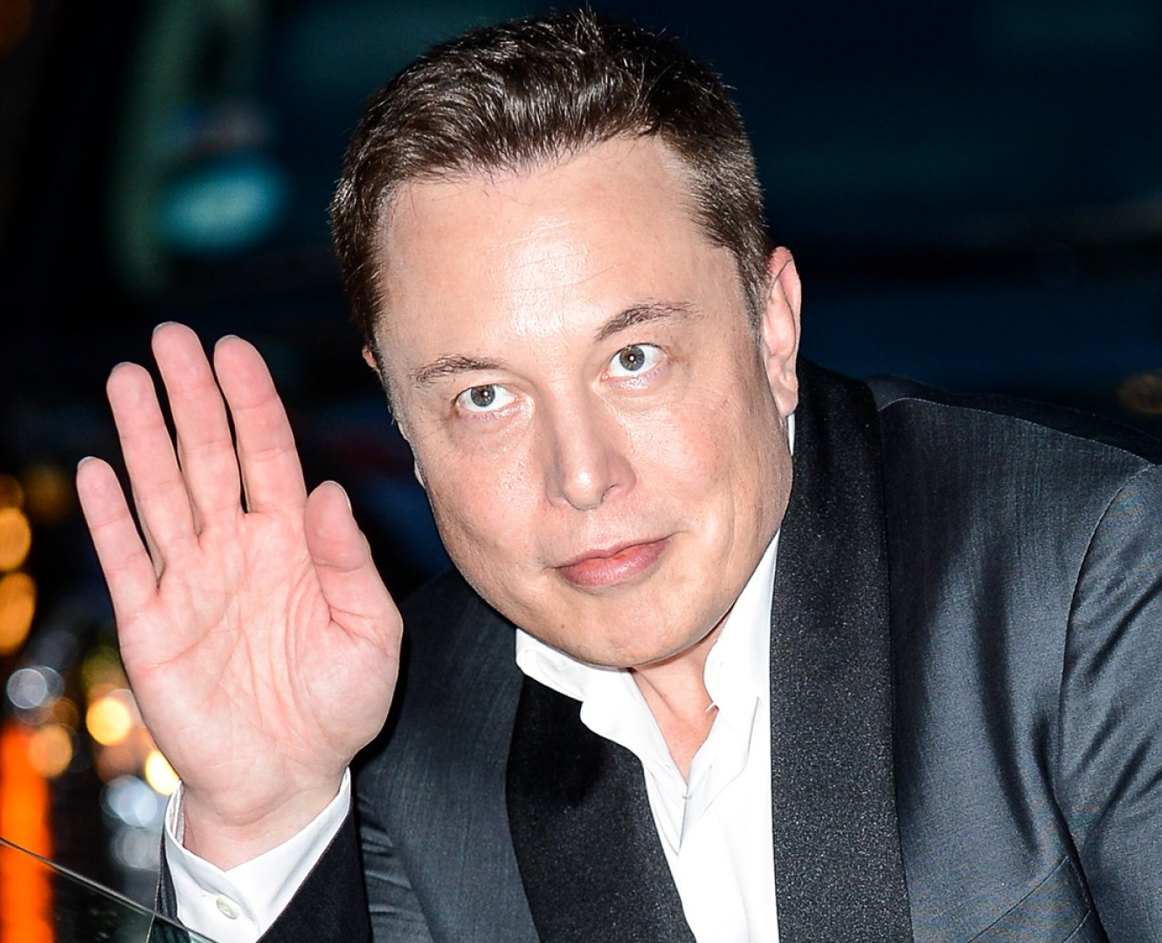
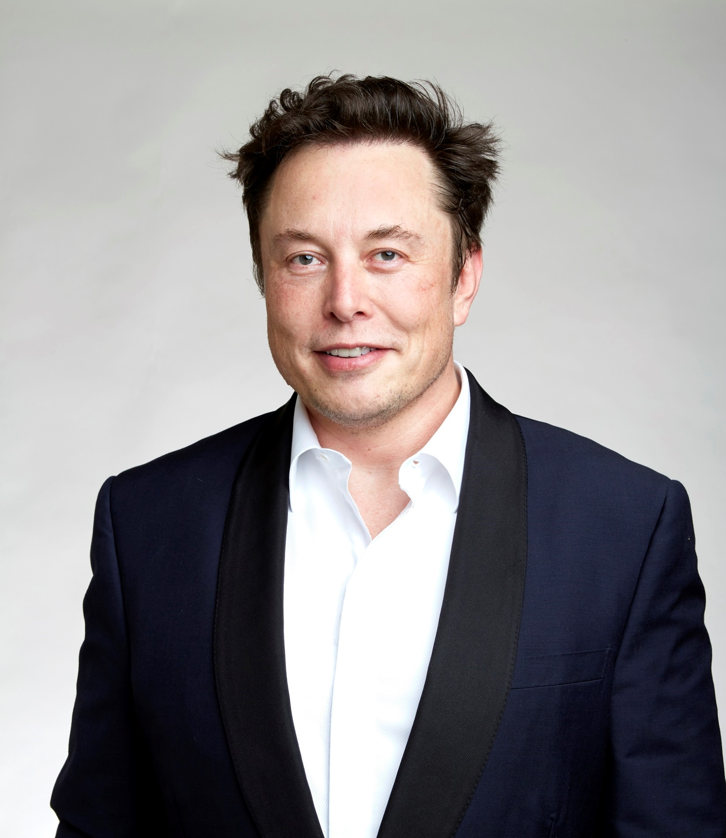
What made Elon Musk successful?
The open mindset of big thinking is one of the prime factors of his success. Elon always had big plans and big dreams. He believes in the fact that big dreams prepare us for a higher level and demand higher work output with different thinking.
This Photo by Unknown Author is licensed under CC BY-NC-ND
This Photo by Unknown Author is licensed under CC BY-SA

Slide 4
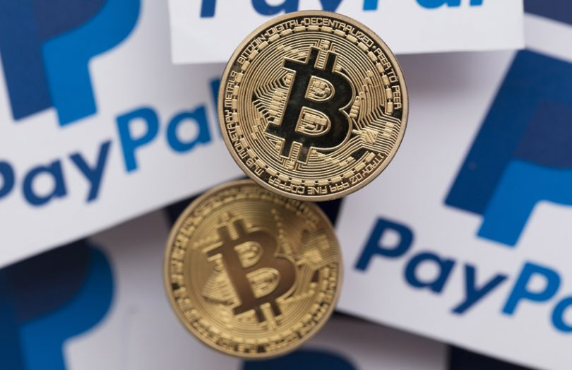
How did Elon Musk start his business?
In 1995 he founded Zip2, a company that provided maps and business directories to online newspapers. In 1999 Zip2 was bought by the computer manufacturer Compaq for $307 million, and Musk then founded an online financial services company, X.com, which later became PayPal, which specialized in transferring money online.
This Photo by Unknown Author is licensed under CC BY-NC-ND

Slide 5
What kept Elon Musk motivated?
During the interview, Musk said a lot of his motivation stems from his teen years as he has always had a deep curiosity in the universe and what it means to exist in it. In past interviews, he's even speculated whether life is a simulation. "I think the 'why' of things is very important," Musk said.
This Photo by Unknown Author is licensed under CC BY-SA-NC

Slide 6
What is Elon Musk dream?
Elon Musk wants to make humans a multiplanetary species. Colonization of Mars has been the main goal of the entrepreneur's multi-billion dollar company SpaceX since its founding two decades ago.
This Photo by Unknown Author is licensed under CC BY

