Slide 1
Larry Ellison
American businessman

Slide 2
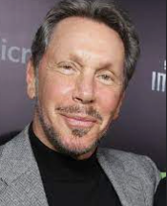
About him
Lawrence Joseph Ellison (born August 17, 1944) is an American business magnate and investor who is the co-founder, executive chairman, chief technology officer (CTO) and former chief executive officer (CEO) of the American computer technology company Oracle Corporation.^{[2]} As of October 2022, he was listed by Bloomberg Billionaires Index as the eleventh-wealthiest person in the world, with an estimated fortune of $83 billion.^{[3]} Ellison is also known for his 98% ownership stake in Lanai, the sixth-largest island in the Hawaiian Archipelago.^{[4]}

Slide 3
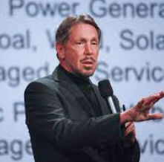
His succeed
Ellison had more success with his early embrace of the Internet. Oracle developed products that were compatible with World Wide Web technologies, which helped the company to grow. In the early 2000s Ellison started Oracle on an aggressive strategy of buying rival software companies

Slide 4
More about his business
Larry Ellison is the founder of Oracle, the software company that created the first commercially viable relational database. Under his leadership, Oracle grew into the largest supplier of database software and the second-largest supplier of business applications in the world.

Slide 5
Done thank u for listening

