Slide 1
Chemistry Homework
By bashar AlKfouf

Slide 2
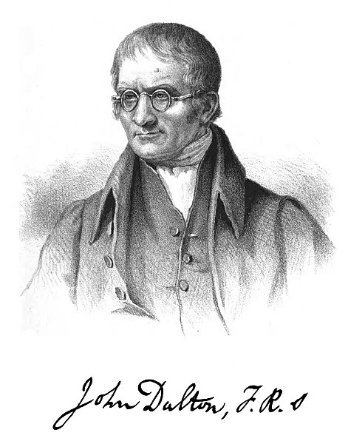
Main points in daltons atomic model
All matter is comprised of tiny, definite particles called atoms.
Atoms are indivisible and indestructible
Atoms of different elements contain different mass.
Atoms of different elements combine in fixed whole-number ratios when forming compounds.
Not all of these concepts were new. Dalton’s theory built strongly upon the work of other scientists, such as Henry Cavendish and Joseph-Louis Proust. His contribution was to combine these ideas into a consistent theory that could be measured and tested. What other chemists proposed, Dalton showed.

Slide 3
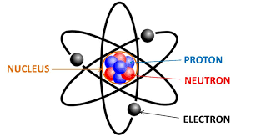
How has the atomic structure changed by time?
Bohr's model (1913)
Niels Bohr improved Rutherford's model. Using mathematical ideas, he showed that electrons occupy shells or energy levels around the nucleus. The Dalton model has changed over time because of the discovery of subatomic particles .
Because more experiments gave more data, theories and models for atoms changed to be more accurate over time.
Rutherford's experiment prompted a change in the atomic model. If the positive alpha particles mostly passed through the foil, but some bounced back. AND if they already knew that the electron was small and negative, then the atom must have a small positive nucleus with the electrons around them.

Slide 4
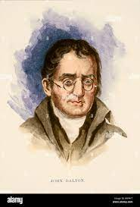
Daltons theory
Dalton hypothesized that the law of conservation of mass and the law of definite proportions could be explained using the idea of atoms. He proposed that all matter is made of tiny indivisible particles called atoms, which he imagined as "solid, massy, hard, impenetrable, movable particle(s)".

Slide 5
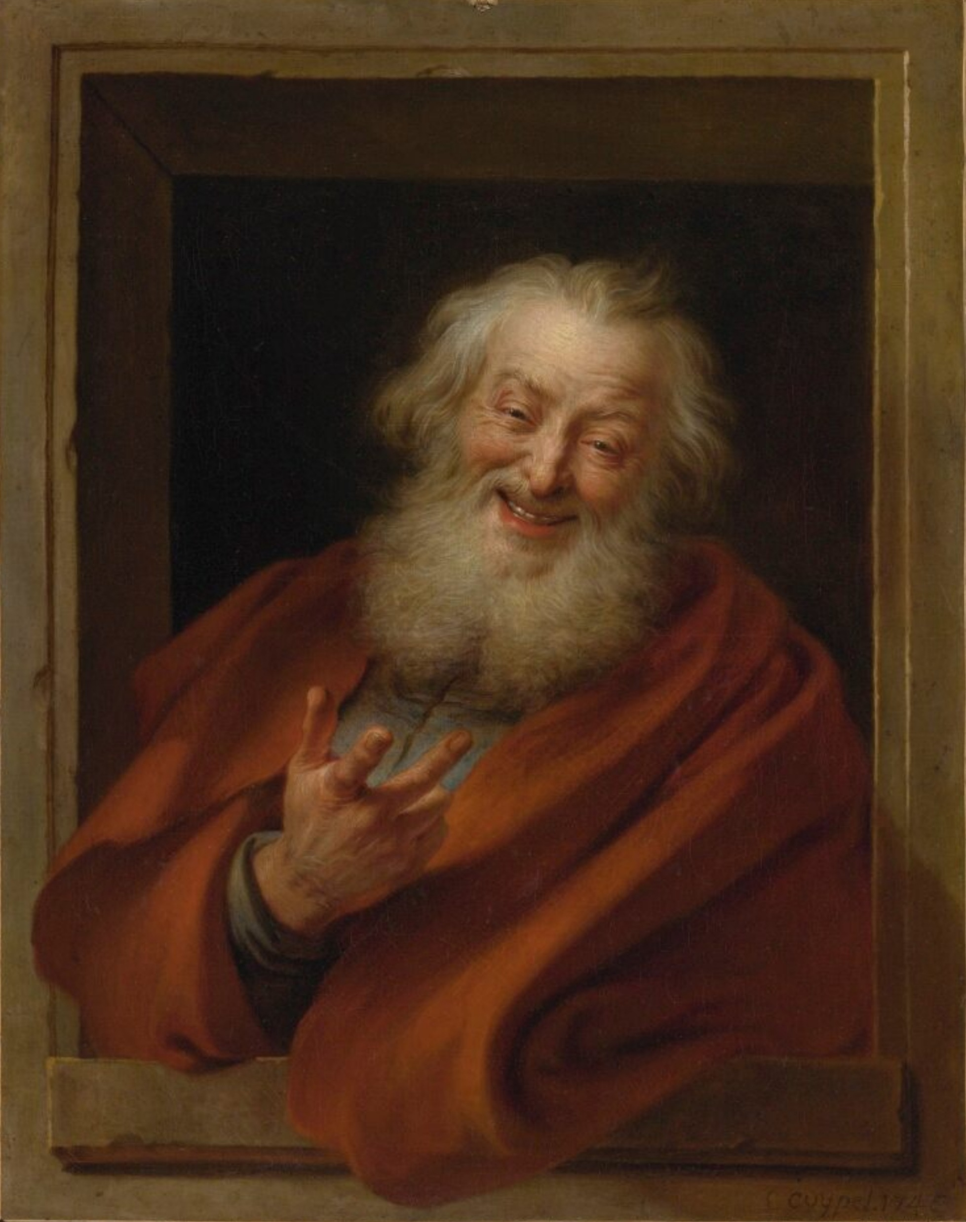
Democritus theory
Democritus believed that atoms were uniform, solid, hard, incompressible, and indestructible and that they moved in infinite numbers through empty space until stopped. Differences in atomic shape and size determined the various properties of
matter.

Slide 6
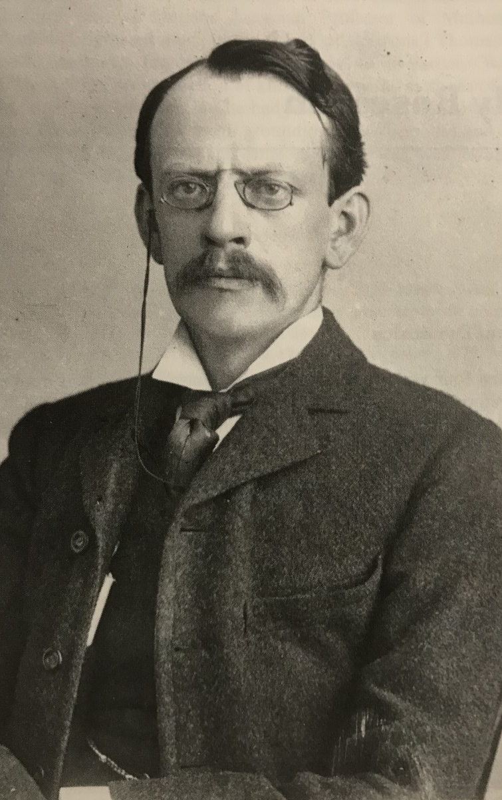
Thomson's Theory
According to Thomson's atomic model, an atom is made up of a positively charged sphere into which negatively charged electrons are implanted. Because electrons and protons have the same magnitude, an atom as a whole is
electrically neutral.

Slide 7
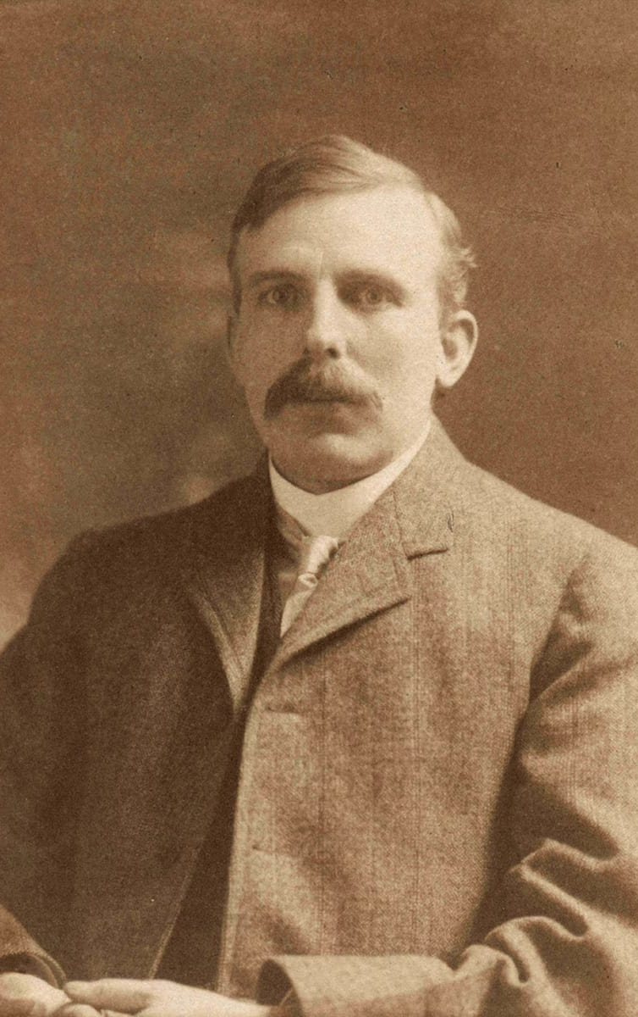
Rutherford's Theory
Rutherford's model proposed that the negatively charged electrons surround the nucleus of an atom. He also claimed that the electrons surrounding the nucleus revolve around it with very high speed in circular paths. He named these circular paths as orbits.
Ernest Rutherford found that the atom is mostly empty space, with nearly all of its mass concentrated in a tiny central nucleus. The nucleus is positively charged and surrounded at a great distance by the negatively charged electrons.

