Slide 1
Chemistry Homework
By bashar AlKfouf

Slide 2
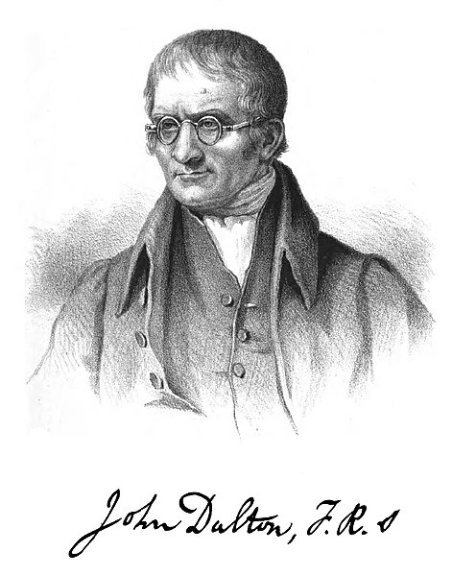
Main points in daltons atomic model
All matter is comprised of tiny, definite particles called atoms.
Atoms are indivisible and indestructible
Atoms of different elements contain different mass.
Atoms of different elements combine in fixed whole-number ratios when forming compounds.
Not all of these concepts were new. Dalton’s theory built strongly upon the work of other scientists, such as Henry Cavendish and Joseph-Louis Proust. His contribution was to combine these ideas into a consistent theory that could be measured and tested. What other chemists proposed, Dalton showed.

Slide 3
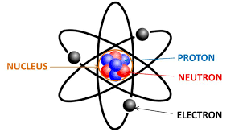
How has the atomic structure changed by time?
Bohr's model (1913)
Niels Bohr improved Rutherford's model. Using mathematical ideas, he showed that electrons occupy shells or energy levels around the nucleus. The Dalton model has changed over time because of the discovery of subatomic particles .
Because more experiments gave more data, theories and models for atoms changed to be more accurate over time.
Rutherford's experiment prompted a change in the atomic model. If the positive alpha particles mostly passed through the foil, but some bounced back. AND if they already knew that the electron was small and negative, then the atom must have a small positive nucleus with the electrons around them.

