Slide 1
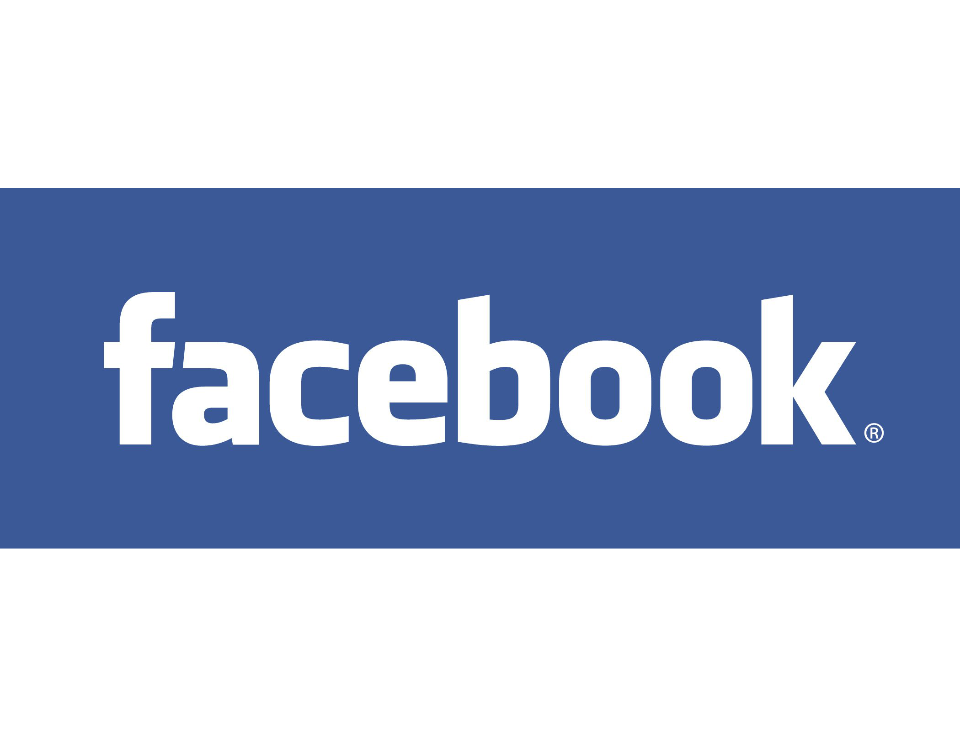
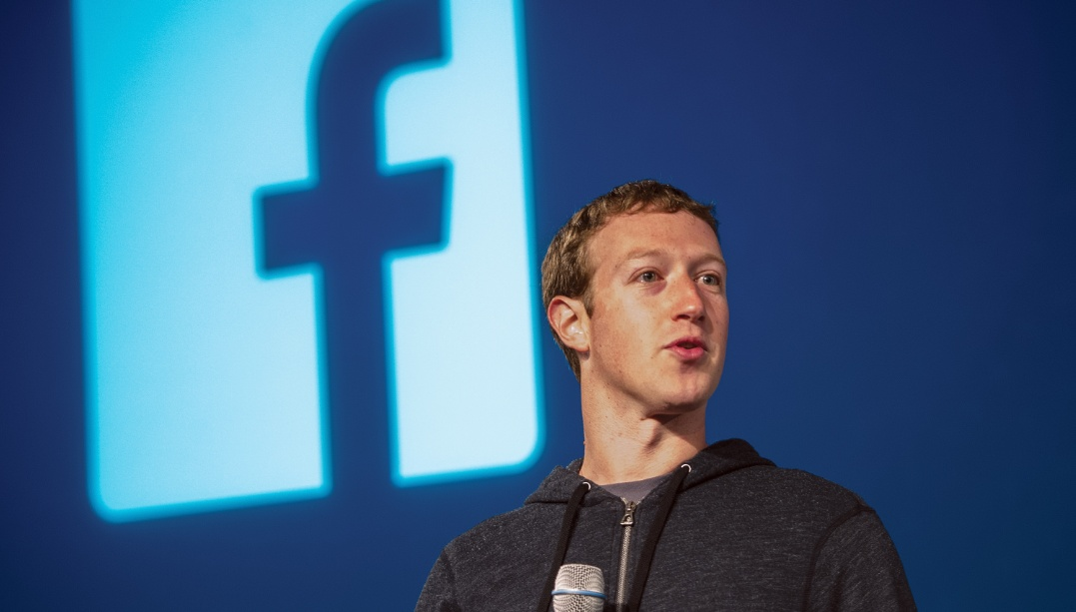
Mark Zuckerberg
By Joseph
This Photo by Unknown Author is licensed under CC BY-SA

Slide 2
The Origin of Facebook
In 2003, Zuckerberg, a second-year student at Harvard, wrote the software for a website called Facemash. He put his computer science skills to questionable use by hacking into Harvard's security network, where he copied the student ID images used by the dormitories and used them to populate his new website. Website visitors could use Zuckerberg's site to compare two student photos side-by-side and determine who was "hot" and who was "not."
Facemash opened on October 28, 2003—and closed a few days later, after it was shut down by Harvard execs. In the aftermath, Zuckerberg faced serious charges of breach of security, violating copyrights, and violating individual privacy. Though he faced expulsion from Harvard for his actions, all charges against him were eventually dropped.

Slide 3
TheFacebook: An App for Harvard Students
On February 4, 2004, Zuckerberg launched a new website called TheFacebook. He named the site after the directories that were handed out to university students to help them to get to know one another better. Six days later, he got into trouble again when Harvard seniors Cameron Winklevoss, Tyler Winklevoss, and Divya Narendra accused him of stealing their ideas for an intended social networking website called HarvardConnection. The claimants later filed a lawsuit against Zuckerberg, however, the matter was eventually settled out of court.

Slide 4
Membership to the website was at first restricted to Harvard students. Over time, Zuckerberg enlisted a few of his fellow students to help grow the website. Eduardo Saverin, for example, worked on the business end while Dustin Moskovitz was brought on as a programmer. Andrew McCollum served as the site's graphic artist and Chris Hughes became the de facto spokesperson. Together the team expanded the site to additional universities and colleges.

Slide 5
Facebook: The World's Most Popular Social Network
In 2004, Napster founder and angel investor Sean Parker became the company's president. The company changed the site's name from TheFacebook to just Facebook after purchasing the domain name facebook.com in 2005 for $200,000.
Zuckerberg's antics and the site's profits eventually led to him becoming the world's youngest multi-billionaire, he's done his part to spread the wealth around. In 2010, he signed a pledge, along with other wealthy businessmen, to donate at least half of his wealth to charity. Zuckerberg and his wife, Priscilla Chan, have donated $25 million toward fighting the Ebola virus3﻿ and announced that they would contribute 99% of their Facebook shares to the Chan Zuckerberg Initiative to improve lives through education, health, scientific research, and energy.

