Slide 1
The rise of microsoft
A story of William henry bill gates

Slide 2
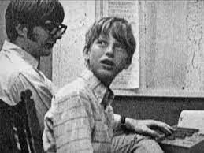
The humble beginning
William henry bill gates was born in 1955 in Seattle Washington, and he was just a normal kid also he was being educated in lakeside school witch was a private school that had the latest educational techonolgies over there he befriended paul allen, who is the co founder of Microsoft,both were interested in computers and programing

Slide 3
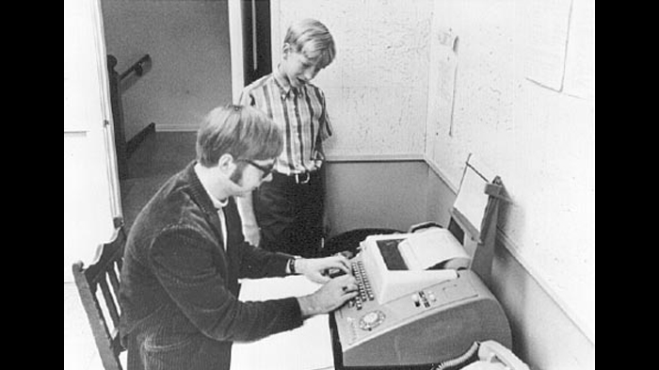
The first project
Bill gates had an intrest in programing the ge system in basic when he was just 13 years old also he wrote it on a computer witch was in fact an implementation of tic-tac-toe that allows the person to play games with the computer

Slide 4
The education rise
Bill gates was inrolled with Harvard witch is a university located in Massachusetts in the northeastern united states in 1973 after he graduated from Lakewood he got a scholarship ,and he scored a shocking 1590 out of 1600 on S.A.T. his dad told him to study pre-law ,but after a while he decided to switch to computer science and programming

Slide 5
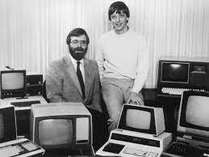
The job with mits
Bill gates signed up for a job at mits witch was a computer manufacture that recently released the altair 8800,and then bill gates started his journey,he also dropped out because he was planning on making a new software project called micro-soft

Slide 6
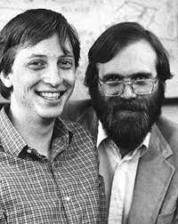
The founding of microsoft
Gates and allen registered the trademark “Microsoft” in 1976,gates wrote an open letter to computer hobbyists condemning the early adopters for sharing rather than paying for software

Slide 7
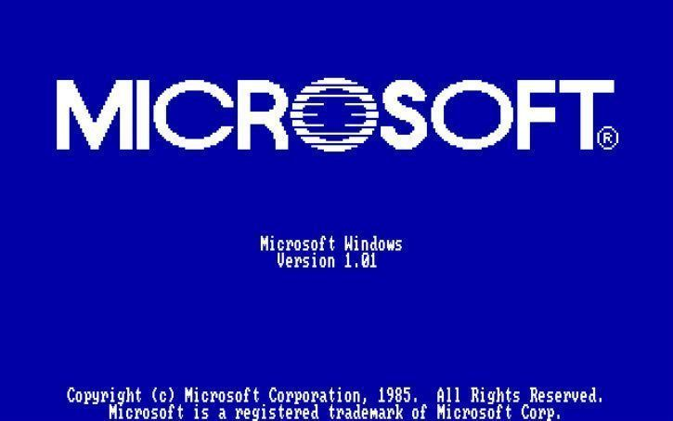
The OS 1 project
In 1985 Microsoft teamed up with IBM to program windows 1.0,windows 1.0 was supposed to go on the ibm personal computer for office,although windows 1.0 wasn’t that popular because at that time many computers didn’t handle the operating system due to the requirements your computer has to follow

Slide 8
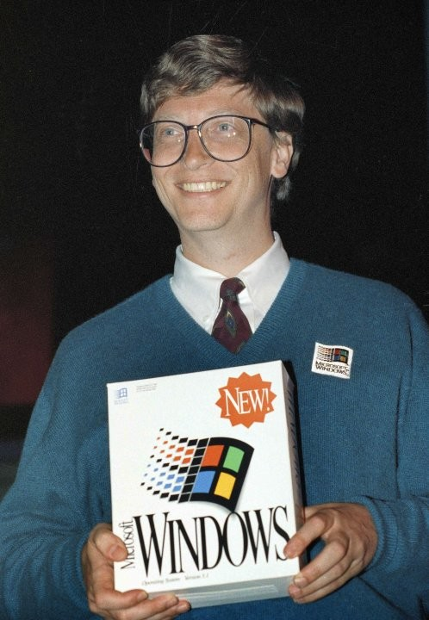
The operating system rise
In 1987 and 1991 Microsoft realeased windows 2.0 and 3.0 and 3.1 these operating systems were more popular that windows 1.0 because they had office products like excel and word also 3.0 and 3.1 had an NT version wich means that people don’t need to use D.O.S witch had the 9x kernel witch was used to make windows 9x systems run

Slide 9
The beginning of the CD age
Also bill gates realeased windows 98 and ME windows 98 was meant for buissneses and home use but ME was a different story the OS was very buggy and crashed a lot so it didn’t sell well but the OS that many of our parents used witch is windows xp or experiance
Bill gates wanted to make windows more simple and efficient and also make plug and play hardware changes so Microsoft programed windows 95 a revolution , windows 95 was very successful and bringing a wopping 246 million dollars

Slide 10
conclusion
at the end bill gates is just a normal person like you and me and bill gates today is 66 years old and he owns Microsoft the biggest tech and software company in the world and he is also a author, a business magnate and a philanthropist and sadly paul allen sadly passed away in 2019 and his passion was his passion for computers and confidence in his abilities while young
I hope you enjoyed this big presentation about bill gates I hope you all have a good day ☺

