Slide 1
Bill gates
By:Sadeen AbuHazeem

Slide 2
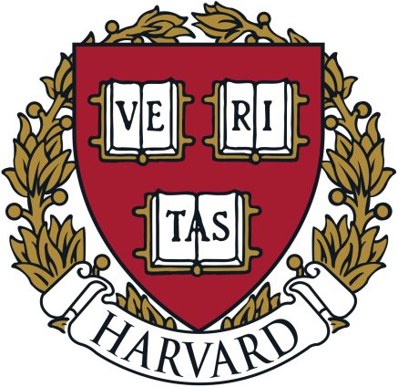
Inspirational story of bill gates
Bill gates is an American business magnate, software developer, investor, author, and philanthropist. When bill gates was a kid he used to get bullied, as in high school his original plan was to be a math teacher. that was until his friend Paul Allen convinced him to continue a career in computer programming , so bill gates took his advice and created his first computer program about tic-tac-toe at the age of just 13. However his parents weren't happy because they had other plans for their children as they wanted him to pursue a law career, and he didn’t want to make his parents upset so he went to Harvard to study law. As in time he found himself spending more time on the computer than on class that was because he was really happy when he was coding and law was not something that excited him, later on he dropped out of Harvard to pursue his dreams.

Slide 3
Bill gates programs and success
After bill gates dropped out he went on with his dream and he formed Microsoft with his childhood friend Paul Allen but not everything was going perfect, at first the company was struggling financially and some of their big clients went bankrupt. So bill gates faced many challenges on his path to success. One of those were windows 1.0 . Bill gates predicted that after the release windows will be running on 90% of all computers but he was wrong windows was received poorly and only 10% of computers ended up using it and he wasn’t expecting that he was very disappointed. After two years of hard work, windows 2 was released big innovations were included, Microsoft word and excel were presented for the first time. Windows became a huge success finally 90% of computers were using it and bill gates become a billionaire at the age of 31, and only 8 years later he became the richest man in the world . Trough the bill & melinda gates foundation he has donated more than 45 billion dollars. Bill gates is one of the most successful people in the world and there could be a lot learned from his success story

