Slide 1
How do people start a business
Celina Akkawi 6F

Slide 2
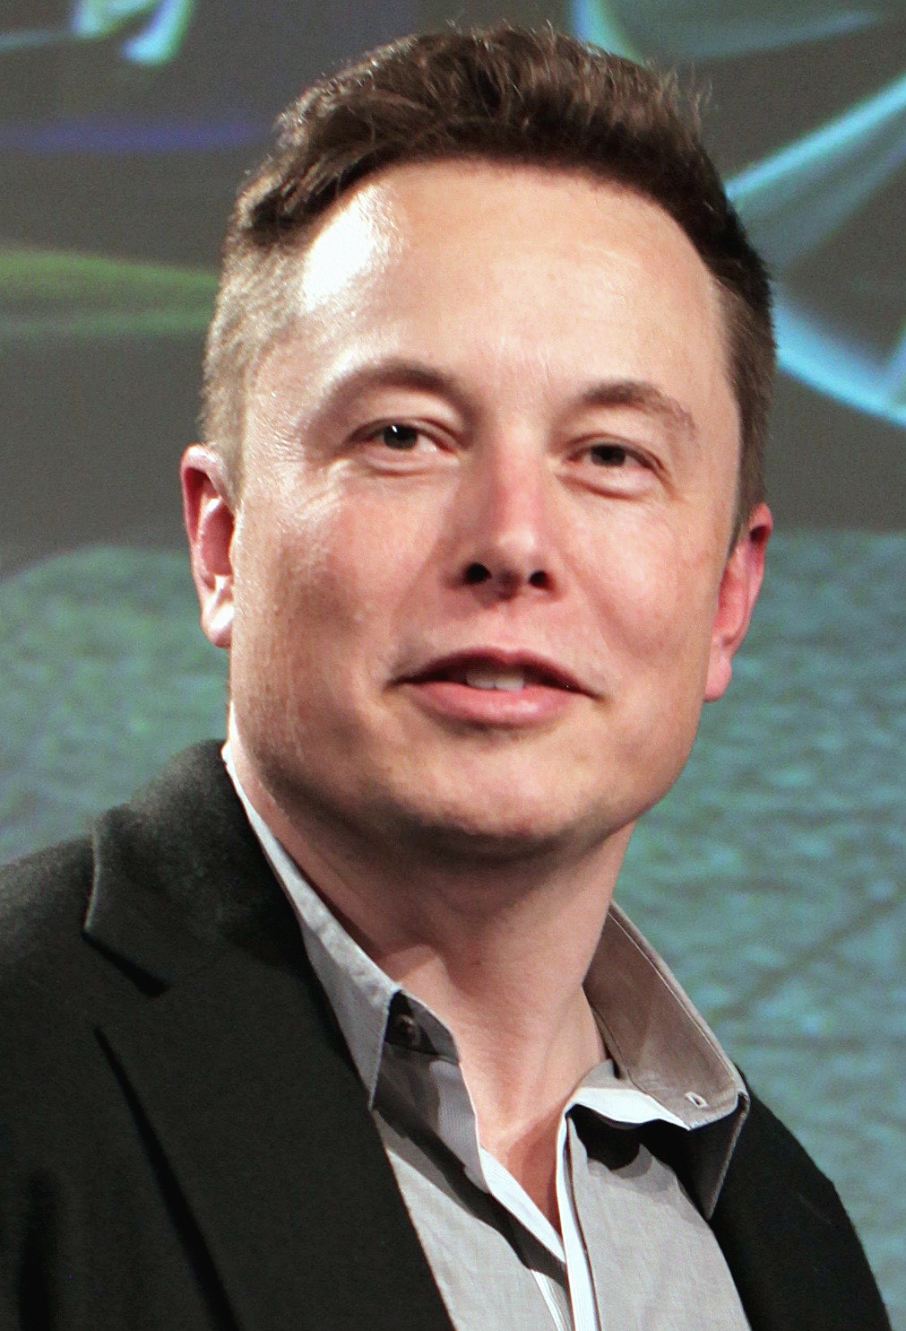
Elon musk
A south-african-canadian-american bussiness man
This Photo by Unknown Author is licensed under CC BY-SA

Slide 3
His passion
Elon had a great passion for computers right from childhood.
He dropped out of Stanford University two days after enrolling for his Ph. D. in energy Physics
He believed that the internet had greater potential to impact the world
He achieved great results in the world of technology

Slide 4
His acheivements
Co-founder of PayPal
Founder of Tesla Motors the electric car company that is changing the world
Founder of Space X, which is focused on space exploration and space travel

Slide 5
How he started
In 1995 Elon founded Zip2 , a company that provided maps and business directories to online newspapers.
In 1999 Compaq bought Zip2 for $307 million
Musk then founded an online services company called X.com, which later became PayPal, which is specialized in transferring money online.

