Slide 1
TIME LINE POSTER
Done By Adam
7F

Slide 2
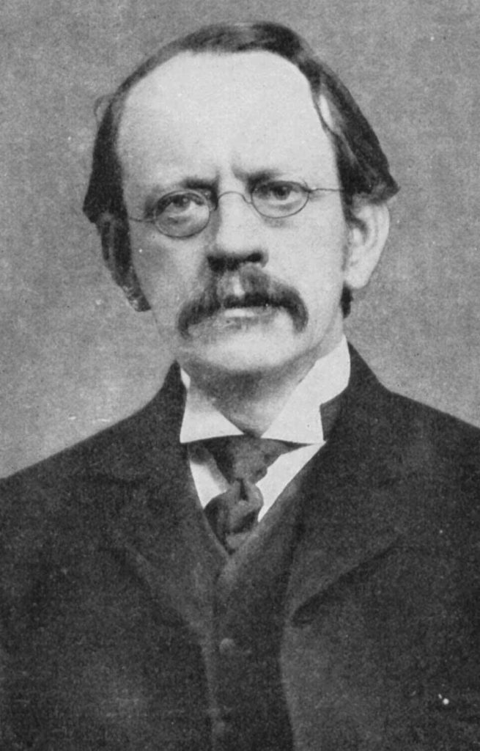
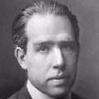
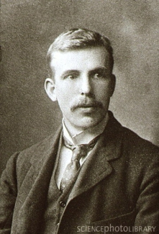
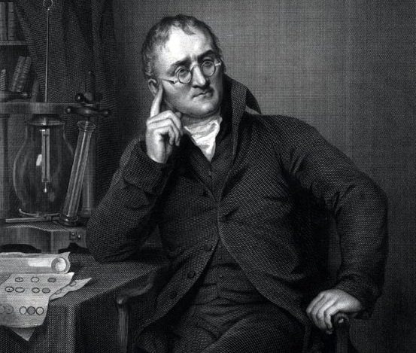
TIMELINE OF A ATOMIC MODEL
Democritus
John Dalton
J.J. Thomson
Niels Bohr
Ernest Rutherford
460-370 BC
1766-1844
1856-1940
1885-1962
1871-1937

