Slide 1
Horacio Pagini

Slide 2
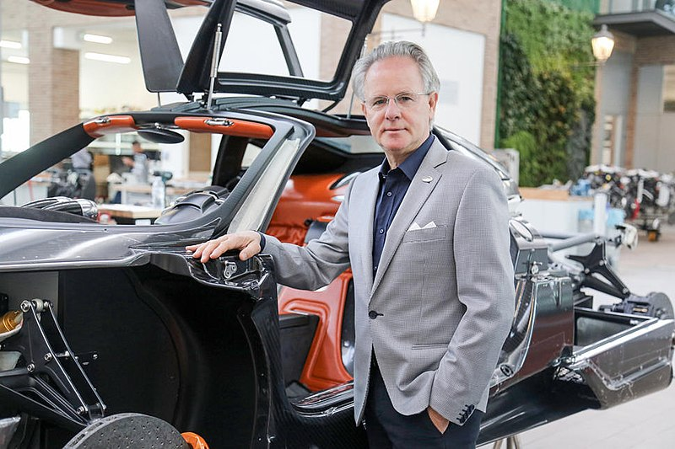
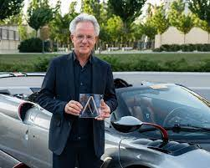
Horacio Pagini is an Argentine-Italian businessman and engineer in the automotive industry. He is the founder of Pagani Automobili S.p.A., an Italian specialty auto-maker. Born 10th of November 1955 in Casilida, Argentina. Before Horacio founded Pagini, he worked in Renault and Lamborghini so he had experience before starting his own motorsport company.

Slide 3
Pagani took an interest in engineering while still living in Argentina. However, he felt from the beginning that the rural town in which he was born in would not be adequate for the engineering career he dreamed of. He opened a small shop where he worked at a very young age, gaining valuable experience in craftsmanship. At the age of 20, Pagani had designed and built his first F3 racer. The turning point in Pagani's life came when he was hired by Renault to improve the body of a racing car. His work offered staggering improvements and Pagani was able to showcase his talent. After having success on this small scale, Pagani visited Lamborghini and met with the company's chief technical director Giulio Alfieri. In 1982, he decided to move to Italy and he was hired by Lamborghini. Pagani began working basic jobs such as sweeping the floor, however he was able to work his way up the company.

Slide 4
The turning point in Pagani's life came when he was hired by Renault to improve the body of a racing car. His work offered staggering improvements and Pagani was able to showcase his talent. After having success on this small scale, Pagani visited Lamborghini and met with the company's chief technical director Giulio Alfieri. In 1982, he decided to move to Italy and he was hired by Lamborghini. Pagani began working basic jobs such as sweeping the floor, however he was able to work his way up the company.

Slide 5
He was a chief engineer at Lamborghini and he built the Countach Evoluzione concept. He tried to persuade Lamborghini to buy an autoclave so they could extend the production of the carbon parts for the Evoluzione. They refused, saying that Ferrari did not have an autoclave, so Lamborghini didn't need one. Pagani borrowed the capital to buy his own autoclave late in 1987 and then, in 1991, he broke away from the company and founded his own consultancy called Modena Design which continues to make carbon fiber composites for Formula One cars and clients like Daimler, Ferrari and Aprilia.

Slide 6
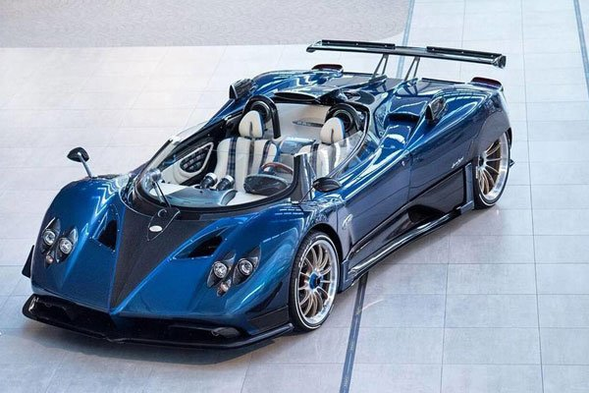
Pagani Automobili Modena was founded by Pagani in 1992. The first car he produced was the Zonda, which took seven years to complete, followed by the Huayra, named after Huayra-tata, the god of the wind in Incan Culture.

