Slide 1
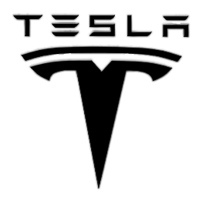
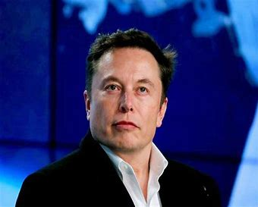
ELON MUSK June 28, 1971
by
Michael madanat

Slide 2
The billionaire entrepreneur Musk has dual nationality between South Africa and Canada. His father is a South African and his mother a Canadian. He spent his childhood in South Africa and later years in Canada.
This is How Elon Musk Gets his Start
After he got a seat in Ph.D. in Applied Physics at Stanford University which is very prestigious but he dropped out just after two days to start a new company. He and his brother borrowed $28000 from their father and launched a company called Zip2. To save rent and other expenses he used to sleep in his company office and took showers in a near gym. Four years later they sold their company to Compaq for $307 million in cash and $34 million in stock, this is how Elon Musk gets his start he received $22 million for his 7% stake from the sale.
Later he started another company called X.com and it merged with its competitor and turned into PayPal where he got fired as CEO. Later eBay acquired it for $1.5 billion. This is where Elon Musk got rich, he got $165 million from the deal.

Slide 3
From Ordinary Story to Success Story
At that time Electric cars are considered to be slow and ugly but a company called Tesla wants to change it, but while they are in a position of bankrupt Elon Musk invested $80 million on Tesla Motors and became its CEO.
At first, it is a failure, cars are very priced, TV shows like Top Gear brought a lot of negativity to the brand but Elon Musk fights back. He took precision care and took some bold decisions like firing some of the employees and even its co-founder and by actively participating in that company’s innovation and decision making he made the company a car giant. Even our Prime Minister Narendra Modi also visited his factory. Now they are manufacturing Tesla Roadster 2.0 which is the world’s fastest car ever. now if anyone heard the word “electric car” chances are they are thinking of Tesla mostly like it has no opposition. Tesla is now ruling the electric car market unanimously.
Same in the case of SpaceX, at the beginning it was a failure, they tried to launch their first rocket but failed to reach the orbit three times, for every failure it costs millions of dollars. If there had another failure, Elon Musk might lose all his money at that time. But on their fourth attempt the project got succeeded, At that time they got a deal from NASA and from henceforth there is no turning back. They are the first private company to send a spacecraft to International Space Station. Elon Musk taught himself Rocket Science, as he taught himself programming at the age of 12, for him, it’s just a Rocket Science.

Slide 4
He never gives up. Once in an interview, he said “My mentality is that of a samurai. I would rather commit seppuku than fail.”Japanese samurais won’t let their enemies kill them if they can’t win a battle they will kill themselves with their blade. This “never give up attitude” brought him immeasurable success. Not only that but also he is a hard worker, He works 80-100 hours a week. This 46-year-old Business Magnet is the partial inspiration for the movie character “Iron Man” played by Robert Downey Jr. He is a stutterer, he stutters a lot while he is speaking, but the crowd usually laughs and wait for him to speak. If you’re successful, people will ignore your shortcomings.

