Slide 1
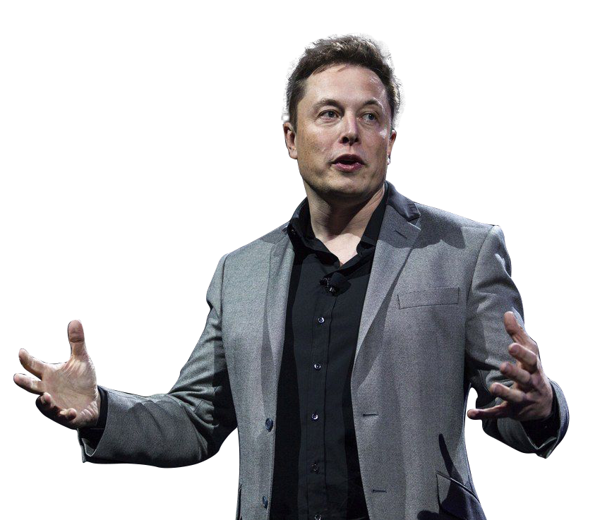
ELON MUSK
Samir Malky – 7G

Slide 2
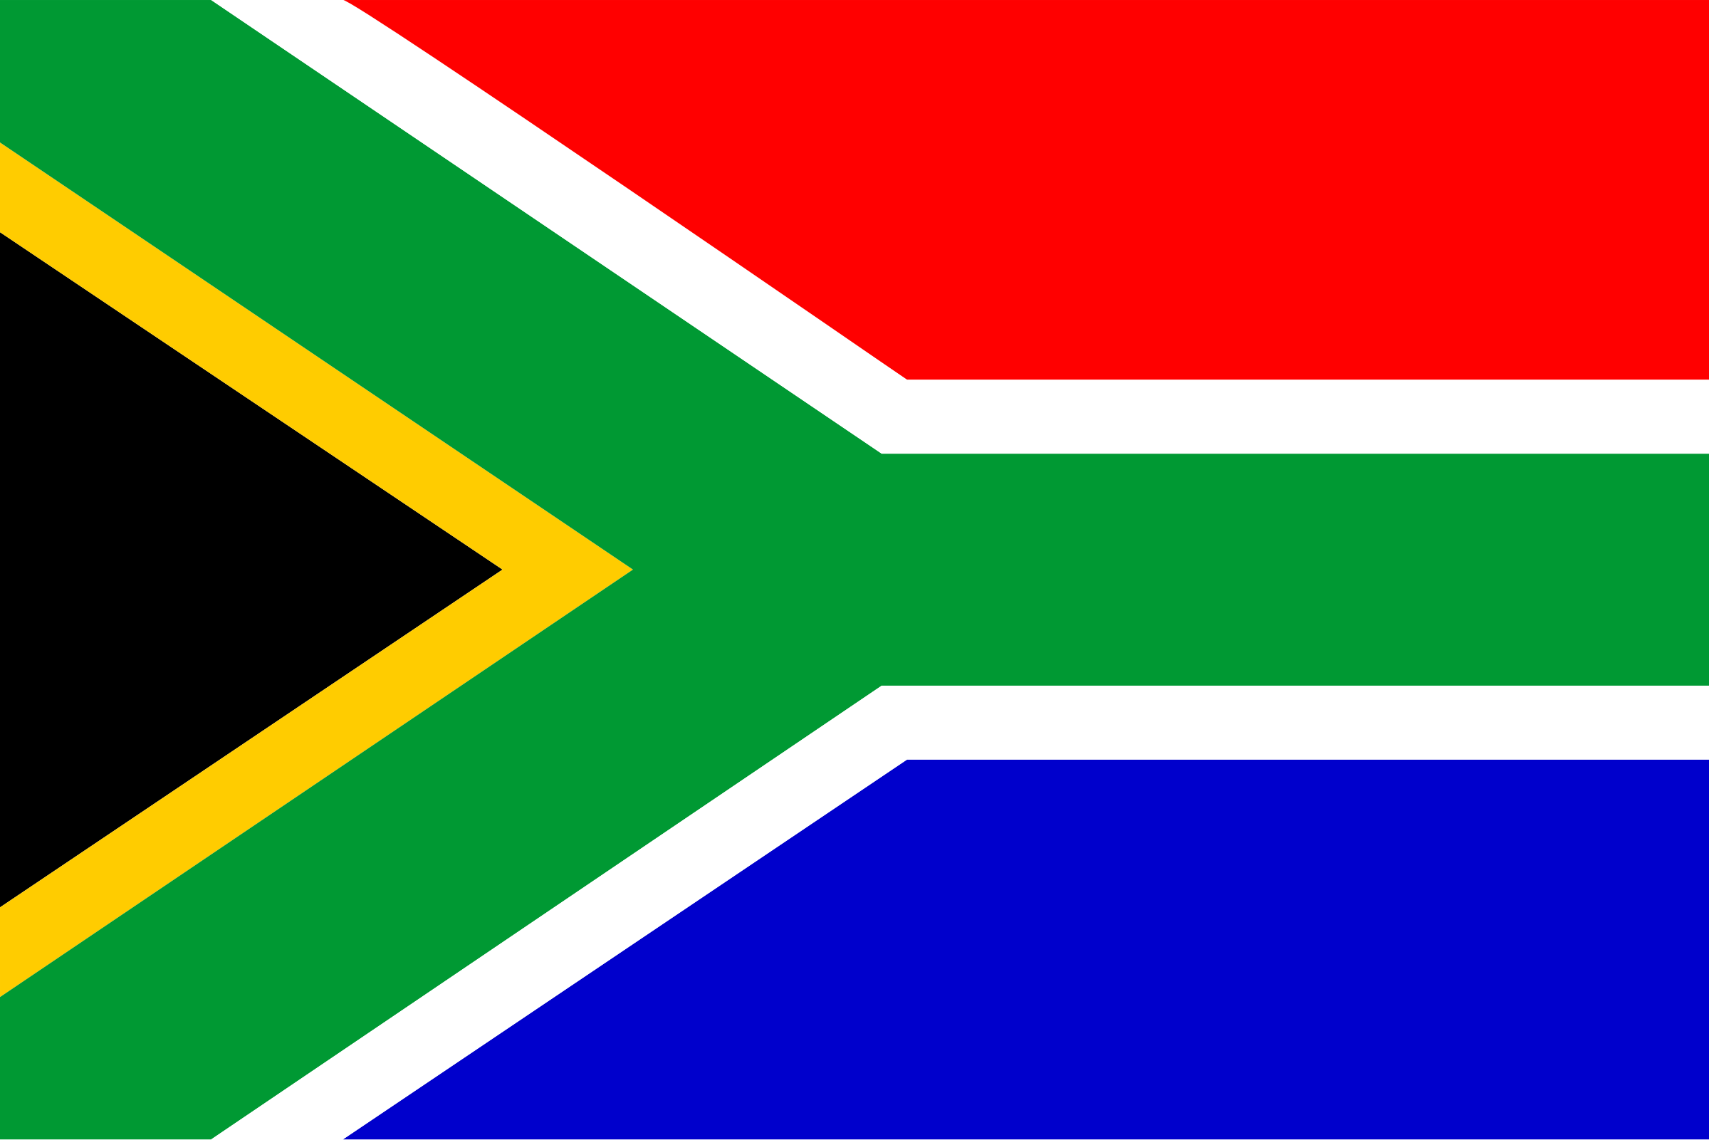
Elon Musk was born in South Africa in 1971. From a young age, Musk became a fan of Isaac Asimov ‘a Russian-born American writer and professor of biochemistry at Boston University’s’ books, gradually inspiring his interest in futurism. In 1997, Musk graduated from the University of Pennsylvania with a Bachelor of Science degree in economics and a Bachelor of Arts degree in physics, having transferred from Queen’s University in Kingston, Ontario. Musk financed his own university education, through a combination of scholarships, loans, and working two jobs alongside his studies.

Slide 3
Elon Musk was born in South Africa in 1971. From a young age, Musk became a fan of Isaac Asimov ‘a Russian-born American writer and professor of biochemistry at Boston University’s’ books, gradually inspiring his interest in futurism. In 1997, Musk graduated from the University of Pennsylvania with a Bachelor of Science degree in economics and a Bachelor of Arts degree in physics, having transferred from Queen’s University in Kingston, Ontario. Musk financed his own university education, through a combination of scholarships, loans, and working two jobs alongside his studies.

Slide 4
After graduating, Musk moved on to a PhD programme at Stanford but made the decision to drop out just two days after the programme began to pursue his entrepreneurial visions. Zip2 was a company that provided online city guide software to newspapers, founded by Musk, his brother, and a friend. Despite its eventual success, the company took time to get off the ground and, in the interim, Musk struggled financially. He found himself sleeping on the couch in their startup’s office and had to shower and use the restroom facilities at his local YMCA.

Slide 5
After graduating, Musk moved on to a PhD programme at Stanford but made the decision to drop out just two days after the programme began to pursue his entrepreneurial visions. Zip2 was a company that provided online city guide software to newspapers, founded by Musk, his brother, and a friend. Despite its eventual success, the company took time to get off the ground and, in the interim, Musk struggled financially. He found himself sleeping on the couch in their startup’s office and had to shower and use the restroom facilities at his local YMCA.

Slide 6
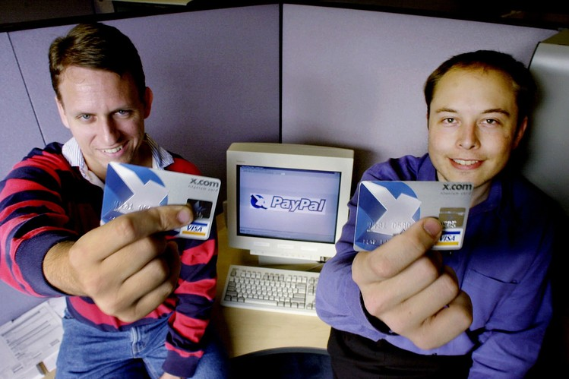
However, despite the lows of the Zip2 endeavour, the trio soon enough found angel investors who backed the company as well as clients in the city. Various big-name news publishing companies such as the New York Times and the Chicago Tribune saw promise in the startup and its useful city guide mapping software. Elon Musk’s first-ever entrepreneurial venture sold for $307 million in 1999, earning him $22 million for his 7% share in the company when he was just 27-years-old.

Slide 7
However, despite the lows of the Zip2 endeavour, the trio soon enough found angel investors who backed the company as well as clients in the city. Various big-name news publishing companies such as the New York Times and the Chicago Tribune saw promise in the startup and its useful city guide mapping software. Elon Musk’s first-ever entrepreneurial venture sold for $307 million in 1999, earning him $22 million for his 7% share in the company when he was just 27-years-old.

Slide 8
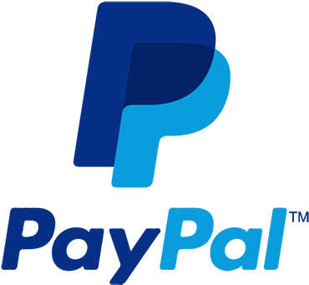
Following the success of Zip2, Musk went on to invest the bulk of his earnings into his next venture, financial services company X.com, which he founded alongside Harris Fricker, Ed Ho, and Christopher Payne in 1999.
X.com was one of the world’s first online banks and deposits were insured by the Federal Deposit Insurance Corporation. By 2000, X.com had merged with Confinity Inc, a software company based in Silicon Valley. The merged company changed its name to PayPal, which eBay then bought in 2002 for $1.5 billion.

Slide 9
Following the success of Zip2, Musk went on to invest the bulk of his earnings into his next venture, financial services company X.com, which he founded alongside Harris Fricker, Ed Ho, and Christopher Payne in 1999.
X.com was one of the world’s first online banks and deposits were insured by the Federal Deposit Insurance Corporation. By 2000, X.com had merged with Confinity Inc, a software company based in Silicon Valley. The merged company changed its name to PayPal, which eBay then bought in 2002 for $1.5 billion.

Slide 10
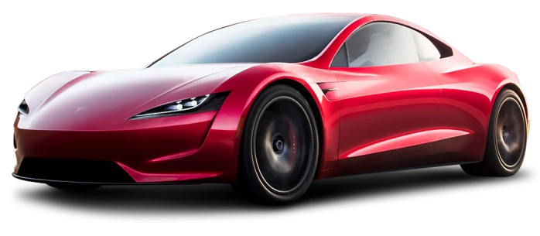
With eBay’s acquisition of PayPal, Musk could easily have chosen to retire, but instead, he chose to invest most of his newfound millions into two major separate ventures. The first venture was Tesla Motors, an electric vehicle and clean energy company which Musk founded in July of 2003 alongside Martin Eberhard and Marc Tarpenning. In 2004, Musk made a $6.5 million investment in the company, becoming its largest shareholder and its chairman. In 2008, Musk became Tesla’s CEO and, the following year, the company began production of its first car model, The Roadster.

Slide 11
With eBay’s acquisition of PayPal, Musk could easily have chosen to retire, but instead, he chose to invest most of his newfound millions into two major separate ventures. The first venture was Tesla Motors, an electric vehicle and clean energy company which Musk founded in July of 2003 alongside Martin Eberhard and Marc Tarpenning. In 2004, Musk made a $6.5 million investment in the company, becoming its largest shareholder and its chairman. In 2008, Musk became Tesla’s CEO and, the following year, the company began production of its first car model, The Roadster.

Slide 12
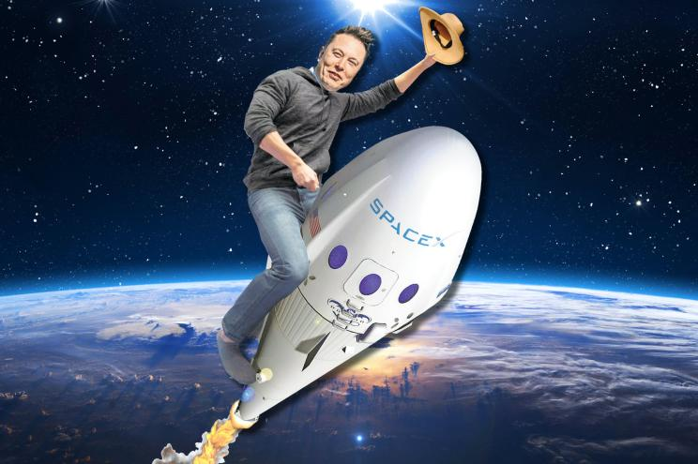
Musk’s second big venture in the early 2000s was aerospace company SpaceX, which he founded with the support of rocket engineer Tom Mueller. Originally, SpaceX was headquartered in a warehouse in El Segundo, California. By 2005, the company had 160 employees, each having been personally interviewed and approved by Musk.

Slide 13
Musk’s second big venture in the early 2000s was aerospace company SpaceX, which he founded with the support of rocket engineer Tom Mueller. Originally, SpaceX was headquartered in a warehouse in El Segundo, California. By 2005, the company had 160 employees, each having been personally interviewed and approved by Musk.

Slide 14
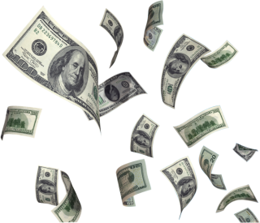
The goal was to revolutionise space transportation, with the ultimate goal of making human life multi-planetary. Despite a series of rocket launch failures between 2005 and 2009, in 2010, SpaceX became the first commercial company to send a spacecraft into orbit and return it safely to Earth.
Fast forward to September 2021, SpaceX successfully completed its first orbital launch of an all-private crew. Meanwhile, Tesla’s Model 3 became the first electric car to sell 1 million units globally and the company’s quarterly profits topped $1 billion for the first time. According to Forbes, Musk is currently the world’s second-richest man, with a net worth of $201.2B.

Slide 15
The goal was to revolutionise space transportation, with the ultimate goal of making human life multi-planetary. Despite a series of rocket launch failures between 2005 and 2009, in 2010, SpaceX became the first commercial company to send a spacecraft into orbit and return it safely to Earth.
Fast forward to September 2021, SpaceX successfully completed its first orbital launch of an all-private crew. Meanwhile, Tesla’s Model 3 became the first electric car to sell 1 million units globally and the company’s quarterly profits topped $1 billion for the first time. According to Forbes, Musk is currently the world’s second-richest man, with a net worth of $201.2B.

Slide 17
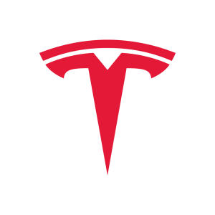

Slide 18
:
Tesla, is an American multinational automotive and clean energy company headquartered in Austin, Texas. Tesla designs and manufactures electric vehicles, battery energy storage from home to grid-scale, solar panels and solar roof tiles, and related products and services.
:
SpaceX is an American spacecraft manufacturer, space launch provider, and a satellite communications corporation headquartered in Hawthorne, California.
with the goal of reducing space transportation costs to enable the colonization of Mars.
:
PayPal Holdings, Inc. is an American multinational financial technology company operating an online payments system in the majority of countries that support online money transfers and serves as an electronic alternative to traditional paper methods such as checks and money orders.

