Slide 1
Larry Page
By: Bashar kfouf class: 6G

Slide 2
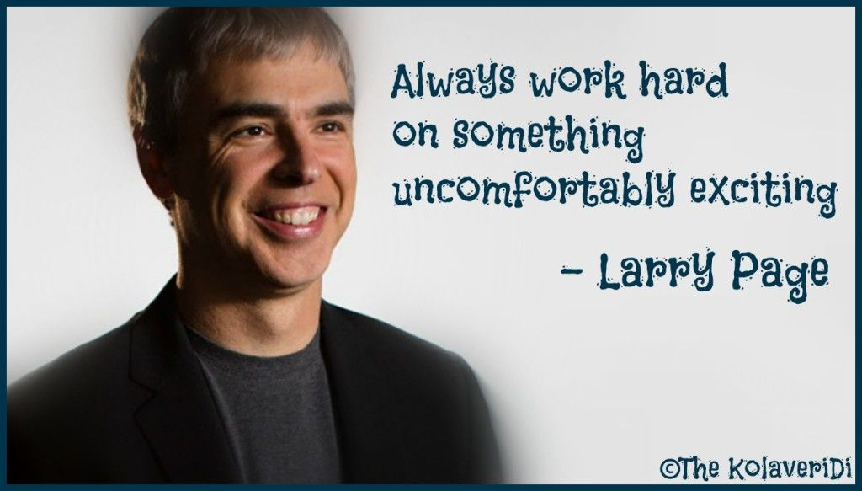
Larry page’s Passion
Larry Page's Childhood was filled with odd jobs and a lack of direction. He had no idea what he wanted to do with his life, but he knew he had a passion for computers. In 1989, Larry Page and his friend (Sergey Brin) founded Google in their dorm room at the University of California, Berkeley.

Slide 3
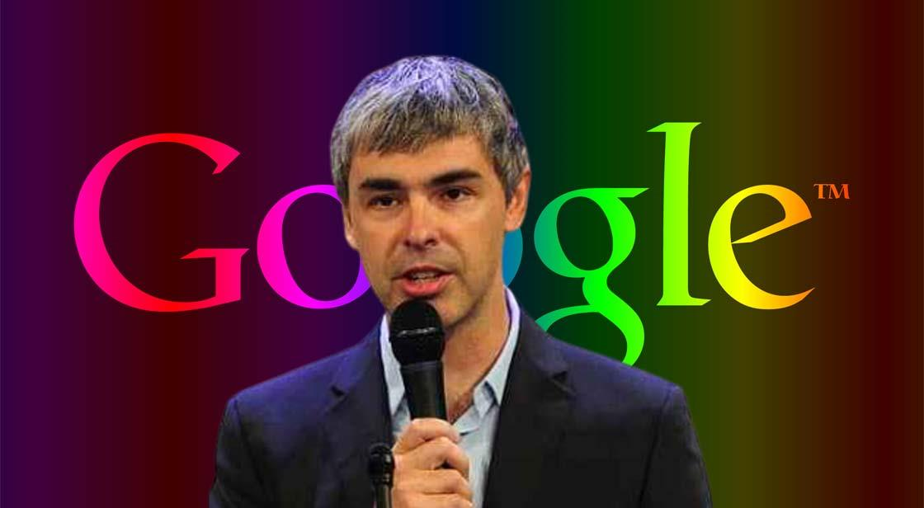
How larry page started hid bussiness
In 1999, Page experimented with smaller servers so Google could fit more into each square meter of the third-party warehouses the company rented for their servers. This eventually led to a search engine that ran much faster than Google's competitors at the time.

Slide 4
Larry page’s nationality
Lawrence Edward Page is an American business magnate, computer scientist and internet entrepreneur. He is best known for co-founding Google with Sergey Brin.

