Slide 1
Viruses & how to prevent them
By: Nour Saba

Slide 2
What is a file infector virus?
File infector viruses infect program files, such as applications, games or utilities. They are often memory-resident, meaning that once they have been executed they remain active in the computer's memory and can infect more programs.

Slide 3
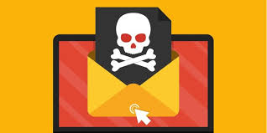
What are some things that you can do if you suspect that a file injector is in your computer?
Unplug the system from the network.
Use an antivirus scanner.
Boot Windows 2020 server using antivirus.
Troubleshoot the detected boot problems.
Run the Scandisk.
Boot to Safe mode.
Check for the latest modified executable.
Investigate unknown programs that automatically start in the system.
Analyze storage device drivers.

Slide 4
What’s the solution to get rid of a file infector virus?
You can get rid of the virus by disconnecting the infected drive and connecting it as a non-system drive to an isolated computer. Then, you can attempt to perform data recovery using readily available data recovery software.

Slide 5
Thank you for reading!

