Slide 1
computer
Selena majali

Slide 2

Safely when solving computer problems

Slide 3
Internet safety
1.Never send anything you wouldn’t say in real life
2.Never give out your address phone number school or your parents names without permission
3.Never send packages or pictures to people you’re met online without your parents permission

Slide 4
4.Do not share your password with friends
5.Never install programs on your computer without permission
6.never agree to met someone you’re met online in person
7.if you find something online that make you fell uncomfortable talk to a parent

Slide 5
How to protect your child from cyber bullying
1.Educate them on password safety
2.Ensure they don’t share identifying info
3.check their social account monthly
4.set social account to private
5.report cyber bullies and disengage

Slide 6
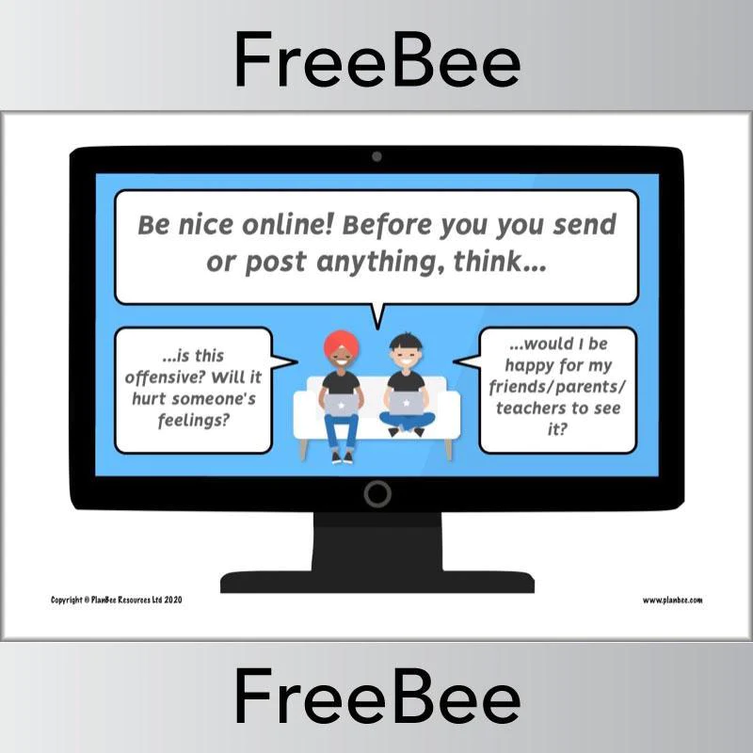
Tips to protect your computer
Use a firewall. ...
Keep all software up to date. ...
Use antivirus software and keep it current. ...
Make sure your passwords are well-chosen and protected. ...
Don't open suspicious attachments or click unusual links in messages. ...
Browse the web safely. ...
Stay away from pirated material.

