Slide 1

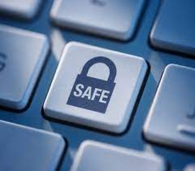
STAY SAFE!!
HOW TO STAY SAFE?
staying safe is important because if you don’t protect your computer it could risk personal information being stolen without your knowledge!
Make sure all cables are disconnected before attempting to move a device!
Never use force when connecting or disconnecting a cable!
Do not open the case of your computer or any device!
Do not lift heavy equipment on your own!
and…
If in doubt, STOP and ask for help!

