Slide 1
atom
By: Salma Camilla alaisami

Slide 2
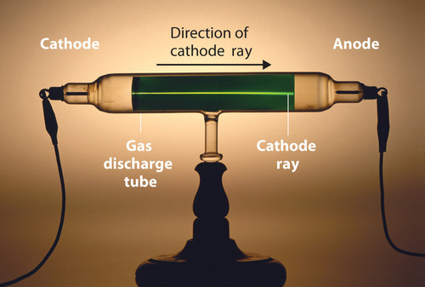
.
In 1897, the British physicist J. J. Thomson (1856–1940) proved that atoms
were not the most basic form of matter
. He demonstrated that cathode rays could be deflected, or bent, by magnetic or electric fields, which indicated that cathode rays consist of charged particles (Figure 2.2.22.2.2). More important, by measuring the extent of the deflection of the cathode rays in magnetic or electric fields of various strengths, Thomson was able to calculate the mass-to-charge ratio of the particles. These particles were emitted by the negatively charged cathode and repelled by the negative terminal of an electric field. Because like charges repel each other and opposite charges attract, Thomson concluded that the particles had a net negative charge; these particles are now called electrons. Most relevant to the field of chemistry
, Thomson found that the mass-to-charge ratio of cathode rays is independent of the nature of the metal electrodes or the gas, which suggested that electrons were fundamental
components of all atoms.

Slide 3
.
All atoms of a specific element are identical in mass, size, and other properties. However, atoms of different element exhibit different propertieAll matter is made up of tiny, indivisible particles called atoms.
s and vary in mass and size.
Atoms can neither be created nor destroyed. Furthermore, atoms cannot be divided into smaller particles.
Atoms of different elements can combine with each other in fixed whole-number ratios in order to form compounds.
Atoms can be rearranged, combined, or separated in chemical reactions.
Limitations of Dalton’s Atomic Theory

Slide 4
.

