Slide 1
Computer Viruses and how to deal with them
By: haya hawari 8H

Slide 2
How does one get viruses on computers, phones, etc..?
Here is a list of reasons as to why computers, phones and other elctronic devises get viruses:
1- inesterting an unknown USB and any other device that mightcause viruses.
2- Installing applications from non-trusted sources
3- not updating your device to the most recent software can also cause your device viruses as there are certain antiviruses installed with it.
There are many more ways that your device can get hacked from.

Slide 3
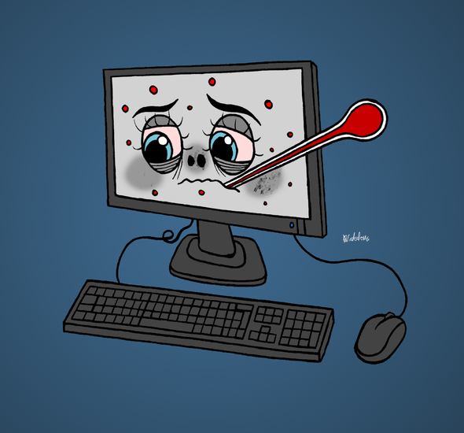
How to deal with computer viruses
Here are only some of the ways you can deal with computer viruses:
1- Download and install a virus scanner.
2- Run a virus scan.
3- Change all your passwords.
4- Delete or quarantine the virus.

Slide 4
Ways to protect your computer from viruses:
Using an antivirus is essential when trying to keep your computer healthy and free from viruses.
Keep Your Software up to Date.
Use a Strong Password
Run a Virus Scan Often.

