Slide 1
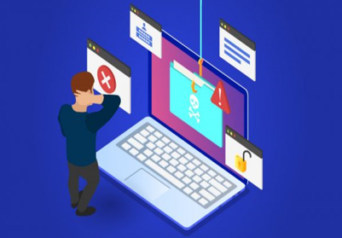
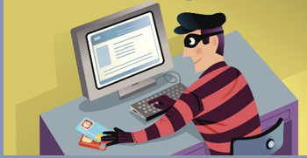
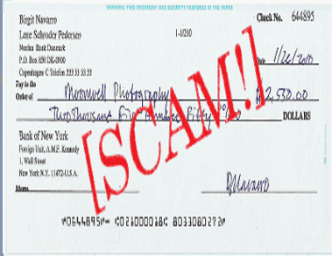
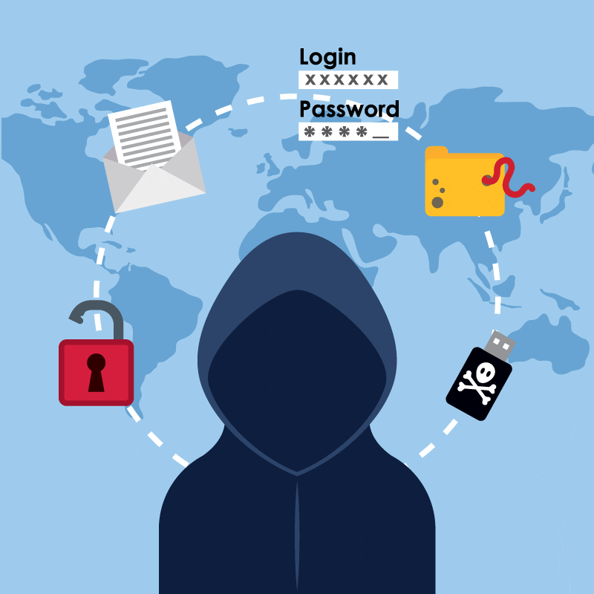
THINK SECURE AND BE CAREFUL OF CYBERCRIME
FISHING
A criminal creates a fake website that looks like the official website of a real bank or internet shopping website.
HACKING
A criminal breaks into a computer system, usually to steal files or personal information
CYBERCRIME
IDENTITY THEFT
A criminal steals personal information such as a persons name and address.
SCAMMING
A criminal sends out an email that askes for money.

