Slide 1
Cybercrime

Slide 2
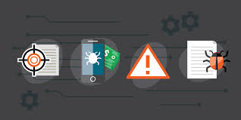
Cybercrime is Dangerous
1st of all you need to keep changing your password very often so you prevent the chances getting hacked , if you got hacked it is a very big deal cause they can delete your account and take all of your stuff away that’s why it is more secured if you put 2nd verification so let us say that you got hacked but you have verification code on the hacker will not be able to log in the account unless if he got the code , always remember to keep updating your software like this it is harder for the hacker to hack you.

Slide 3
Stay Safe
Thank you for listening!

