Slide 1
Cybercrime
by: leen Marwan shmaisani

Slide 2
What is cyber crime?
Cybercrime, also called computer crime, the use of a computer as an instrument to further illegal ends, such as committing fraud, and intellectual property, stealing identities, or violating privacy.
More over, cyber crime is committing illegal ends. There are types of cyber crime, let me show you a few of them.

Slide 3
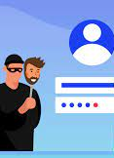
Identity theft
Identity theft is when a criminal steals a personal information such as a person’s name and address.
Or when someone pretends to be some that you may know.

Slide 4
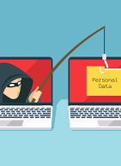
Phishing
Phishing is when a criminal creates a fake website that looks like the official website of a real bank or internet shopping website.

Slide 5

Scamming
Scamming is when a criminal sends out an email that asks for money. Sometimes the email contains a threat that the victim owes money and will have to go to court, without them actually owing them money.

Slide 6
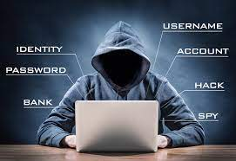
Hacking
Hacking is when a criminal breaks into computer system, usually to steal files or personal information.
For example, a hacker decides to steak personal or important information, by using hack, and breaking into a computer system.

Slide 7
Who are cybercriminals?
A cybercriminal is someone who uses the internet to commit their crimes. Some cybercriminals sell illegally over the internet. Some cybercriminals attempt to steal money and other possessions from people.
Basically cybercriminals are the people who commit cybercrimes and illegal ends, there are also many more types of cyber crime, these are just some of them, that are used more often.

Slide 8
If someone who u don’t know, sent you and email what do you do?
lets take a short quiz to see if you understood what cybercrime is!
Open the email
Leave it unopened and tell your parents

Slide 9

BACK TO QUESTION
NEXT

Slide 10

BACK TO QUESTION
NEXT

Slide 11
While opening a website, should you make sure if it’s a real website or a phishing website?
Open it and hope for the best
Make sure it’s a real website, before clicking on it

Slide 12
BACK TO QUESTION
NEXT

Slide 13
BACK TO QUESTION
NEXT

Slide 14

Did you do well? I hope so! Thanks for reading my power point and completing my short quiz, stay safe!

