Slide 1
Staying safe while solving computer problems
Rakan nahhas 8d

Slide 2
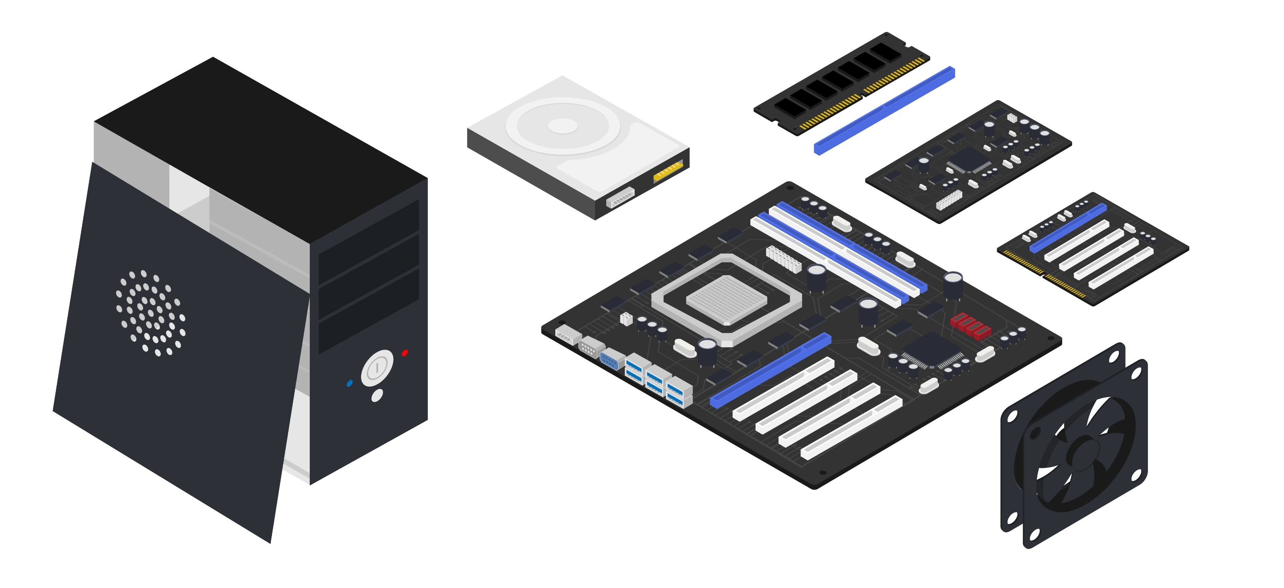
Do not open case of your computer or any device
Opening your devices can sometimes lead to the risk of something not working and it could get all dusty.

Slide 3
Never put force on cables
Putting force on cables can lead to cable breaking or the inside of the port breaking.

Slide 4
Ask for help!
You should never be scared to ask for help, nobody knows everything
Its also better to not do something you know nothing about and potentially damaging your device

Slide 5
Thank you

