Slide 1
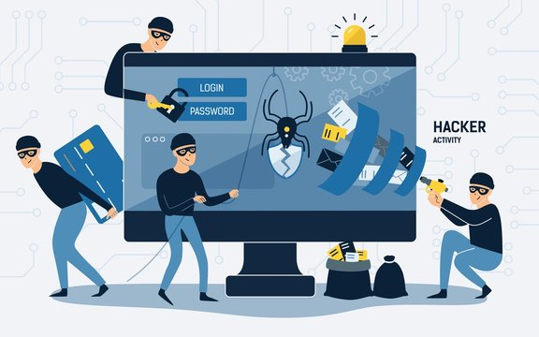
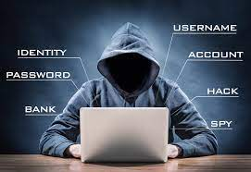
CYBERCRIME
Identity theft
Identity theft is a crime in which an cyber criminal obtains key pieces of personally identifiable information such as Social Security or driver's license numbers, to impersonate someone else, usually they look for mail and bills in the trash and listening to your phone conversations.
Phishing
Phishing is when a victim is contacted by email or text message by someone posing as a legitimate institution to trick you into opening a an untrusted source so u will click and link or download an attachment.
Hacking
An effort to attack a computer system or a private network inside a computer with unauthorized access to or control of computer network security systems with the intention of committing a crime.
Scamming
A scam is a deceptive scheme or trick used to cheat someone out of something, especially money, usually a criminal send and email or message telling the victim that they will have to go to court if the victim wont pay.

