Slide 1
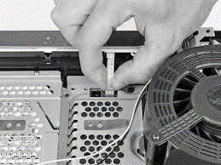
DO NOT OPEN THE CASE OF A COMPUTER
Things not to do when solving computer problems
DO NOT USE FORCE WHILE UNPLUGGING CABLES FROM THE COMPUTER
SWITCH OFF POWER POINTS BEFORE CONNECTING OR DISCONNECTING A MAINS ELECTRICITY CABLE
DO NOT LIFT HEAVY WEIGHTS BY YOURSELF

