Slide 1
Solving computer problems safely
By: Yahia Abu Hadba
8c

Slide 2
Solving computer problems:
When you are solving computer problems, you will be working with electrical equipment. Your priority is to stay safe. Always follow computer safety rules.
This Photo by Unknown Author is licensed under CC BY-NC

Slide 3
Safety rule number 1
Switch off power points at the wall before connecting or disconnecting a mains electricity cable.
This Photo by Unknown Author is licensed under CC BY-NC-ND
This Photo by Unknown Author is licensed under CC BY-NC-ND

Slide 4
Safety rule number 2
Do not open the case of your computer or any device.
This Photo by Unknown Author is licensed under CC BY-NC

Slide 5
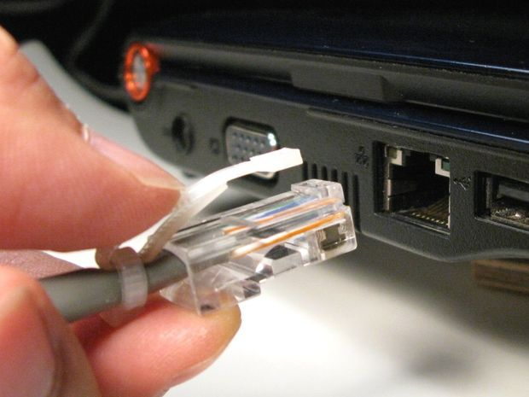
Safety rule number 3
Never use force when connecting or disconnecting a cable or component.
This Photo by Unknown Author is licensed under CC BY-SA
This Photo by Unknown Author is licensed under CC BY-SA

Slide 6
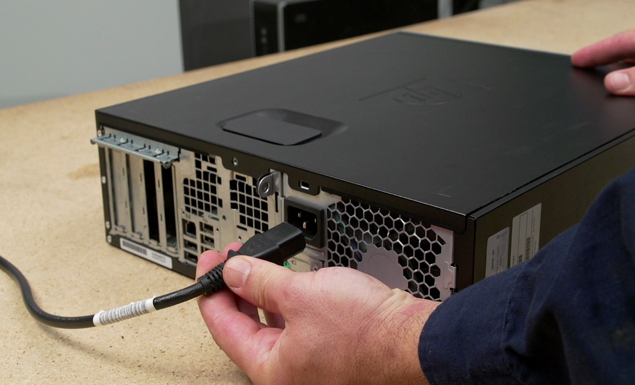
Safety rule number 4
Make sure all cables are disconnected before attempting to move a device.
This Photo by Unknown Author is licensed under CC BY-SA-NC

Slide 7
Safety rule number 5
Do not lift heavy equipment on your own.
This Photo by Unknown Author is licensed under CC BY-NC
This Photo by Unknown Author is licensed under CC BY-SA-NC

Slide 8
Safety rule number 6
If in doubt, stop and ask for help.
This Photo by Unknown Author is licensed under CC BY-SA
This Photo by Unknown Author is licensed under CC BY

