Slide 1
Computer safety
By- Maya Wardat

Slide 2

Why is computer safety important?
Computer Security is important as it enables people to perform their work and study. It helps in the execution of essential business processes, and Safeguards confidential and sensitive information. Computer Security is important enough that it should be learned by everyone.

Slide 3
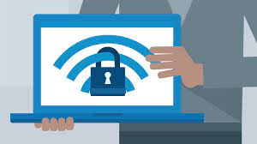
Rules to stay safe online:-
Protect Your Personal Information With Strong Passwords
Keep Personal Information Private
Make Sure Your Devices Are Secure
Pay Attention to Software Updates
Be Careful About Wifi
Set Up Two-Factor Authentication
Back Up Your Personal Data

Slide 4

The Do's and Don'ts of Computers
Don't click on short links
Don't open attachments in email
Don't blindly click on links in browsers or emails
Don't fill your hard drive to capacity
Do run anti-virus
Do patch
Do routinely reinstall your operating system
Do use the cloud

Slide 5

Tips to protect your computer
Use a firewall
Keep all software up to date
Use antivirus software and keep it current
Make sure your passwords are well-chosen and protected
Don't open suspicious attachments or click unusual links in messages
Browse the web safely
Stay away from pirated material.

Slide 6

That’s it thank you

