Slide 1
cybercrime
By raya akkawi 7e

Slide 2
The danger of Cybercrime
What are the dangers of cyber crimes?
. The most common cyber threats include: Hacking - including of social media and email passwords. Phishing - bogus emails asking for security information and personal details. Malicious software – including ransomware through which criminals hijack files and hold them to ransom

Slide 3
Types of cybercrime
did u know these are the types of cybercrime
Email and internet fraud.
Identity fraud (where personal information is stolen and used).
Theft of financial or card payment data.
Theft and sale of corporate data.
Cyberextortion (demanding money to prevent a threatened attack).
Ransomware attacks (a type of cyberextortion).
Be carefull

Slide 4
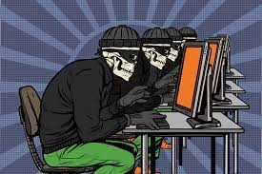
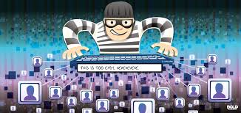
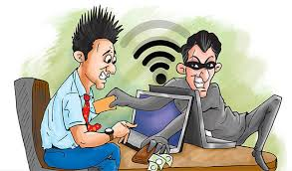
Stop cybercrime

