Slide 1
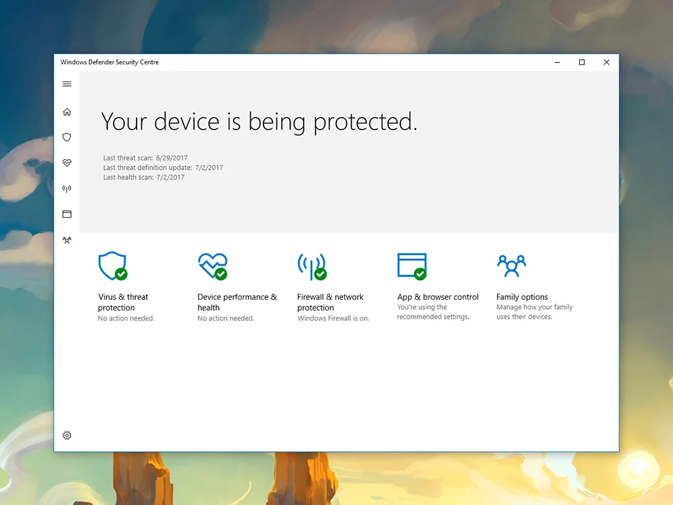
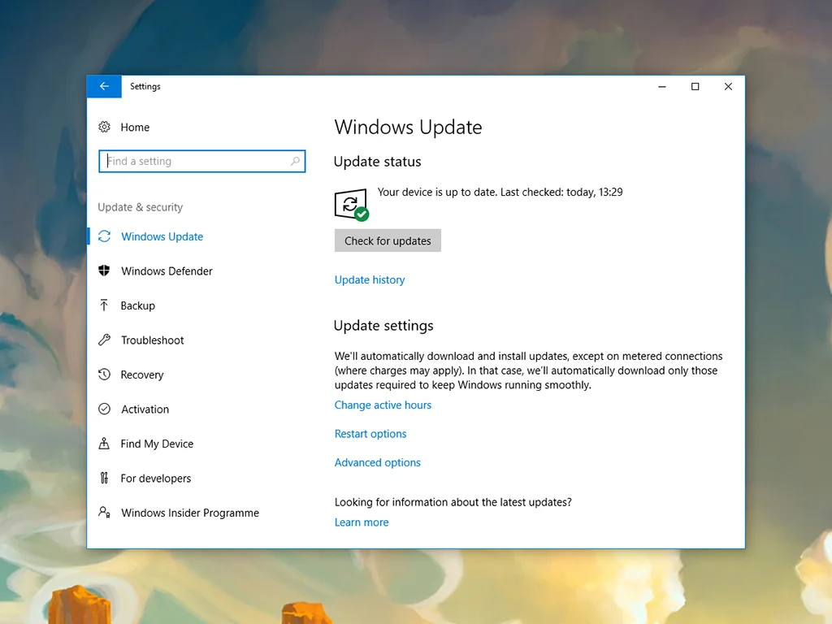
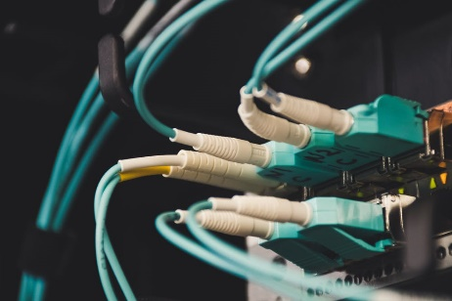
What to do when you have computer problems?
1. Run a thorough virus scan
2. Update your software
3. Test your Wi-Fi connection
4. Check Physical Network Connections
5. Don’t open the case of your computer
6. be careful when you connect or disconnect a cable or component
7. Ask for an adult help

