Slide 1
computer safety
by: Meera Wardat

Slide 2
solving technical problems
solving technical problems, such as those that occur with computers, requires a good deal of specialized knowledge as well, any approach to solving problems of any nature including problems with linux must include more than just a list of symptoms and the steps are necessary to fix or circumvent the problems that caused the symptoms, this is called "symptom-fix" approach looks good on paper to many managers, but it really sucks in practice. The best way to approach problem solving is with a large base of knowledge of the subject and a strong methodology.

Slide 3
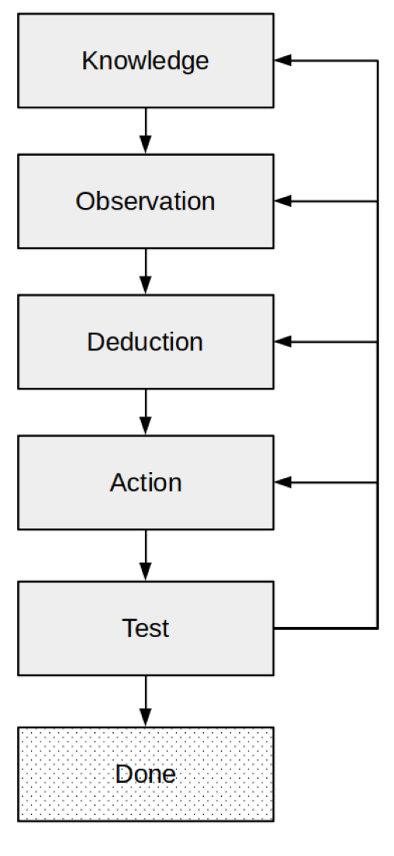
first step of solving technical problems
There are four basic steps that are involved in the problem-solving process, as shown in Figure 1 this algorithm is very similar to that of the scientific method but is specifically intended for solving technical problems.

Slide 4
THANK YOU :)

Slide 5
second step of solving technical problems
The second step in solving the problem is to observe its symptoms. It’s important to take notes of all of the problem symptoms, but also to observe what is working properly. Another important part of observation is to ask yourself questions about what you see and what you do not see.

Slide 6
The 3rd step of solving technical problems
now is the time to perform the appropriate repair action. This is usually the simple part. The hard part is what came before—figuring out what to do. After you know the cause of the problem, it is easy to determine the correct repair action to take. The specific action you take will depend upon the causes of the problem.
Remember, we are fixing the root cause, not just trying to get rid of or cover up the symptom.

Slide 7
The 4th step of solving technical problems
After taking some over repair action, the repair should be tested. This usually means performing the task that failed in the first place, but it could also be a single, simple command that illustrates the problem.
We make a single change, taking one potential corrective action, and then testing the results of that action. This is the only way we can be certain which corrective action fixed the problem. If we were to take several corrective actions and then test one time, there is no way to know which action was responsible for fixing the problem. This is especially important if we want to walk back those ineffective changes we made after finding the solution.

