Slide 1
Computer won’t turn on
Leen ghosheh

Slide 2
This is probably the no.1 problem faced by many of us. To understand this problem, you can compare it to our human body.

Slide 3
When we are sick, we often get a fever. It’s the body mechanism to fight infection. In the same way, when the computer faces any problem, it usually won’t turn on until you fix that. There are hundreds of reasons why a PC won’t boot up. The issues can range from power supply failure to virus infection. Normally, by following the steps given below, your computer should be able to start.

Slide 4
So, here are some solutions
1. Check the power supply
If it’s a laptop, a loss of power could result from a battery that has completely run out of charge. So, the first thing to do is to plug it in and leave it to charge for a few hours. If that doesn’t work, it could mean the charger is faulty, so, if you can try a different charger. If the charger has a power indicator, check whether it lights up when you plug it in.
If your PC is a desktop computer and doesn’t start, check that it’s not the plug socket at fault by plugging it into a different socket. If that doesn’t work, it could be that the power supply in your PC has failed.

Slide 5
2. Make sure the monitor or display is functional
If you can see that your PC has power, because the fans start-up or the power lights come on, but nothing else happens, there are a couple of possible faults.
If you have a desktop PC connected to an external monitor, it could be the display that’s faulty. Check the power connection to the monitor and that it’s properly connected to your PC. Try disconnecting it and reconnecting it. If that doesn’t work, try connecting a different monitor, if possible. That way you’ll be able to either determine it’s the monitor’s fault or rule it out.
If you have a laptop, or if you’ve ruled out the external display, it could be that your PC is in sleep mode and is having trouble waking. To check that, shut it down completely and restart from cold. To do that, hold down the power button for 5 seconds and then press it again to start your PC.

Slide 6
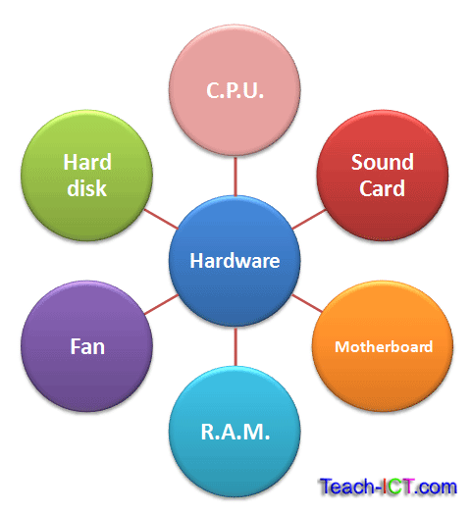
3. Eliminate external hardware
If none of the steps above work, the peripherals could be the culprit. This could either happen because of electrical issues or external hardware failures.
After doing this, try restarting the system again to see if it works or not. If it doesn’t, move on the next final step.

Slide 7
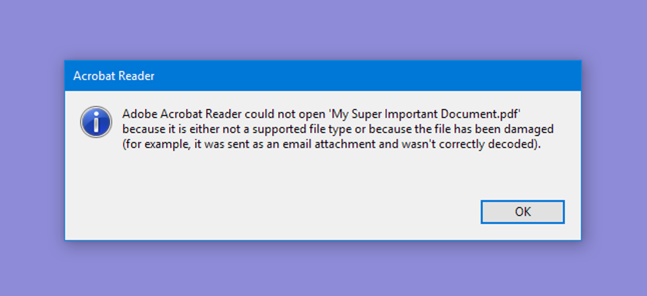
4. Reinstall system
If none of the steps work, the last thing you would want to do is to reinstall your Windows. Because till this point, you can be sure that it’s the software and not a hardware issue.
Since you can’t turn your computer on, there’s no way to get access to your file. However, there are methods to backup your files from the hard drive. A clean installation will help to reset everything back to normal, should your system is infected or corrupted.

