Slide 1
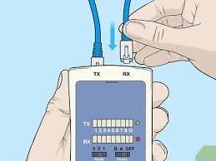
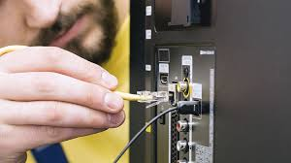
Staying safe online
While solving internet problems you are working with equipment that can be dangerous if not used right
Here is how to use it right:
1-switch off power point at the wall before connecting or disconnecting an electricity cable
2-do not open the case of your computer or any other device.
3-never use force when connecting or disconnecting a cable (try to be calm)
Here are mistakes to avoid when fixing network problems:
1- poor cable management (always keep you cables organized)
2-limited space ( always have more than enough work space)
3- not completing proper testing (testing is important so you don’t have any complications while working)
By:Toleen bosheh 8 f

