Slide 1
Acting responsibly and safely solving computer problems

Slide 2
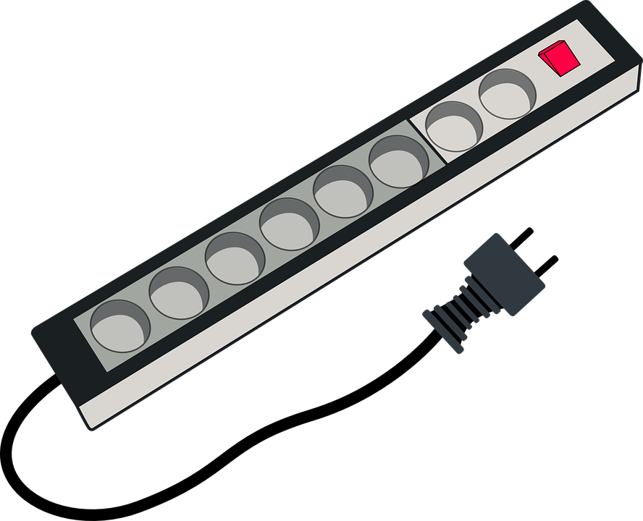
Never use force when connecting and disconnecting a cable
Aggressively disconnecting a cable can make to damage to the cable

Slide 3
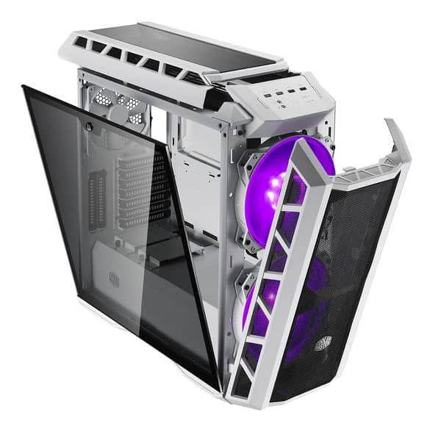
Do not open the case of your computer or the device you’re using
Opening the case can collect dust on the components

Slide 4
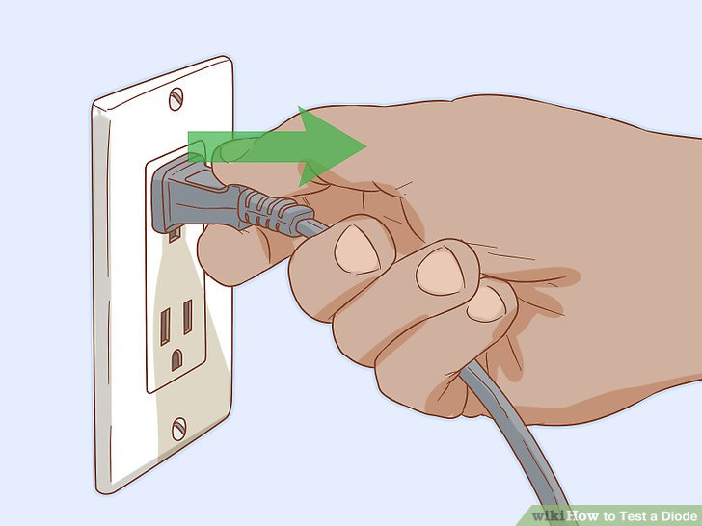
Make sure if the cables are disconnected before picking up a device
Check if the cables are disconnected to avoid damage

Slide 5
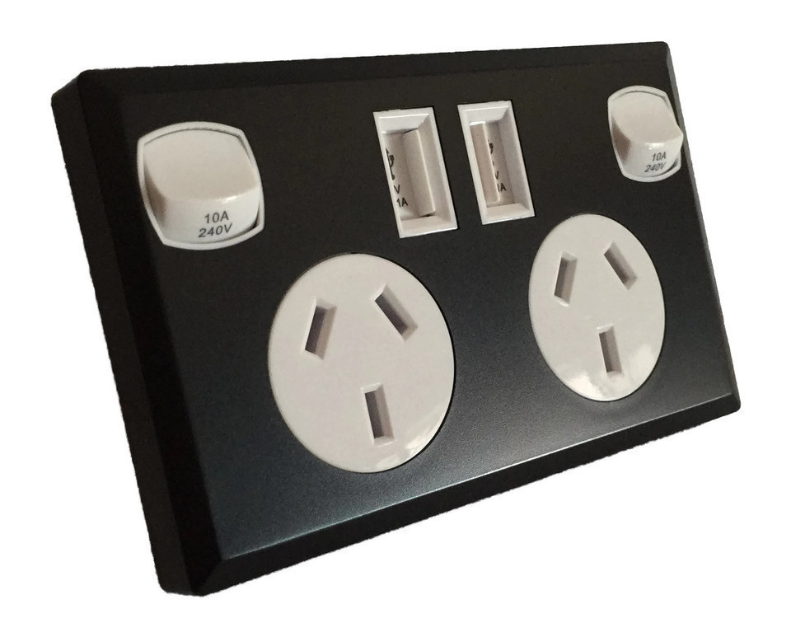
Switch of power points at the wall before connecting or disconnecting a mains electricity cable

Slide 6
If you're in doubt when solving computer problems, stop and ask for help
To avoid creating more problems its better to ask for help!

Slide 7
Do not lift heavy equipment on your own!!

